Slide 1




Multidisciplinary Care of Families with Inherited Heart Disease
Dr Jodie Ingles GradDipGenCouns MPH PhD
Molecular Cardiology Program, Centenary Institute, Sydney.
Sydney Medical School, University of Sydney.
Department of Cardiology, Royal Prince Alfred Hospital, Sydney.

Slide 2


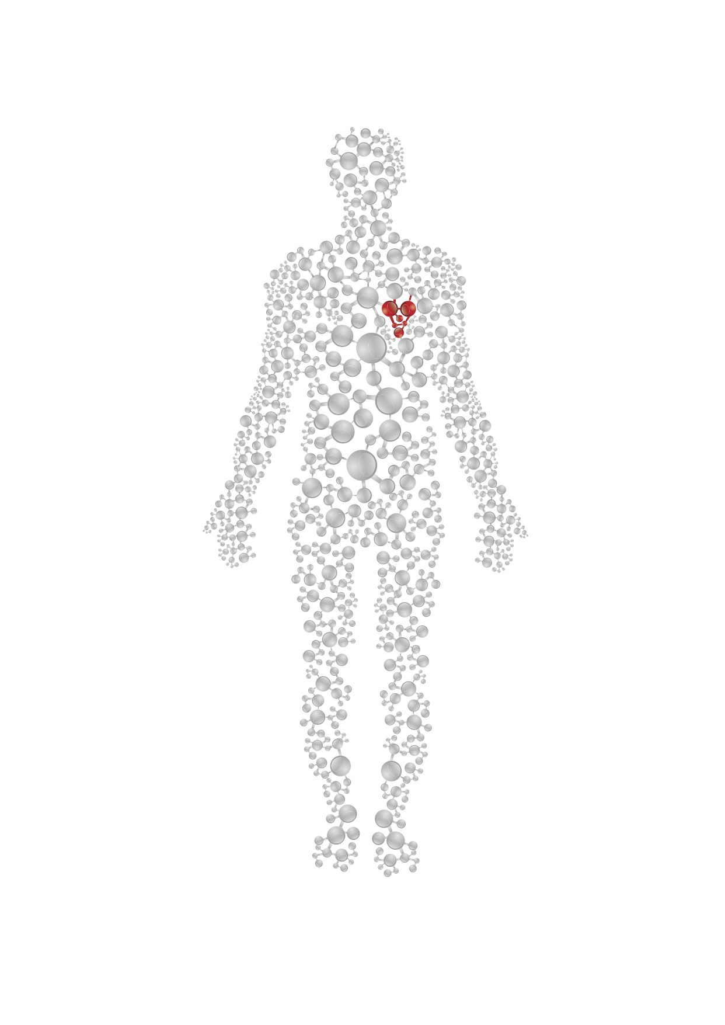




The Cardiac Genetic Patient
Diagnosis and management
Inheritance risk
Treatment options
Genetic testing options
Lifestyle modification
Research

Slide 3
Unique patient group: Psychosocial consequences
New diagnosis? Dealing with having a heart condition. Symptoms, treatments
More anxiety (up to 30%), more depression (up to 15%), worse health-related quality of life
Ingles et al. Int J Card. 2011
Implantable cardioverter defibrillator therapy? Fear of shocks, risk of complications
More anxiety (up to 40%), risk of posttraumatic stress (30%) due to shock
Ingles et al. Int J Card. 2012
James et al. Circ CV Genetics 2012
Family history? Experience with the disease, severe phenotypes, sudden death
More anxiety (up to 60%), more depression (up to 30%). Mothers and those who witnessed death at increased risk
Yeates et al. Eur J CV Nursing. 2013
van der Werf. Eur J Human Genet. 2014.
Ingles et al. JAMA Int Med. 2016
Genetic testing options. Understanding the outcomes & making decisions. Communication with family.
In the setting of genetic counselling, QOL is maintained but can be subtle impacts
Ingles et al. Genet Med. 2012. Christiaans et al. Am J Med Genet A. 2009
Bonner et al. J Genet Couns. 2018. Burns et al. Eur J Hum Genet. 2017

Slide 4

Cardiac genetic testing
Next generation sequencing technology
Cardiac gene chips – 50-100+ genes mainstream → Exomes → Genomes

Slide 5
Cardiac genetic testing: proband testing
Identifying the mutation is a challenge!
N
Proband
TEST FIRST!
N

Slide 6
Cardiac genetic testing: cascade testing
confirmatory testing
+/-
N
+/-
Proband
TEST FIRST!
N
-/-
cascade testing

Slide 7
The Role of the Cardiac Genetic Counsellor
Issues surrounding a diagnosis of a genetic heart disease
New diagnosis
Grief and loss
Risk of SCD
Genetic diagnosis
Inheritance risk to family
ICD therapy & other treatments
Lifestyle modifications
Inheritance risks
Provide education & awareness
Pre-post genetic testing counseling
Investigate & confirm family history
Coordination of family screening
Discuss worries & fears about the diagnosis
Recruitment to research
Ingles et al. Heart Rhythm. 2011

Slide 8
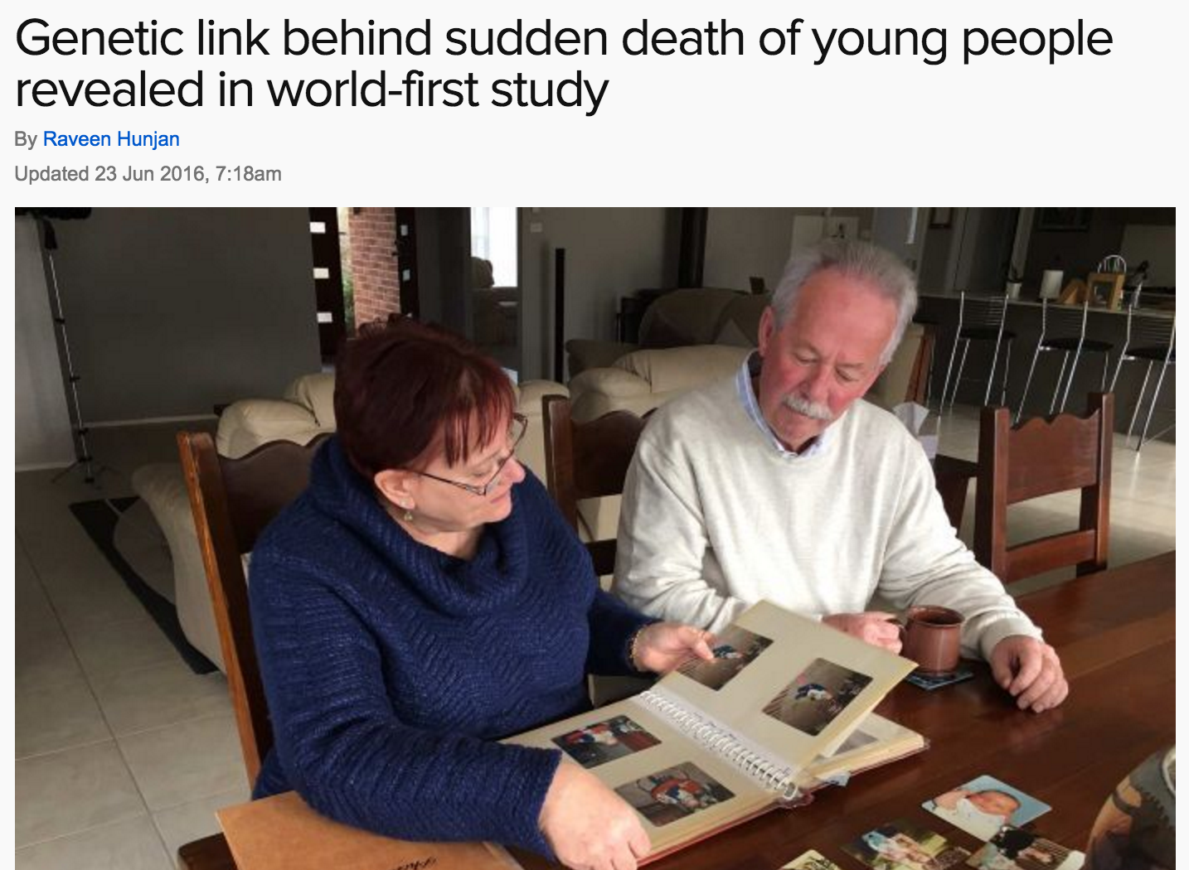
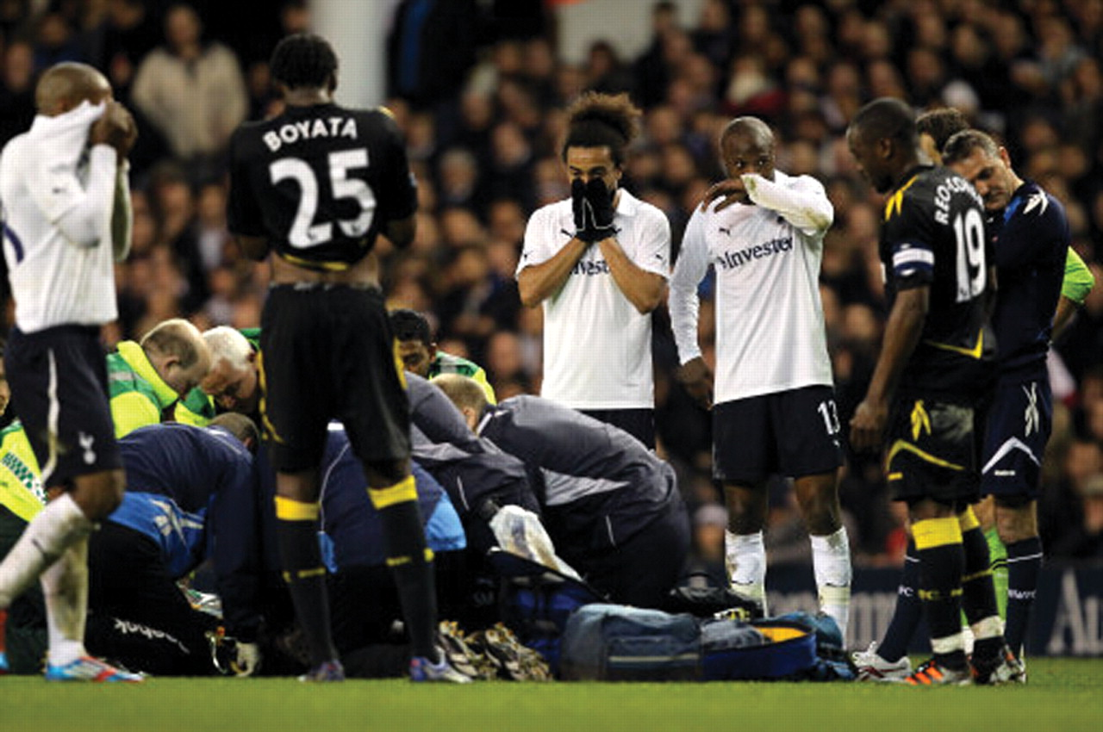
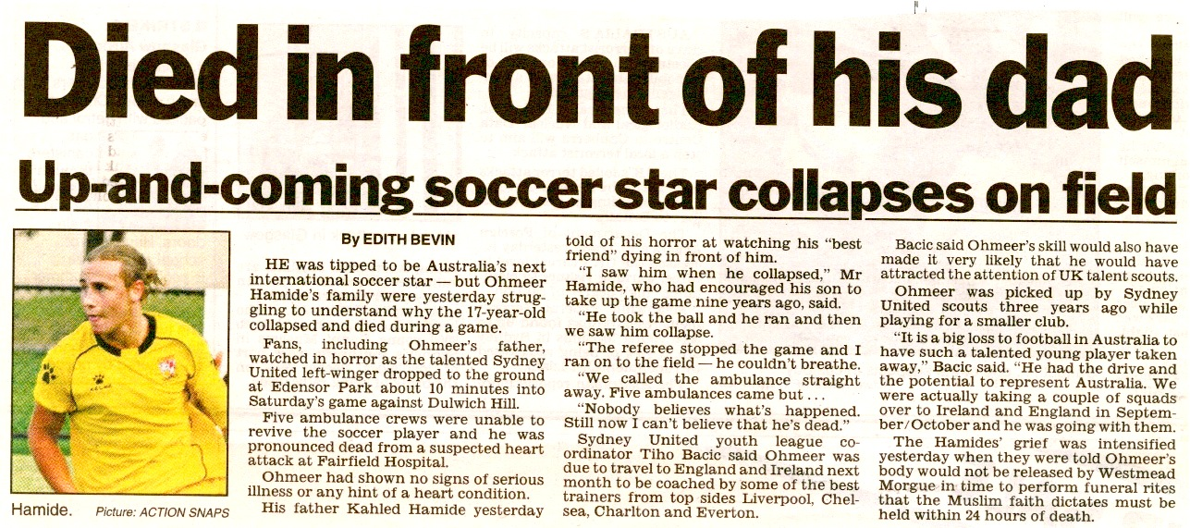

Slide 9
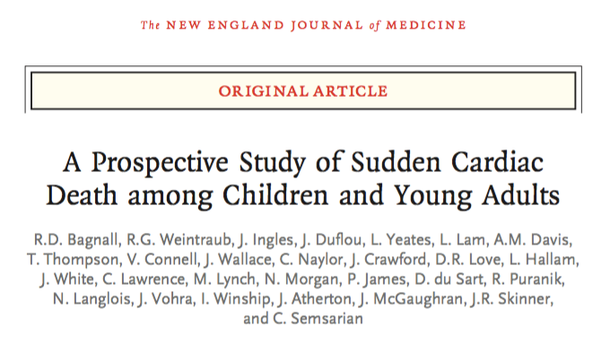
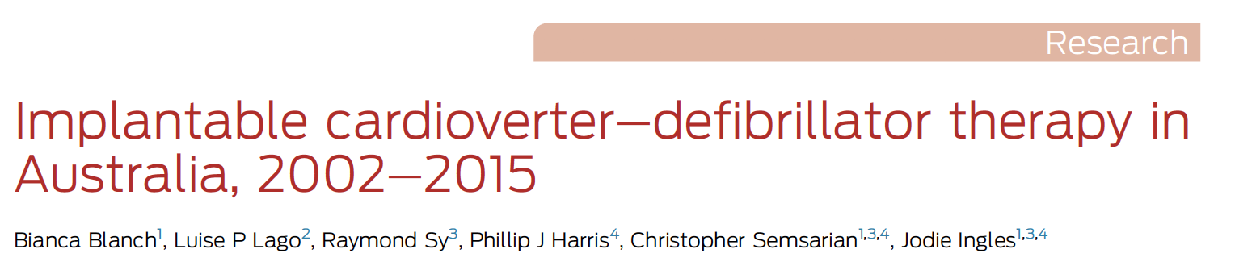
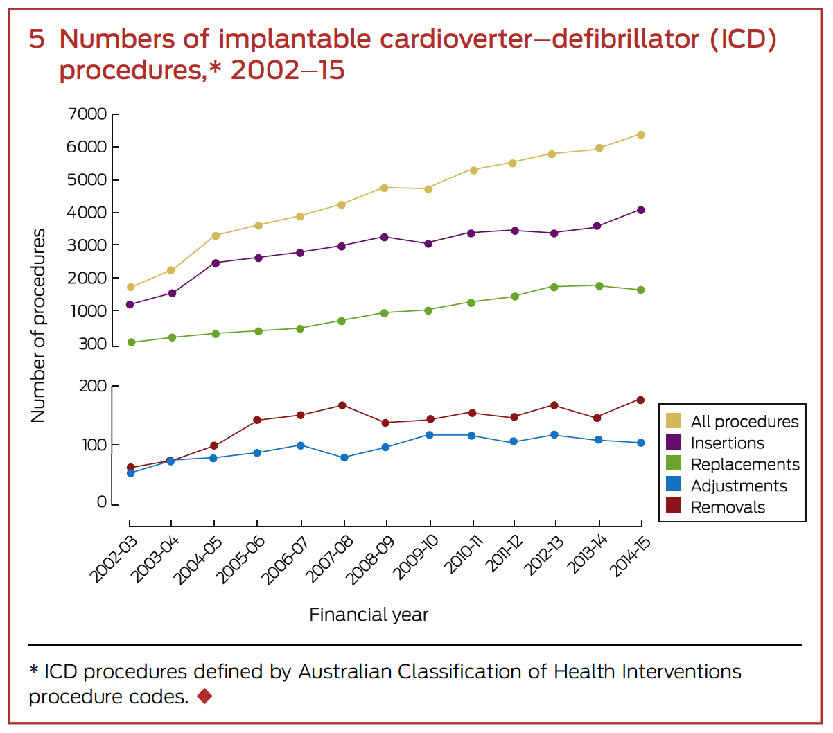
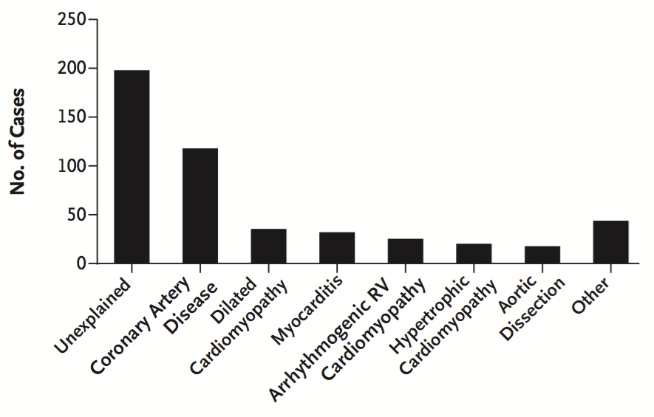
Overall Incidence
1.3 per 100,000

Slide 10
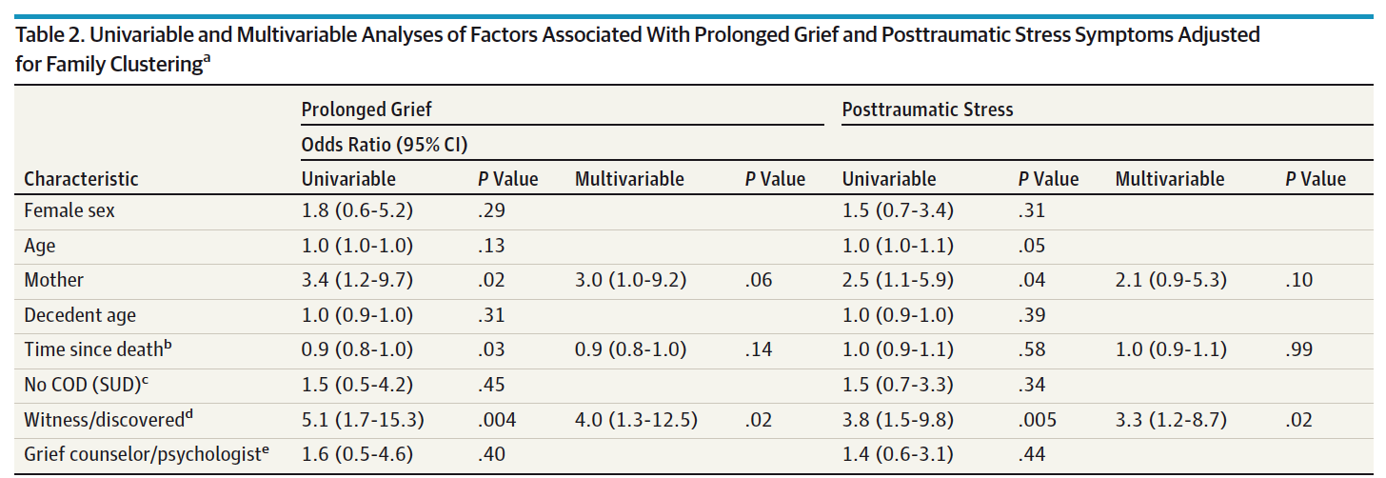
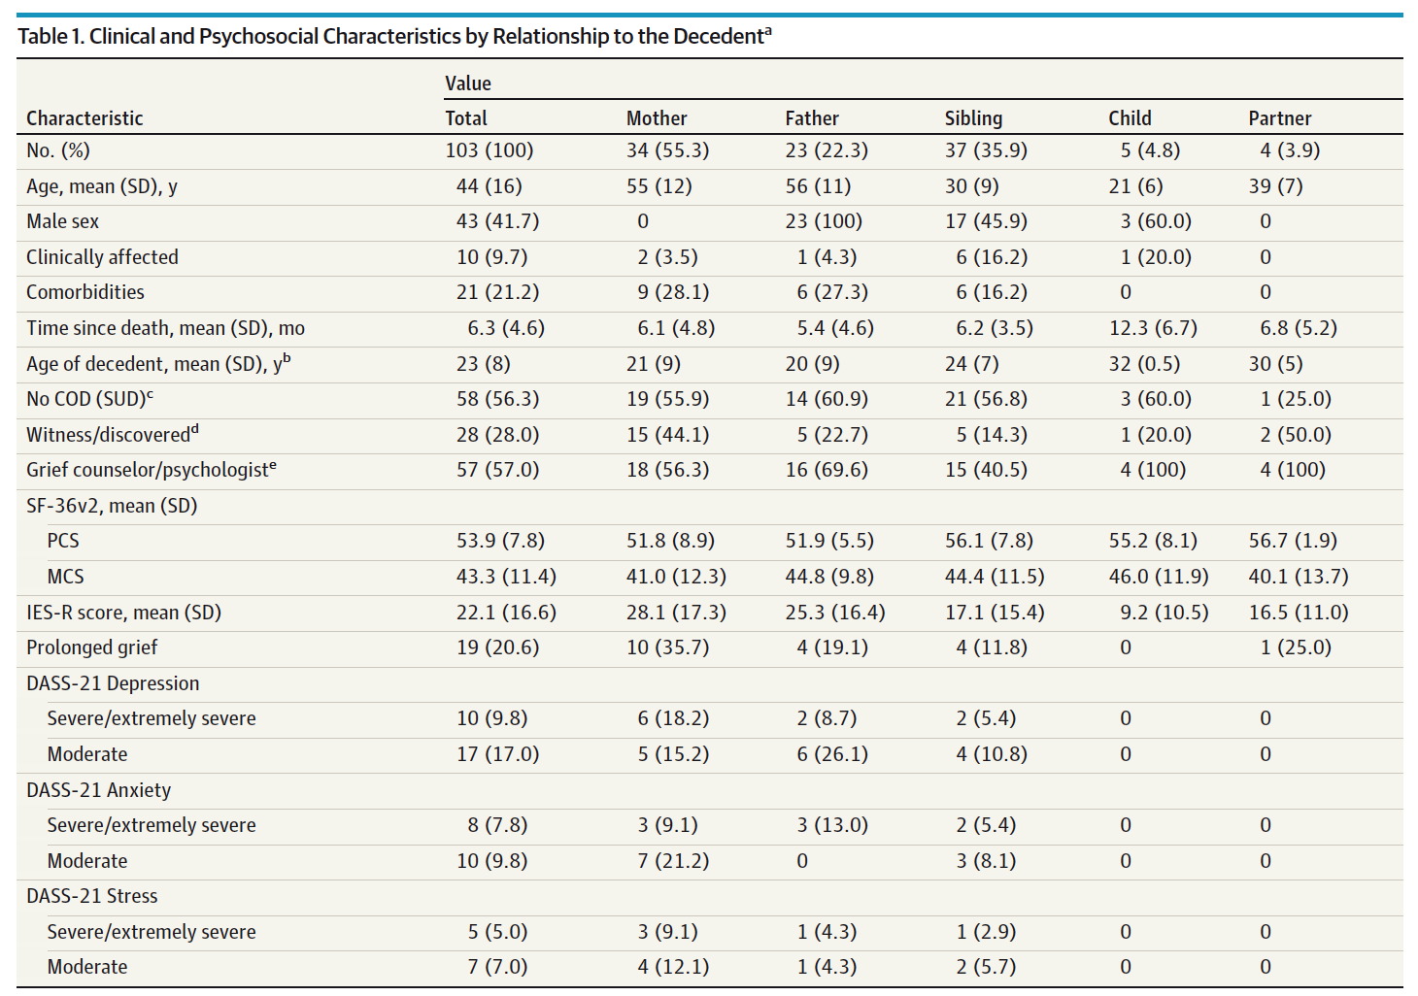
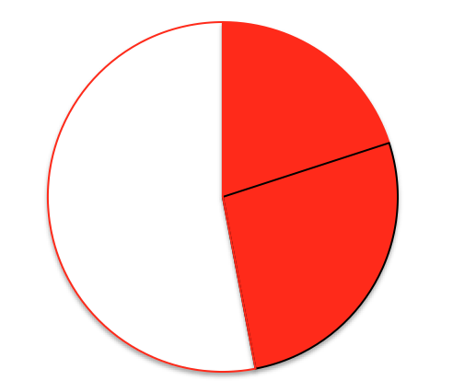
47% prolonged grief and/or posttraumatic stress
18% both
Ingles et al JAMA Int Med 2016

Slide 11
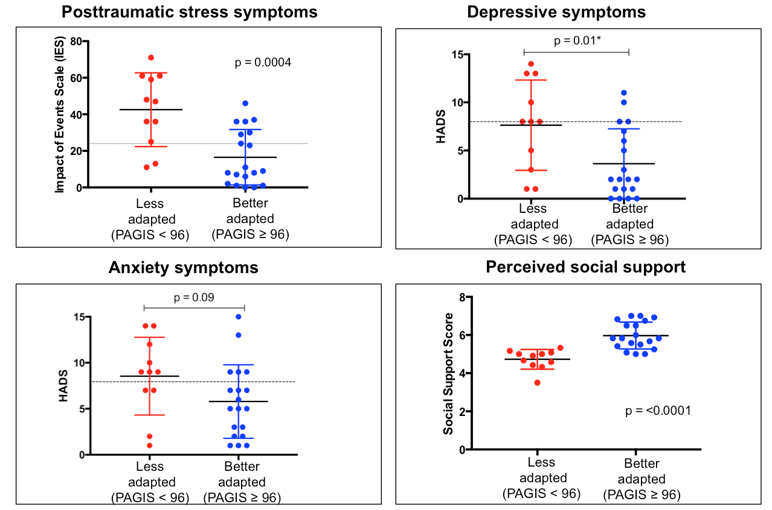
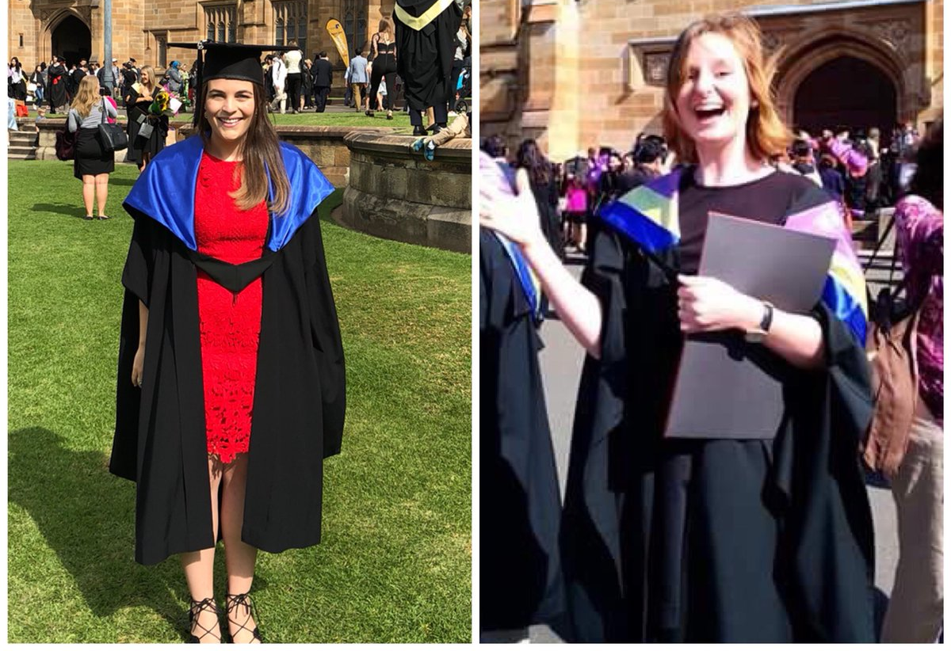
Adjustment and Needs after SCD
Needs Analysis
Impact of Molecular Autopsy
“I believe there are things I can do to avoid the problems that may arise from having the genetic risk”
“I rarely think about the fact that I have the genetic risk”
Domain | % endorsing need | % rating importance | % rating need as met or unmet
Medical | Yes: 70.89 No: 29.11 | Low: 6.36 Moderate: 17.39 High: 75.16 | Met: 67.65 Unmet: 32.35
Psychosocial | Yes: 51.74 No: 48.26 | Low: 5.35 Moderate: 26.54 High: 68.11 | Met: 45.59 Unmet: 54.41
Financial | Yes: 45.95 No: 54.05 | Low: 5.88 Moderate: 47.06 High: 47.06 | Met: 62.50 Unmet: 37.50
Spiritual | Yes: 34.21 No: 65.79 | Low: 7.69 Moderate: 30.77 High: 61.54 | Met: 61.54 Unmet: 38.46
McDonald K, … Ingles J. Unpublished
Bates K, … Ingles J. Unpublished

Slide 12


Slide 13
Lack of consistency of cardiac genetic tests
37%
28%
33%
Yield (%)
17%
9%
2%
24 HCM gene panels
162 unique genes, only 23 (14%) present on more than half of panels
Burns, … Ingles. Circ Cardiovasc Genet. 2017
Ingles et al. In preparation

Slide 14
How do patients understand uncertainty?
More concerned with clinical diagnosis
Expectation genetic testing would alleviate uncertainty
Recall and understanding poor
Misunderstood implications
Burns et al. Eur J Human Genet. 2017

Slide 15
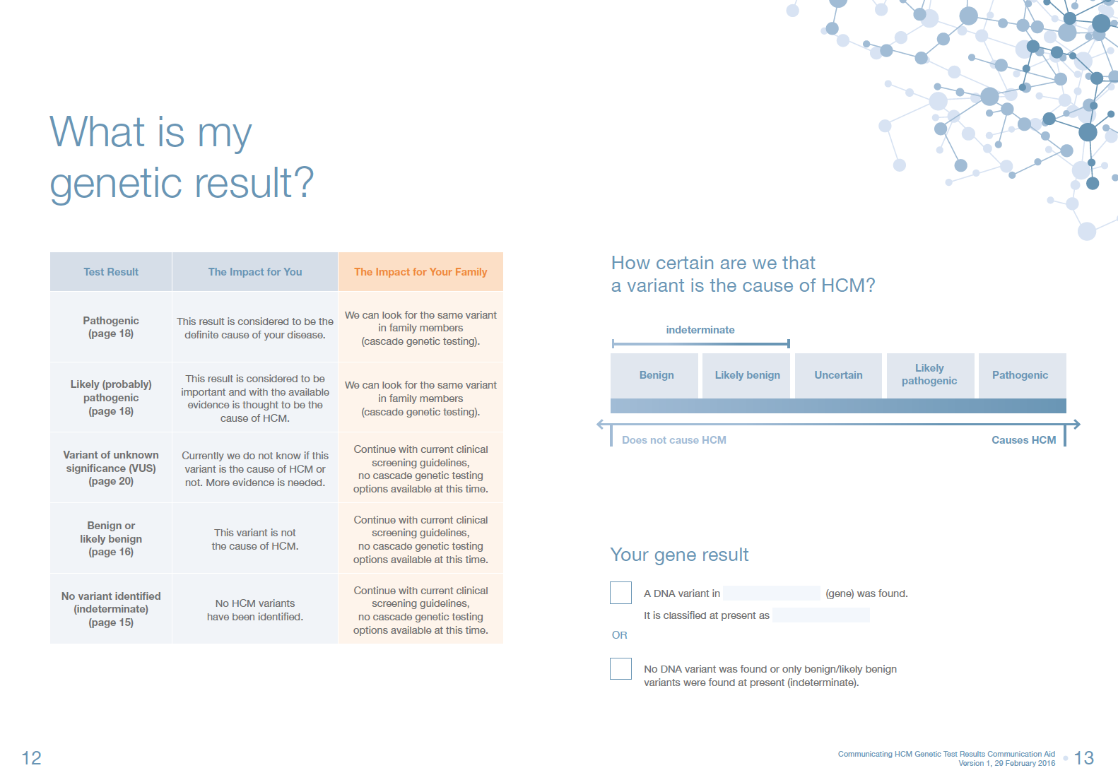


Better Communication of Results
Piloted a booklet
  HCM genetics
  Evidence for the result
  What the result means
  What it means for family
  Encourages passing booklet on
Australia and New Zealand Clinical Trial Registration; ACTRN12617000706370
Yana Smagarinsky, MGC student
Charlotte Burns, PhD student
Smagarinsky … Ingles. Pilot Feasibility Stud. 2017
Burns, James, Ingles. Heart Rhythm. In press

Slide 16
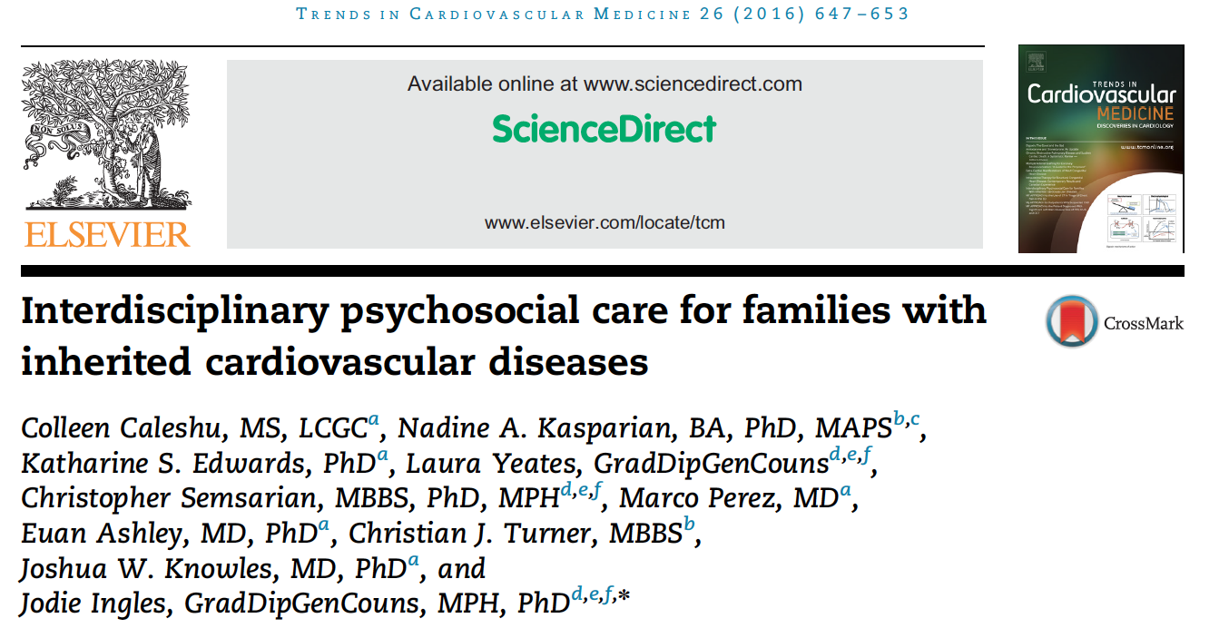
Expertise of a Multidisciplinary Team
PSYCHOLOGICAL
CARE
CARDIAC
CARE
Cardiologist
Nurse
Genetic counsellor
Clinical, genetic and psychological care
Multidisciplinary clinic settings are a feasible way to deliver this
Genetic counsellors key
Psychologist

Slide 17
Summary
Cardiac genetic testing is a rapidly evolving area
Our knowledge is continually changing, with inherent uncertainty
Implications for the family can be significant
Experienced cardiac genetic counsellor is a critical part of the
multidisciplinary team

