Slide 1
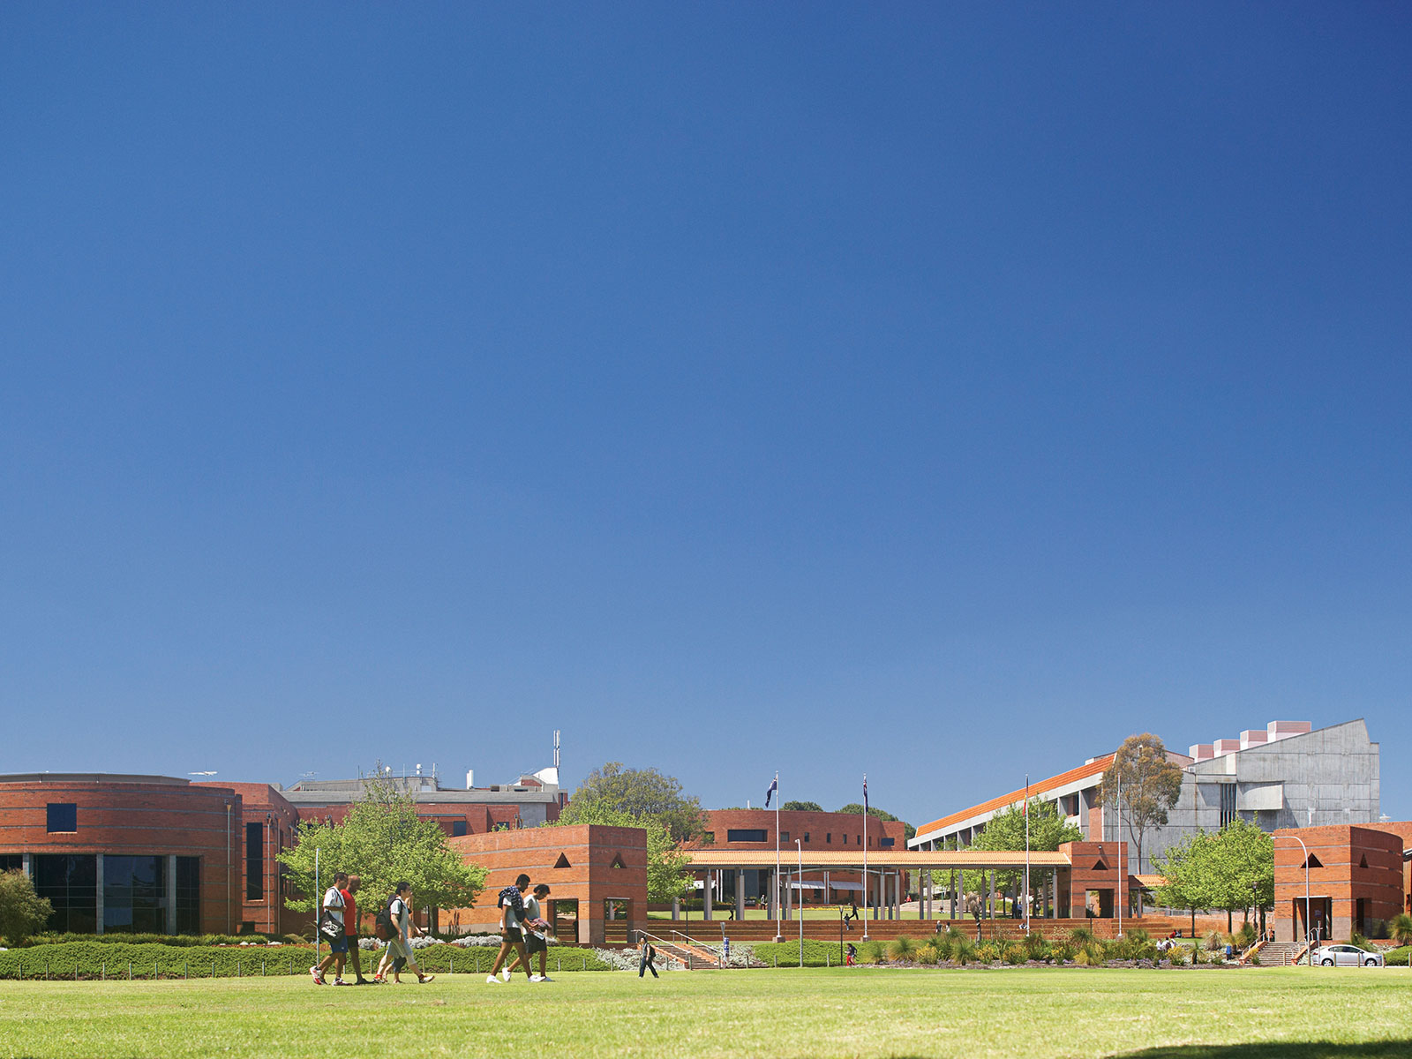
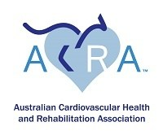
Out of hospital cardiac arrest and considerations for cardiac rehabilitation
Prof Judith Finn PhD, RN

Slide 2




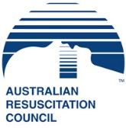

Conflict of interest statement
Research Professor at Curtin University (WA)
Adjunct Research Professor Monash University (Vic) and UWA (WA)
Director of the Australian Resuscitation Outcomes Consortium (Aus-ROC)
Salary support from St John Ambulance Western Australia
Treasurer: Australian Resuscitation Council (WA)

Slide 3
Acknowledgements
Australian & New Zealand Resuscitation Outcomes Consortium (Aus-ROC) Epistry
A/Prof Janet Bray – Heart Foundation Fellow: Monash University)
Dr Susie Cartledge – PhD “Targeting high-risk cardiac patients and their family members for basic life support training” (Monash University); now Deakin University

Slide 4
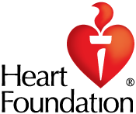
Cardiac arrest
Definition: A cardiac arrest (sudden cardiac death) occurs when the heart suddenly stops beating.
Time critical :For every minute that passes without CPR and AED the chance of survival drops by 10%.

Slide 5
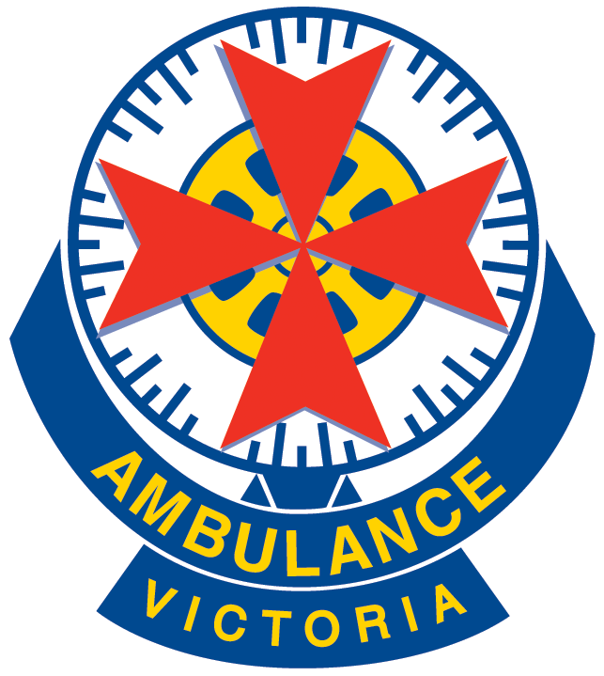
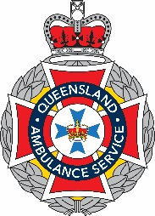


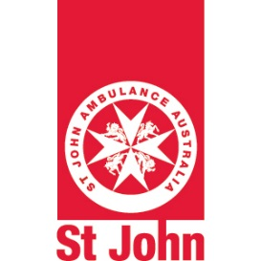



Aus-ROC Australian and New Zealand OHCA Epistry - 2015
NSW and Tas recently joined
Capture population: 19.5 million

Slide 6
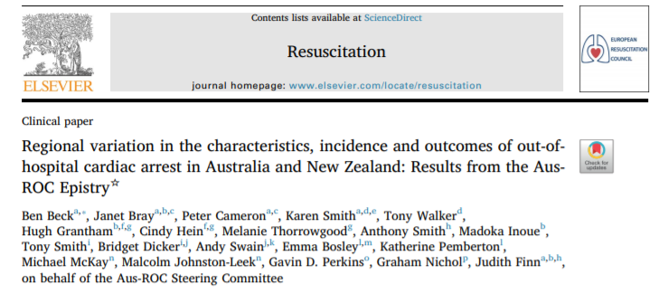
Beck B et al. Regional variation in the characteristics, incidence and outcomes of out-of-hospital cardiac arrest in Australia and New Zealand: Results from the Aus-ROC Epistry. Resuscitation. 2018;126:49-57.
Aus-ROC Australian and New Zealand OHCA Epistry - 2015

Slide 7
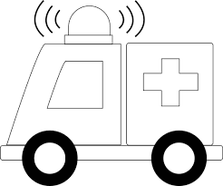


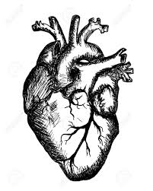
Aus-ROC Australian and New Zealand OHCA Epistry - 2015
19,722 OHCAs
Incidence of 102.5 per 100,000 pop
Aus = Estimated 24,373 per year
66% male
Median age: 66 years (IQR: 50-80 years)
75% occurred in the home
74% ‘presumed cardiac’ cause

Slide 8
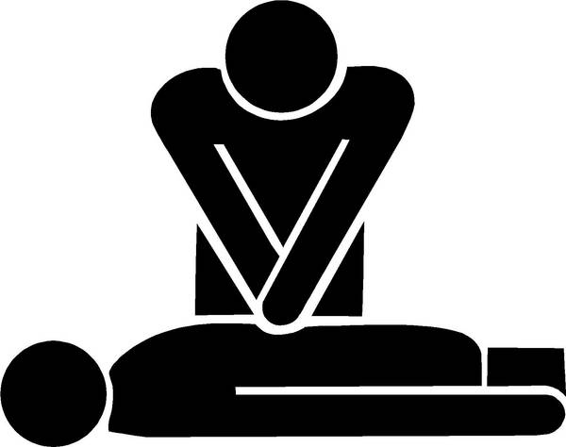



Aus-ROC Australian and New Zealand Epistry OHCA - 2015
48% of cases received attempted resuscitation (n=9,245)
33% had ROSC in the prehospital setting
28% had ROSC on arrival at hospital
12% survived to discharge / 30 days

Slide 9

Aus-ROC Australian and New Zealand Epistry OHCA – 2015
Survival varies in different sub-groups
“Utstein comparator group”
Bystander-witnessed + Shockable rhythm (VF/VT)
31% survived to discharge / 30 days
“EMS Witnessed Arrest group”
25% survived to discharge / 30 days

Slide 10
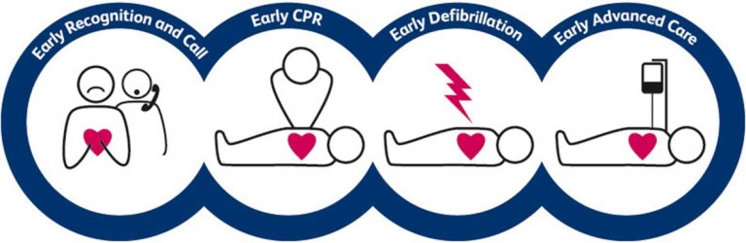
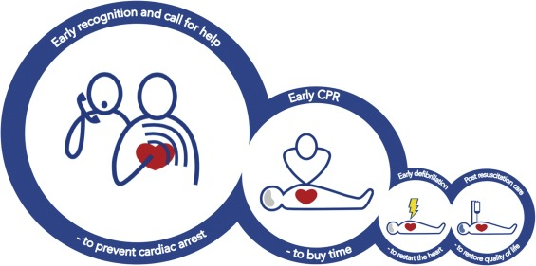
Cardiac Arrest – Chain of Survival

Slide 11
Results: Aus-ROC Australian and New Zealand Epistry - 2015
Bystander CPR rates:
  Of all OHCA (excluding EMS-witnessed cases): 41%
  Of cases that were witnessed to collapse by a bystander: 67%

Slide 12
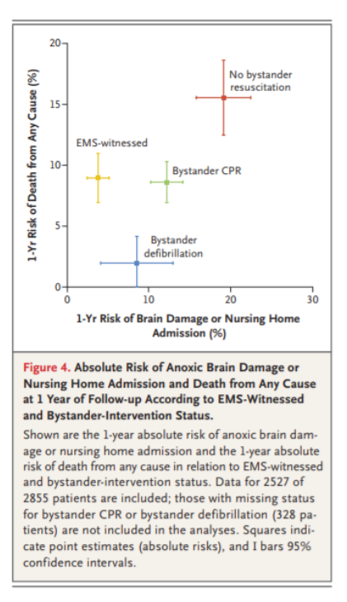
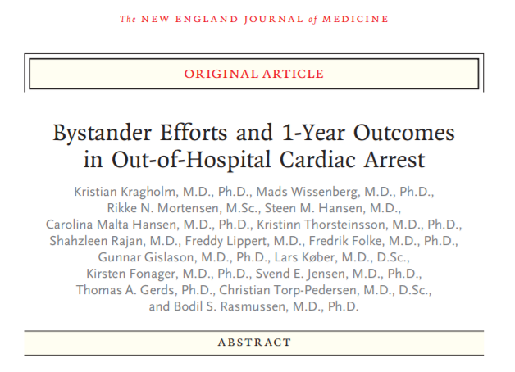
CPR is vital
N Engl J Med 2017; 376:1737-1747

Slide 13
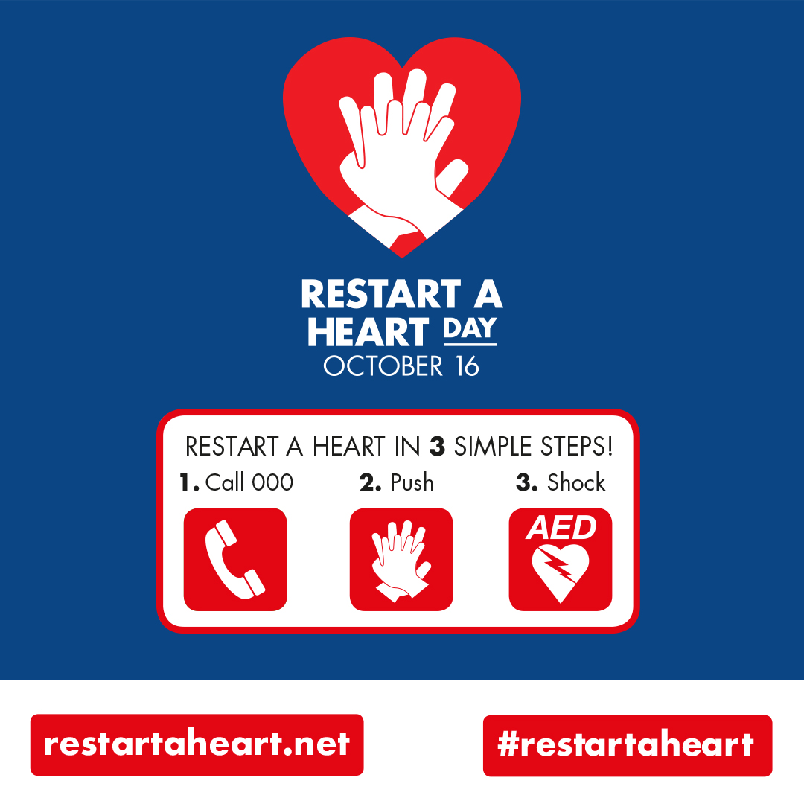
Restart a Heart day October 16th 2018
Restart a Heart Day October 16 2018 is a global initiative to raise awareness and education of CPR and AEDs in our community.
Supported by..

Slide 14
CPR training in cardiac rehabilitation (S. Cartledge’s slide)
Cartledge S, Bray J, Stub D. et al. Heart, Lung and Circulation: 2016: 25(6), 607-612

Slide 15
Cardiac arrest versus heart attack
In people with coronary heart disease, cardiac arrest is often preceded by chest pain and other warning signs of heart attack.
Prompt response to chest pain may avert cardiac arrest and sudden cardiac death in people suffering a heart attack.

Slide 16




Do you know the difference between CA and AMI?
Yes No Unsure
33.1% 29.4% 37.6%
Heart Watch survey conducted by Heart Foundation July 2017, n= 12,000.
Results reported by Bray, J et al

Slide 17

In reality (of the yes’s):
Correct Incorrect Became unsure
48.3% 22.2% 10.4%
Partially correct
18.5%
Bray, J et al

Slide 18
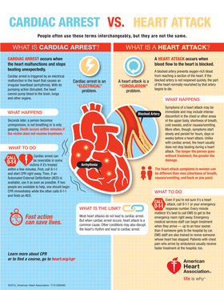

Cardiac Arrest vs. Heart Attack
Infographic
People often use these terms interchangeably, but they are not the same.

Slide 19
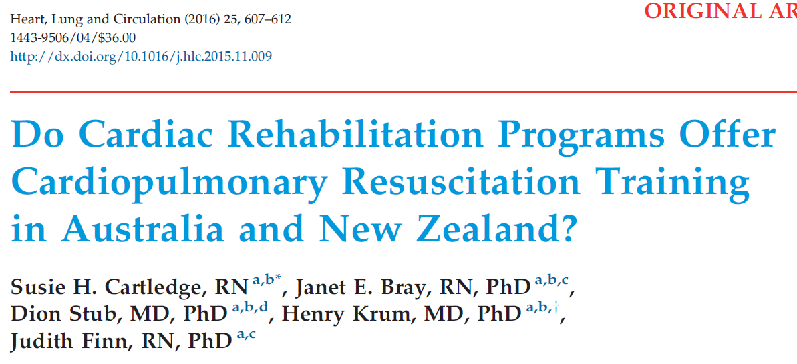
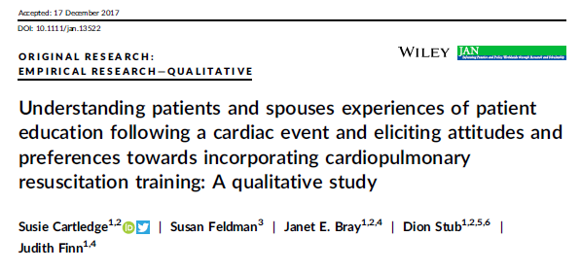
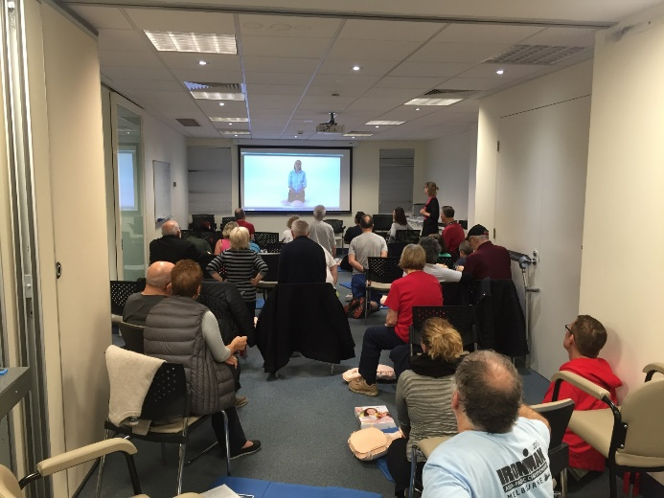
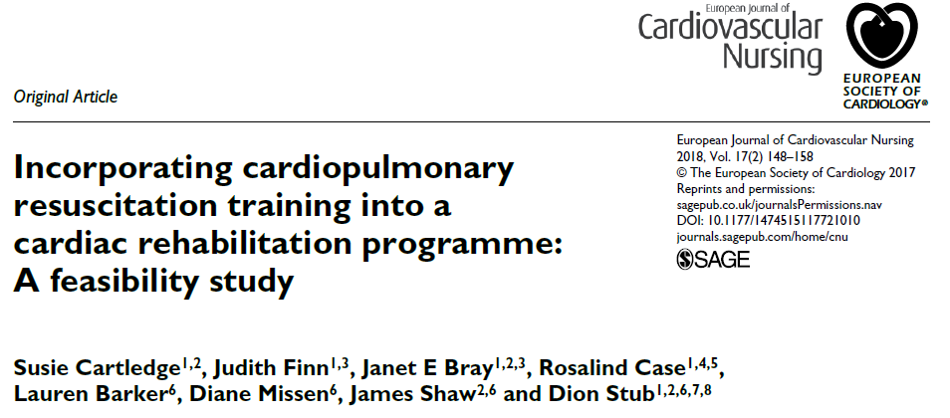
CPR can be taught in cardiac rehab
In 2014, only 24% of CR programs in Australia provided CPR training
CR patients see CPR training as valuable & see CR as the ideal place to learn CPR
CR patients and sig others can be taught
Susie Cartledge’s PhD

Slide 20
In reality (of the yes’s):
Correct Incorrect Became unsure
48.3% 22.2% 10.4%
Partially correct
18.5%
How would you describe the difference ?
Susie Cartledge’s slide

Slide 21
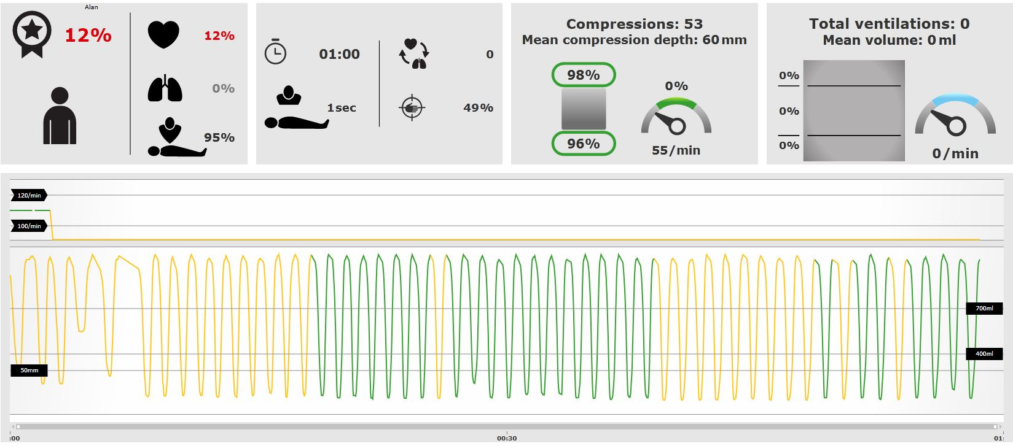
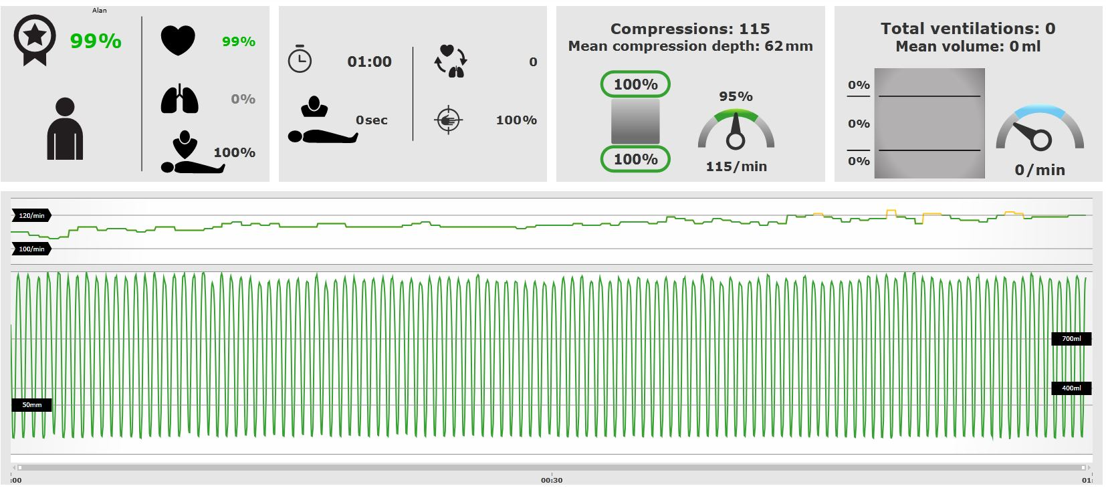
Feasibility study: results
1st attempt: no coaching
12%
2nd attempt: coached
99%
S. Cartledge slide
Notes:
57% did skills assessment (28 patients, 19 family members 70% of family members)
For those that had a second attempt, coaching was provided by the cardiac nurses and by watching the skill reporting screen. We could easily turn people around in that second minute, from a clearly poor attempt, to an excellent attempt

Slide 22
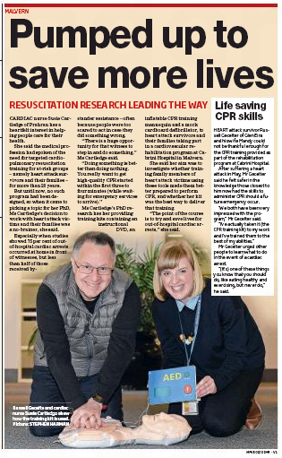

Slide 23
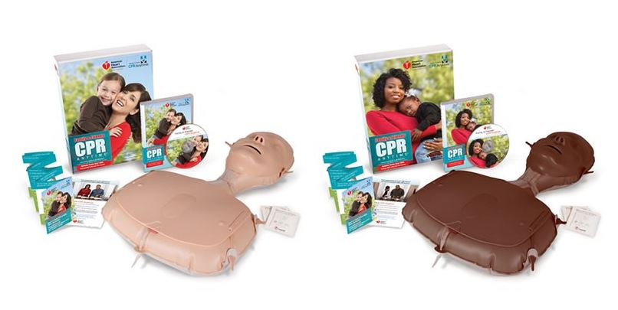
CPR training for cardiac rehab patients – secondary training
83
S. Cartledge slide
We trained
Average: 3
Maximum: 15
They trained
87
Total
170
Cartledge S, Finn J, Bray JE, Case R, Barker L, Missen D, Shaw J, Stub D. Incorporating cardiopulmonary resuscitation training into a cardiac rehabilitation programme: A feasibility study. Eur J Cardiovasc Nurs. 2018;17(2):148-58.
Notes:
The rate of secondary training

Slide 24
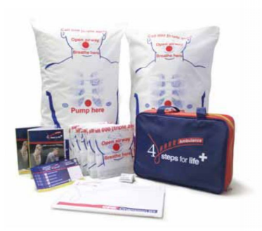
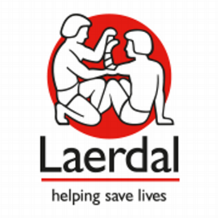
Increasing uptake of CPR in Cardiac Rehabilitation
Aim
  To increase prevalence of CPR training in Australian CR programs (currently 24%)
Intervention
  CPR training information pack (includes two CPR training kits valued $75)
  Information pack + 45 mins education session (videoconference)
Data collection
  10 mins survey before and at 6 month
  susie.cartledge@monash.edu

Slide 25
In conclusion..
OHCA is a major public health problem
OHCA is a time critical condition
Survival can be more than doubled by early recognition, early call for ambulance and early bystander CPR
Cardiac rehab patients are ‘at risk’ of OHCA
Cardiac rehab patients (and families) are willing and able to learn basic life support (including CPR + defib)
Lives can be saved by strengthening the OHCA chain of survival

Slide 26
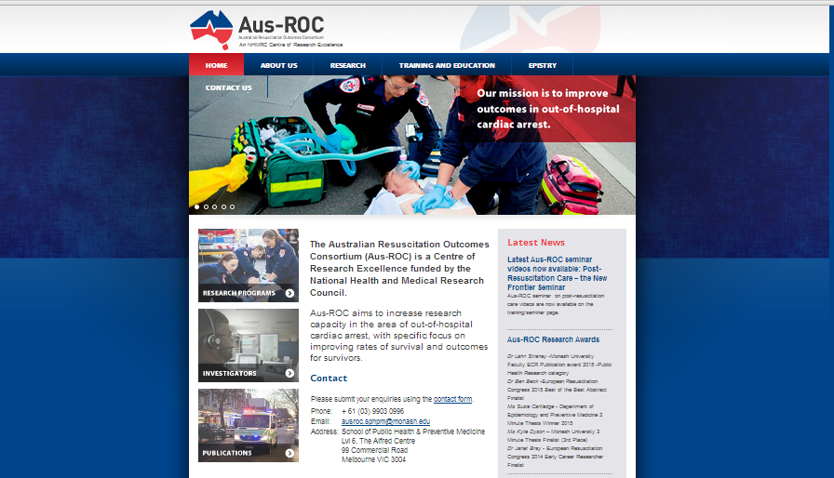
Thank you for your attention.
judith.finn@curtin.edu.au OR judith.finn@monash.edu
www.ausroc.org.au

Slide 27
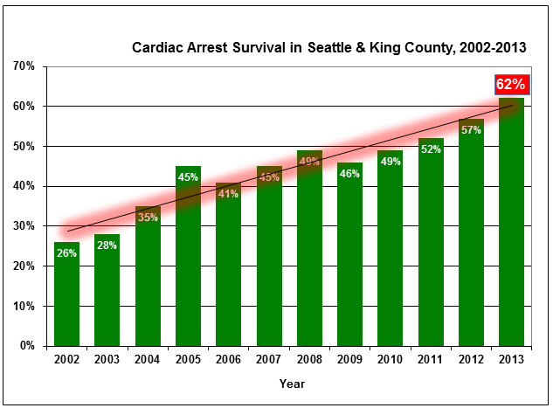
Survival to hospital D/C for bystander-witnessed OHCA of presumed cardiac cause in VF/VT in Seattle & King County
http://www.kingcounty.gov/healthservices/health/news/2014/14051901.aspx

Slide 28
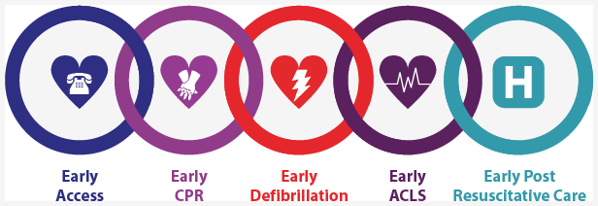
So why does Seattle have the best OHCA survival rates in the world?
“We like to say that it takes a system to save a cardiac arrest victim, and it’s proven true again and again with every new survivor,” said Dr. Mickey Eisenberg, King County Emergency Medical Services Medical Director. http://www.kingcounty.gov/healthservices/health/news/2014/14051901.aspx

Slide 29
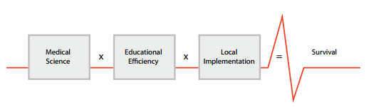
The Utstein Formula for Survival in Resuscitation
Søreide E et al. Resuscitation. 2013;84(11):1487-93.

