Slide 1
Risk factors for atrial fibrillation
Dr Nicole Lowres
Postdoctoral Research Fellow
Heart Research Institute
Charles Perkins Centre, University of Sydney
Notes:
A growing body of evidence supporting the need for atrial fibrillation screening

Slide 2
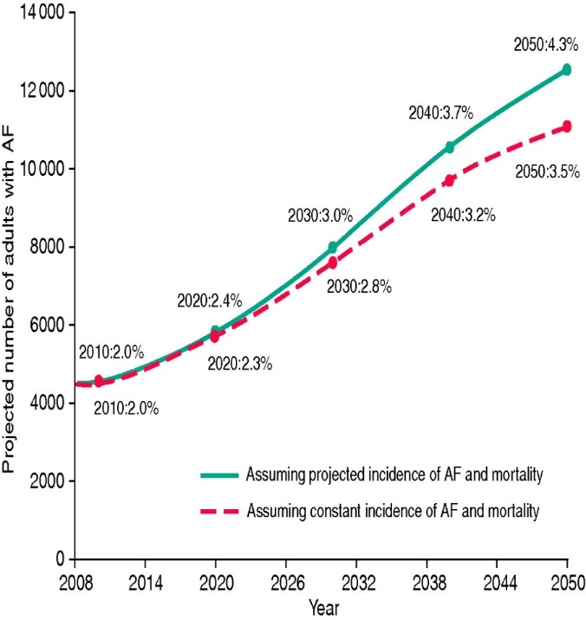
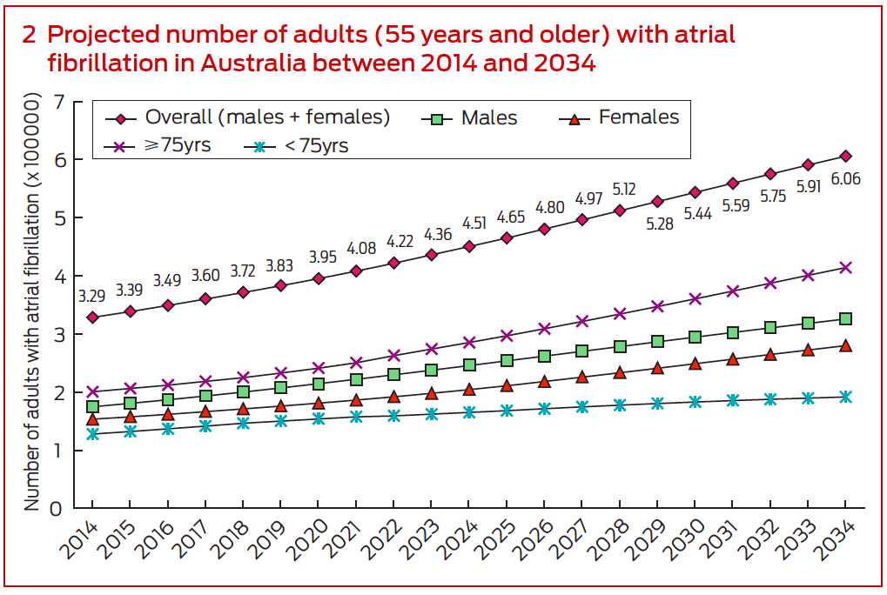
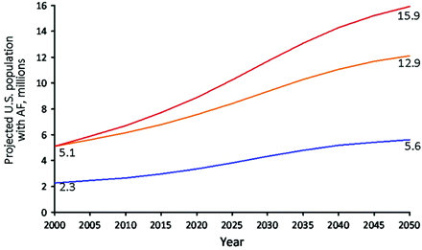
Future prevalence of AF
Iceland
Australia (≥55 years age)
United States
Projected incidence
Projected incidence
______ Miyasaka, J Am Coll Cardiol. 2007;49:986-992.
______ Go, JAMA. 2001;285:2370-2375.
Stefansdottir, Europace. 2011;13:1110-17.
Ball, Med J Aust 2015; 202: 32-5
Notes:
Add extra references to slide text box

Slide 3
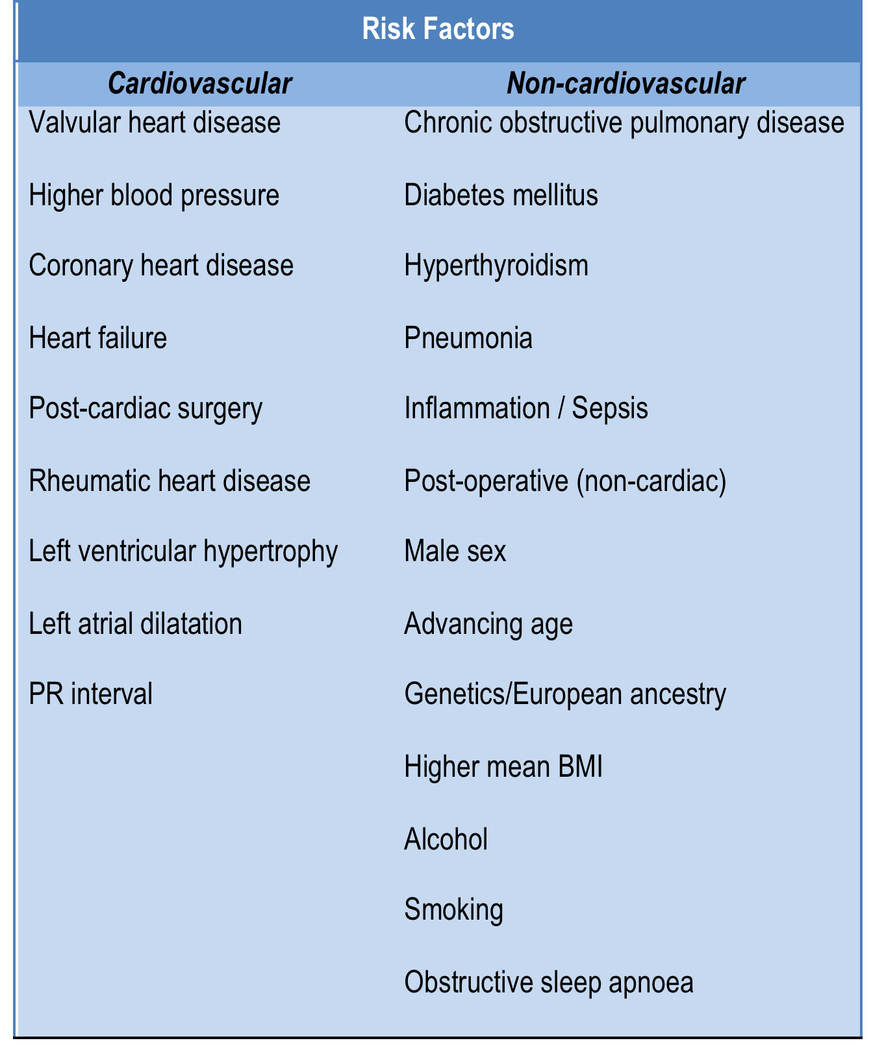

Slide 4
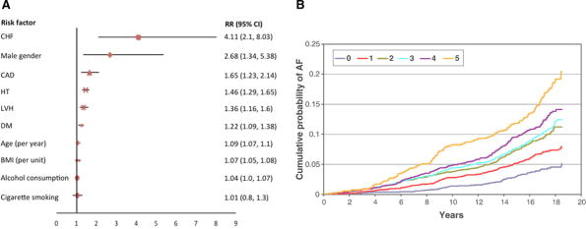
Association of risk factors with AF
Lau. Circulation. 2017;136:583-596
.

Slide 5
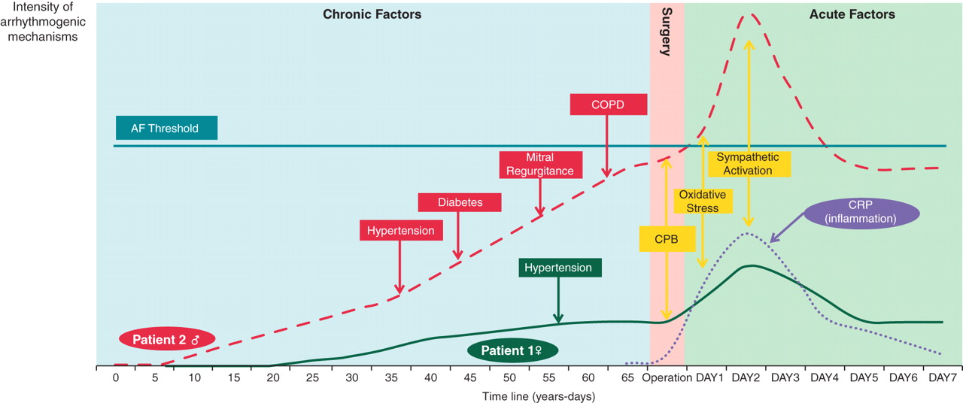
Pathophysiological threshold in atrial substrate
Maesen. Europace. 2012;14:159-174.

Slide 6
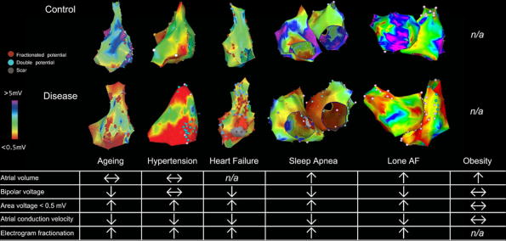
Physiological changes
Lau. Circulation. 2017;136:583-596
.

Slide 7
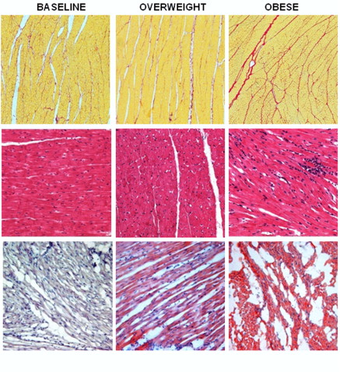
Obesity causes tissue changes
Fibrosis tissue
Inflammatory infiltrate
Lipidosis
Abed. Heart Rhythm. 2013;10:90-100.

Slide 8
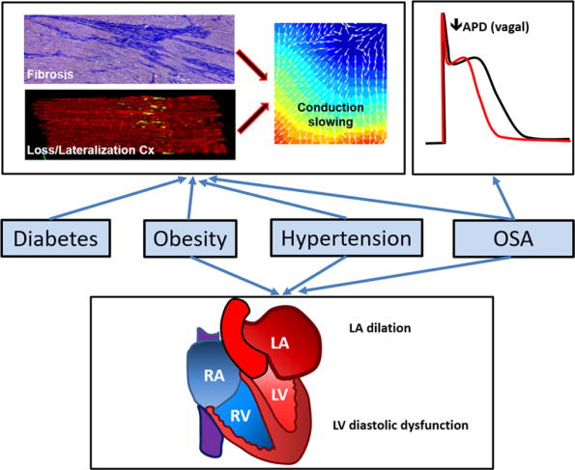
Mechanisms
Lau. Circulation. 2017;136:583-596
.
Notes:
Reduced action potential duration

Slide 9
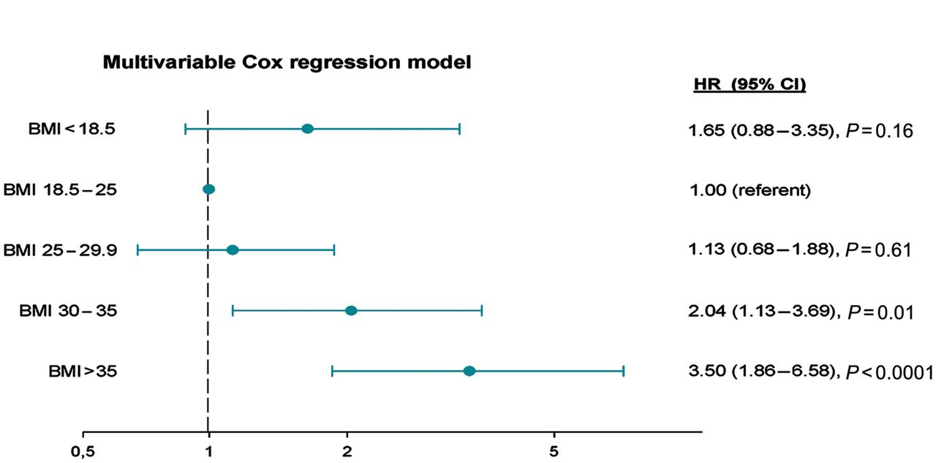
Obesity
Karasoy. Europace. 2013;15:781-6.
Notes:
Results of crude and multivariable Cox regression analyses according to BMI (kg/m²). Crude models were adjusted for age and year of inclusion. Multivariable models were adjusted for age, hyperthyroidism, and previous use of beta-blockers. X-axis shows HR of AF. CI, confidence interval.

Slide 10
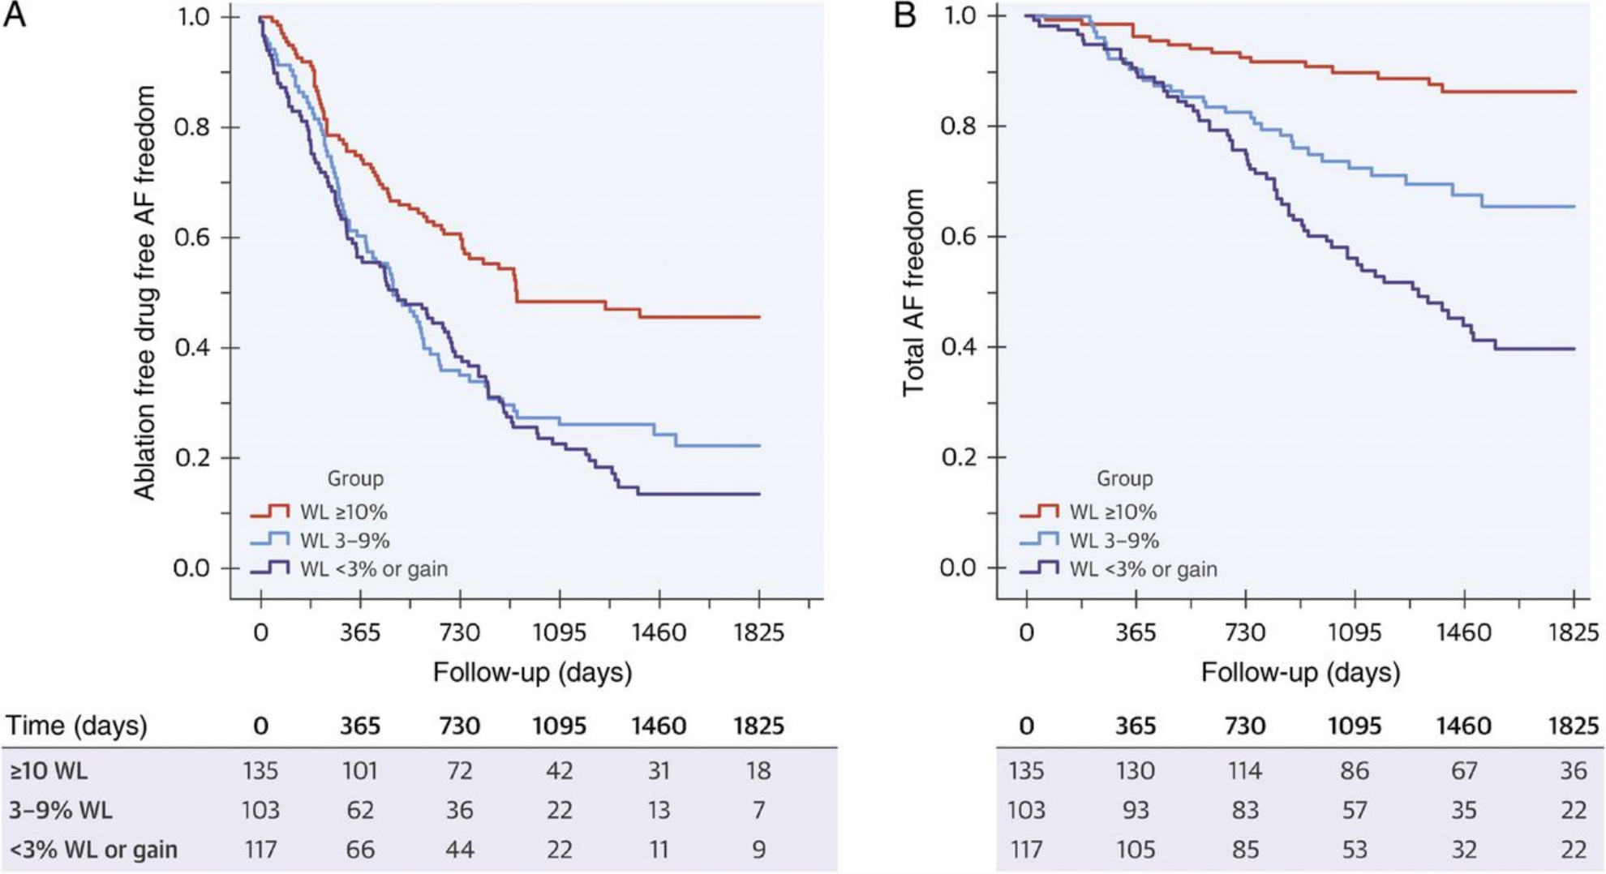
Weight loss
Pathak. J Am Coll Cardiol. 2015;65:2159-69.

Slide 11
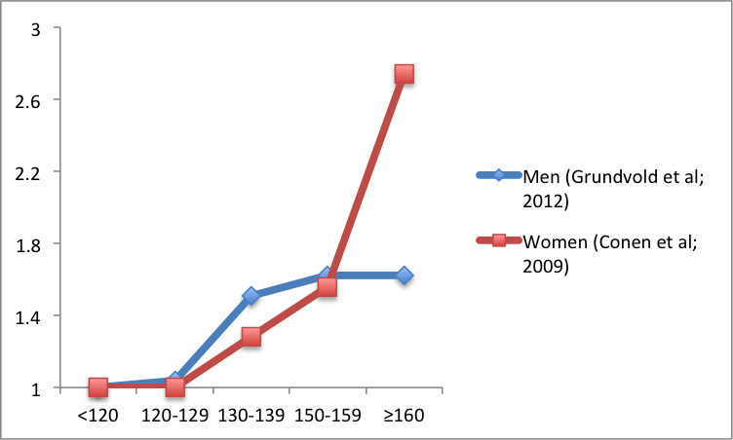
Subclinical Hypertension
Hazard Ratio
Systolic blood pressure (mmHg)
Notes:
For each 10-mmHg decrease in systolic blood pressure, the hazard ratio is reported as 0.87 (95% confidence interval [CI], 0.83-0.91)

Slide 12
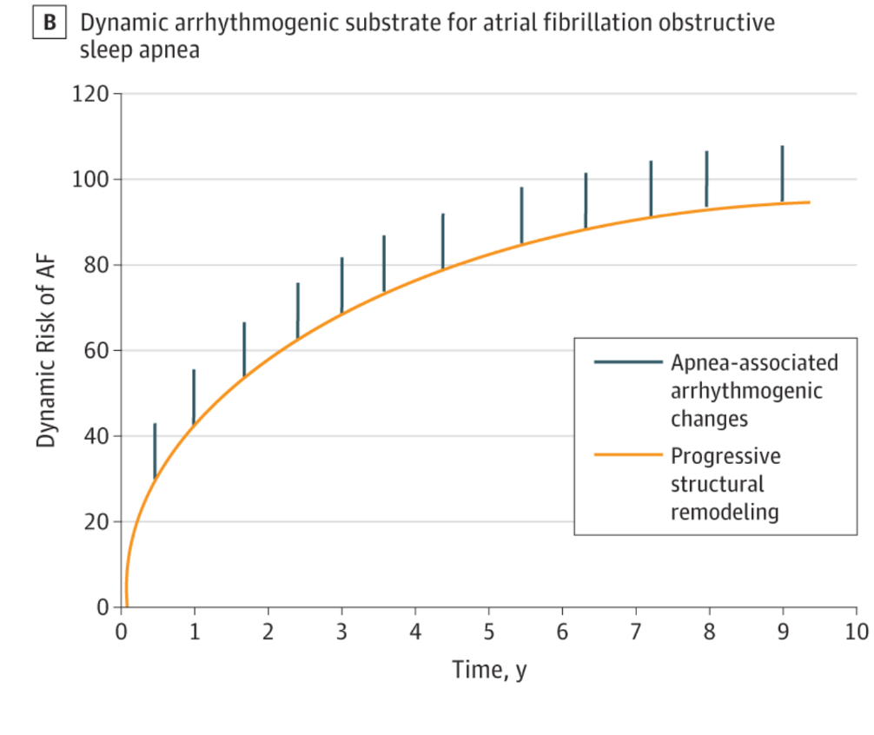
Obstructive sleep apnoea
Linz. JAMA Cardiology. 2018;3:532-40.

Slide 13
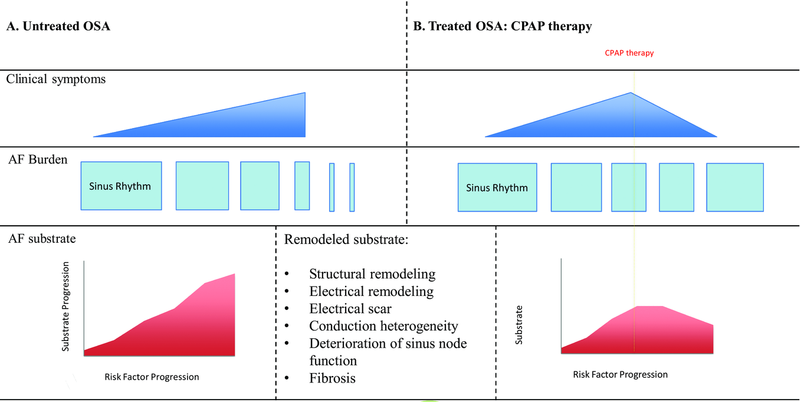
Obstructive sleep apnoea
Nalliah J Cardiovasc Electrophysiol. 2016;27:1001-10

Slide 14
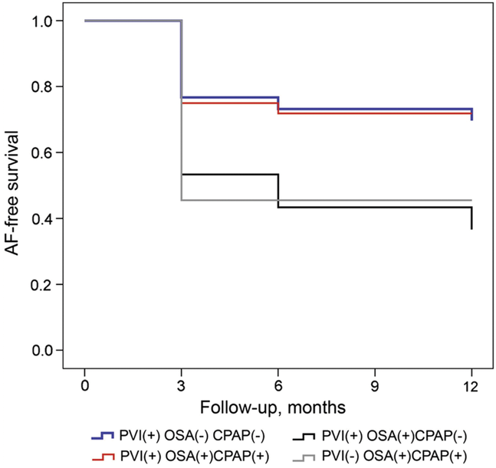
Effect of CPAP treatment
Nalliah J Cardiovasc Electrophysiol. 2016;27:1001-10

Slide 15
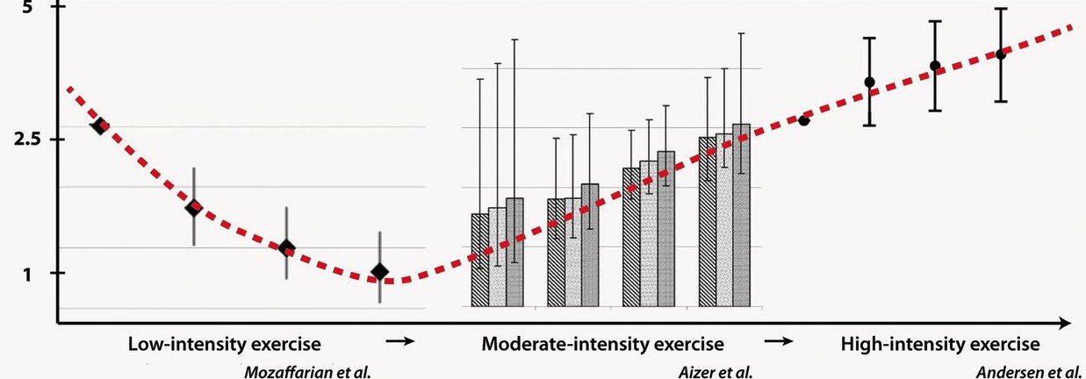
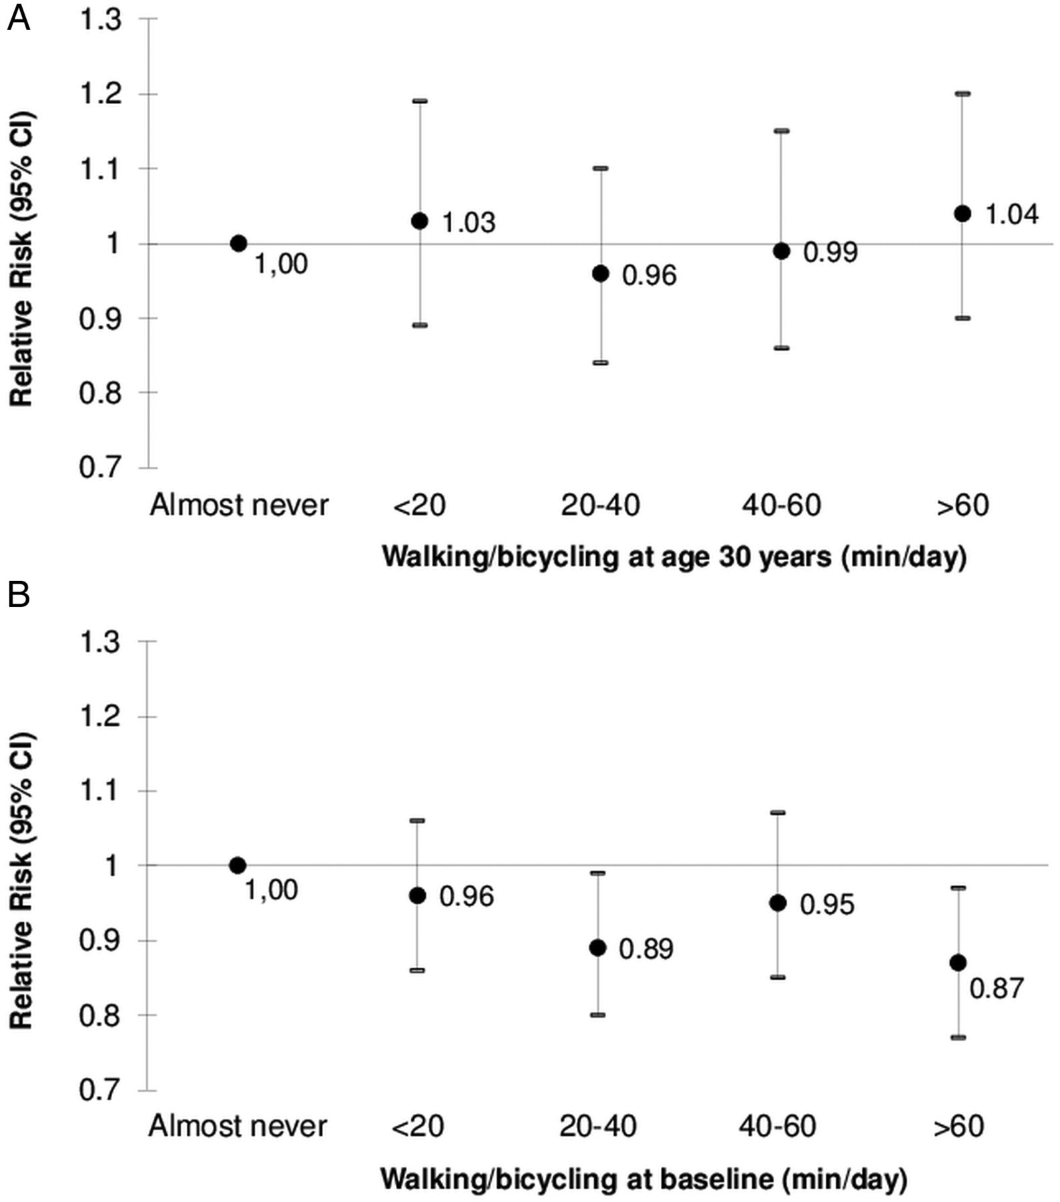
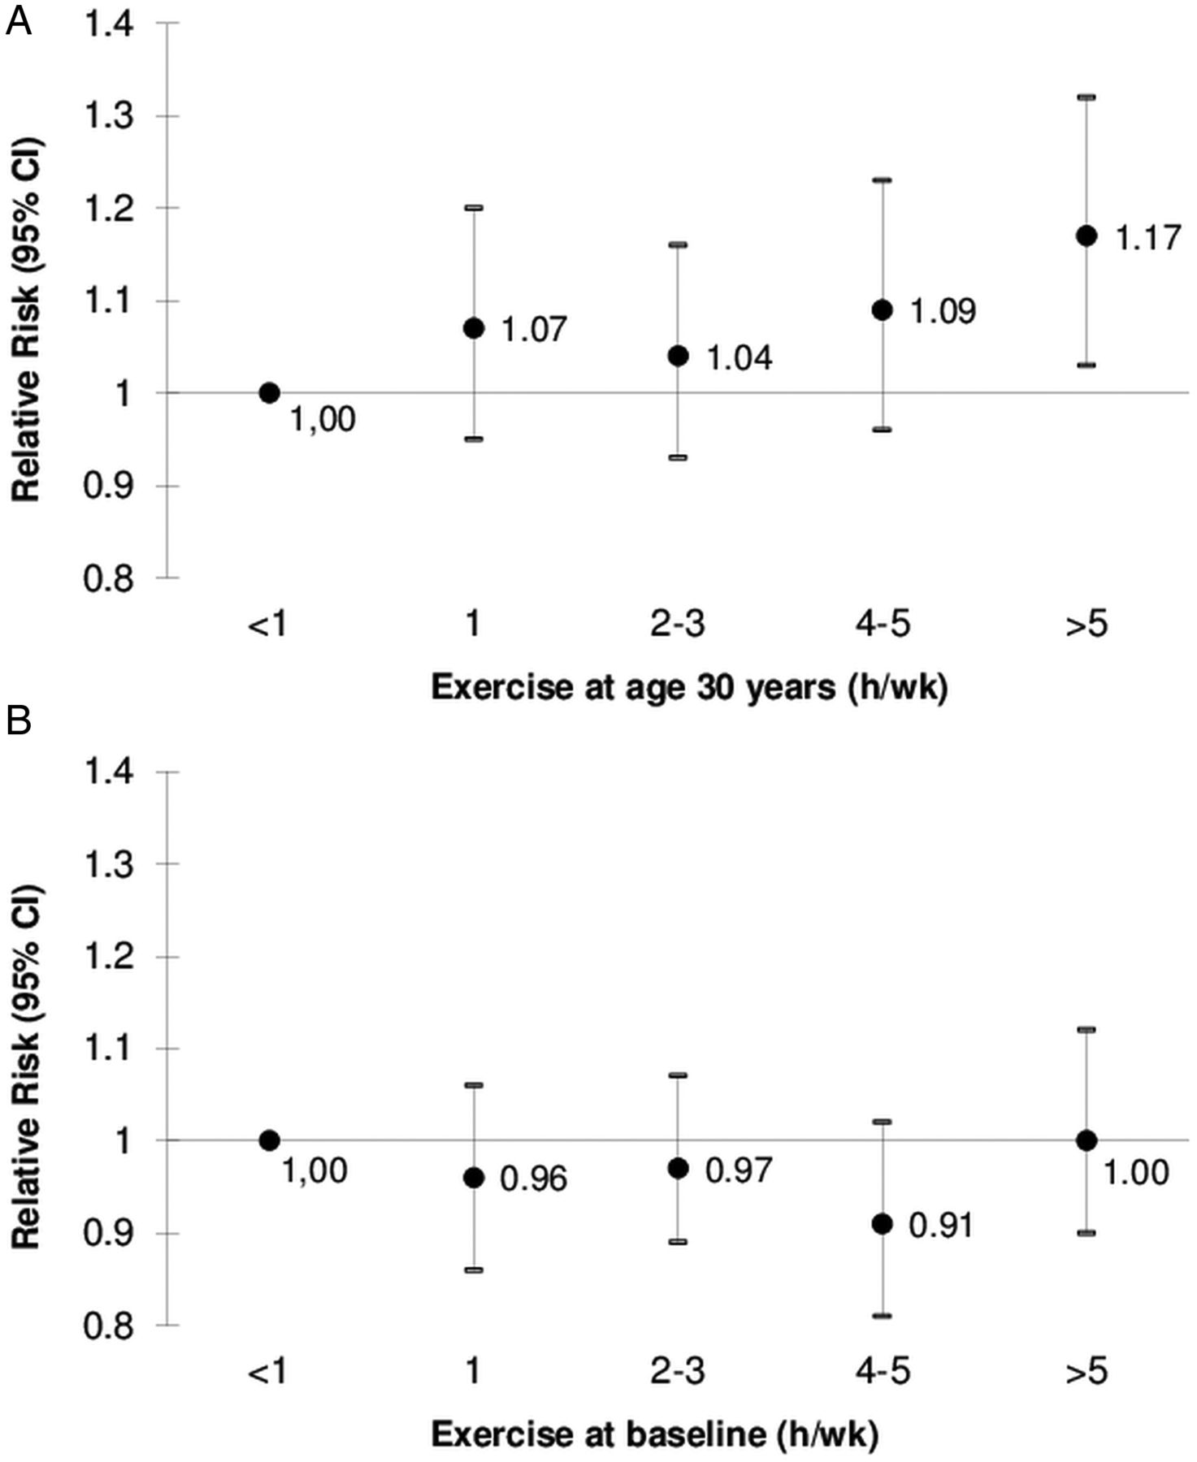
Physical activity and relative risk of AF
La Gersh et al, Eur Heart J, 2013
Drca N et al, Heart, 2014
Notes:
Multivariable relative risks* of atrial fibrillation by exercise at age 30 years (A) and at baseline (B) in the cohort of Swedish men, 1998–2009 *Multivariable relative risks were adjusted for the same variables as in table 2.

Slide 16
Exercise and AF risk
Volumes of 5 to 20 MET-h/week – reduction in risk¹
Endurance training >2,000 hours increases risk²
Progressive increase with cumulated activity
Exercise “deconditioning” leads to reversal of structural changes back to normal substrate
1. Ricci. Eur J Prevent Cardiol. 2018;25:857-866.
2. Guasch, J Am Coll Cardiol. 2013;62:68-77

Slide 17
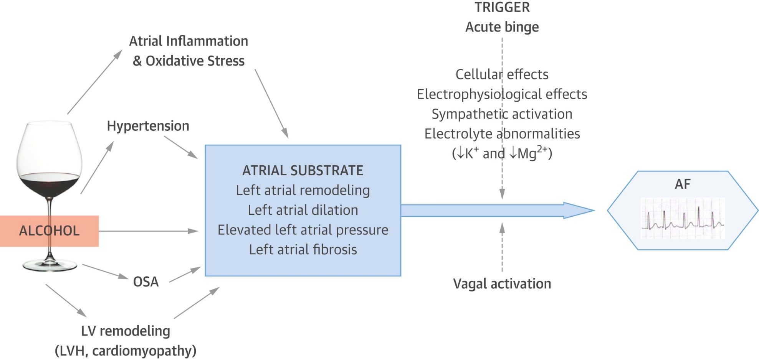
Alcohol: Pathophysiological pathway
Voskoboinik J Am Coll Cardiol. 2016;68:2567-76.

Slide 18
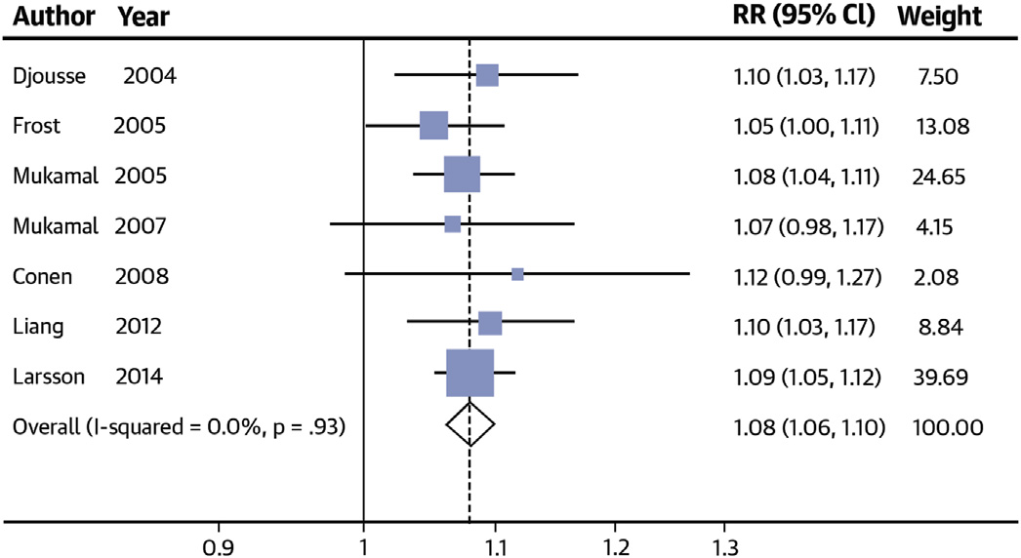
Alcohol
Relative risks of atrial fibrillation per 1 drink/day increment in alcohol consumption
Larsson. J Am Coll Cardiol. 2014;64:281-289.

Slide 19
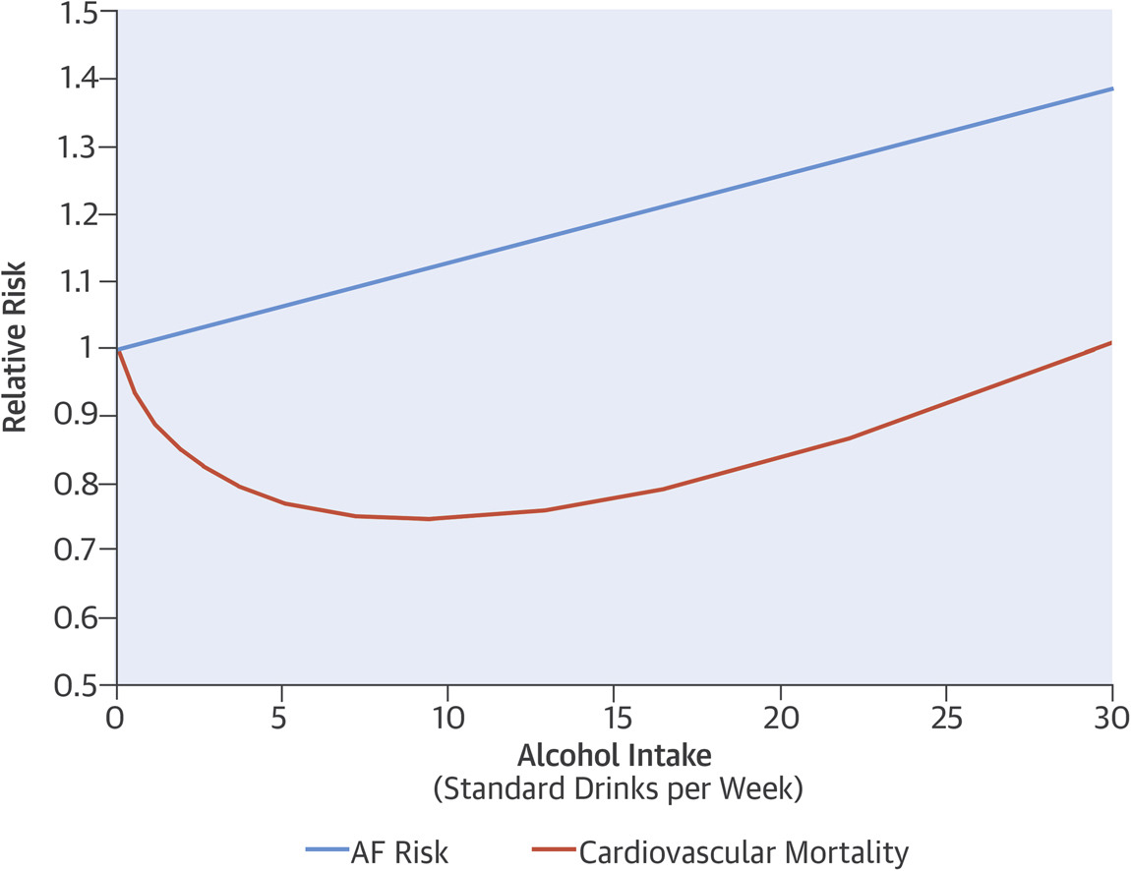
Alcohol consumption
Voskoboinik J Am Coll Cardiol. 2016;68:2567-76.

Slide 20
Smoking
Smoking status and cigarette-years | Mean cigarette-years | Incidence rate | Hazard ratio (95% CI)
Never | 0 | 28 | 1
Former <800 | 302 | 33 | 1.16 (0.96-1.40)
Former ≥800 | 1197 | 55 | 1.89 (1.47-2.42)
Current <800 | 452 | 42 | 1.85 (1.49-2.30)
Current ≥800 | 1149 | 58 | 2.31 (1.83-2.92)
Chamberlain. Heart Rhythm. 2011;8:1160-1166.

Slide 21
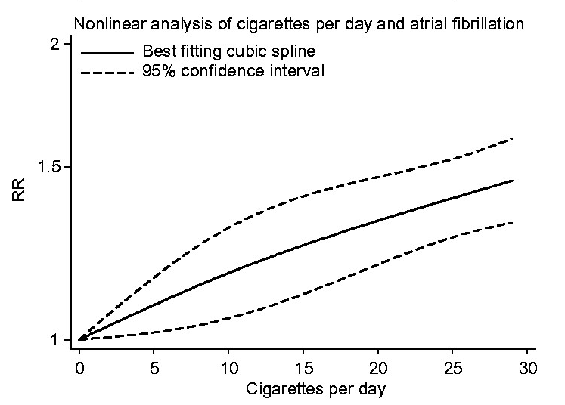
Cigarette smoking
Aune. Eur J Prevent Cardiol. 2018;0:2047487318780435.

Slide 22
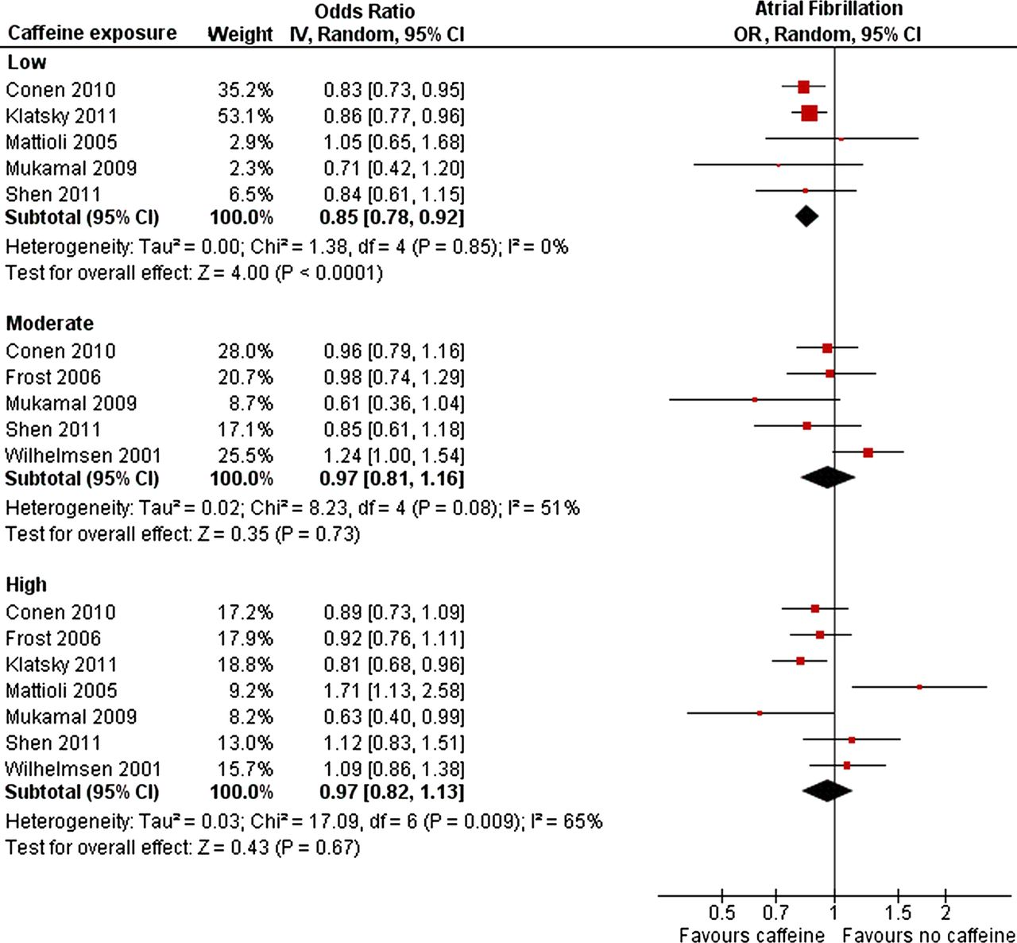
Caffeine exposure
Caldeira. Heart. 2013;99:1383-1389.
Notes:
Risk of atrial fibrillation according to caffeine exposure.

Slide 23
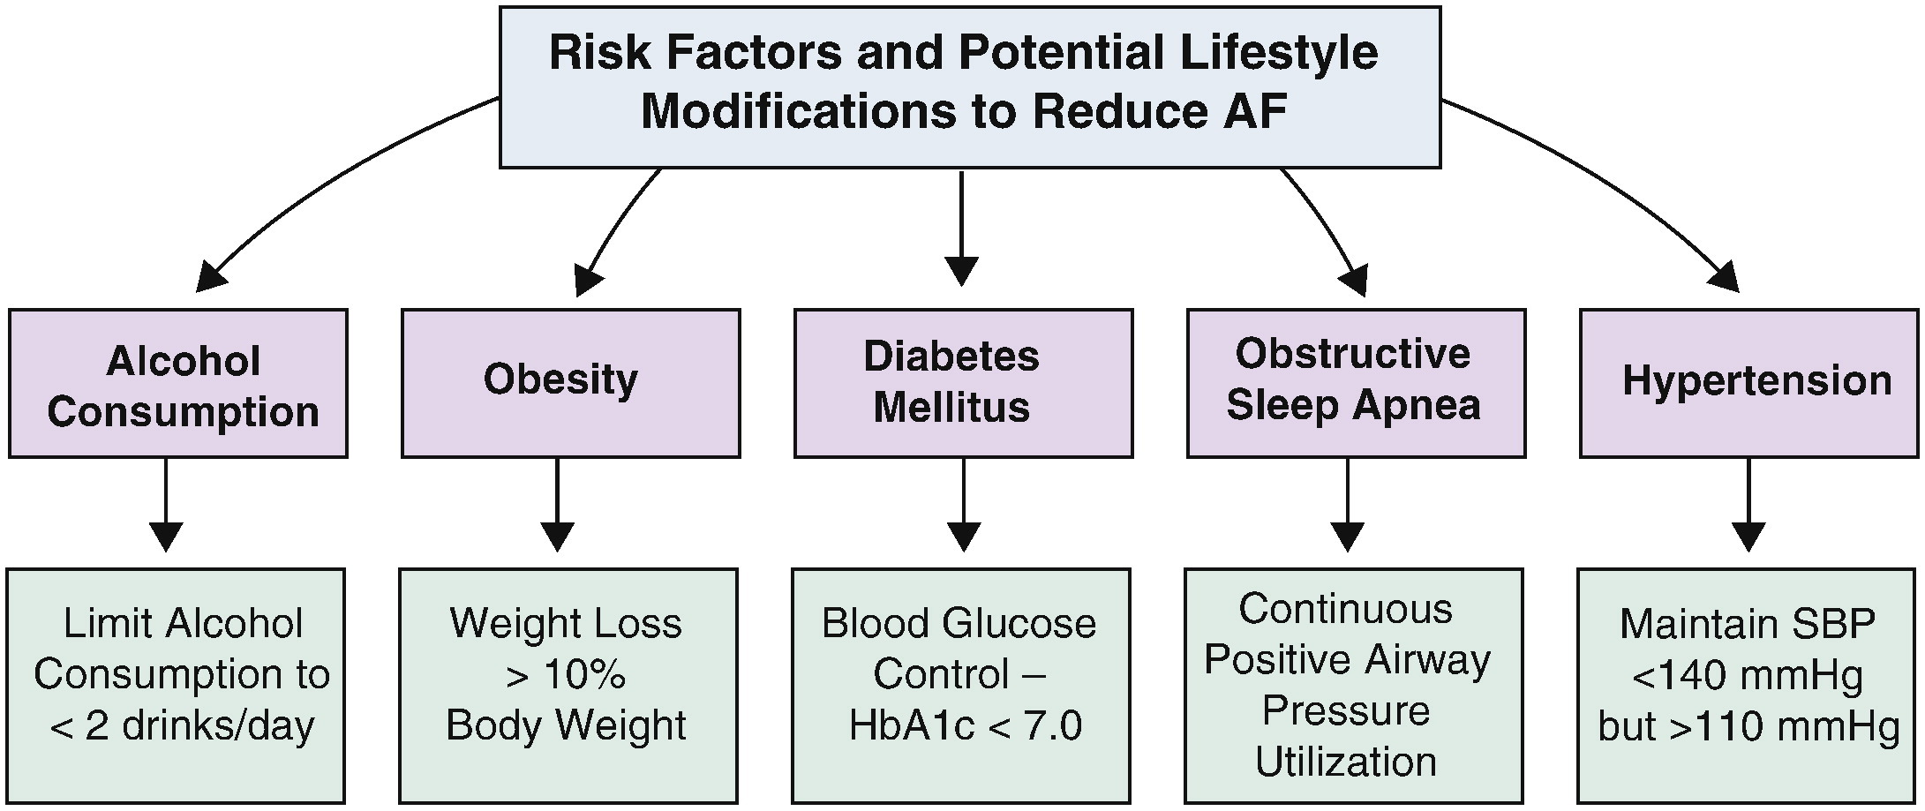
Menezes. Prog Cardiovasc Dis. 2015;58:117-25.

Slide 24
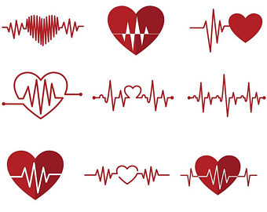

Questions

Slide 25
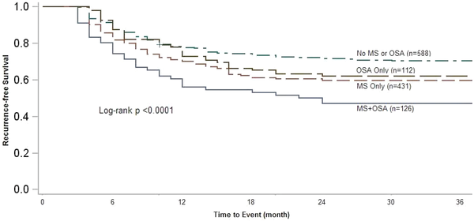
Metabolic syndrome and obstructive sleep apnoea
– catheter ablation outcomes
Mohanty. J Cardiovasc Electrophysiol. 2014;25:930-8.
Notes:
Kaplan–Meier curve comparing recurrence across Group 1 and the 3 subpopulations of Group 2 (MS‐only, OSA‐only, no MS/OSA) shows significantly higher failure in MS+OSA population.
© IF THIS IMAGE HAS BEEN PROVIDED BY OR IS OWNED BY A THIRD PARTY, AS INDICATED IN THE CAPTION LINE, THEN FURTHER PERMISSION MAY BE NEEDED BEFORE ANY FURTHER USE. PLEASE CONTACT WILEY'S PERMISSIONS DEPARTMENT ON PERMISSIONS@WILEY.COM OR USE THE RIGHTSLINK SERVICE BY CLICKING ON THE 'REQUEST PERMISSION' LINK ACCOMPANYING THIS ARTICLE. WILEY OR AUTHOR OWNED IMAGES MAY BE USED FOR NON-COMMERCIAL PURPOSES, SUBJECT TO PROPER CITATION OF THE ARTICLE, AUTHOR, AND PUBLISHER.

Slide 26
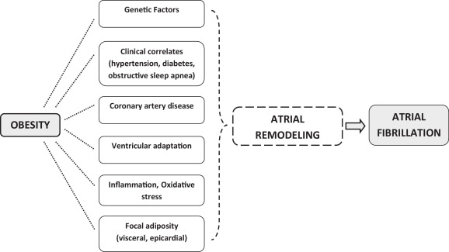
Pathophysiological links between obesity and AF

Slide 27
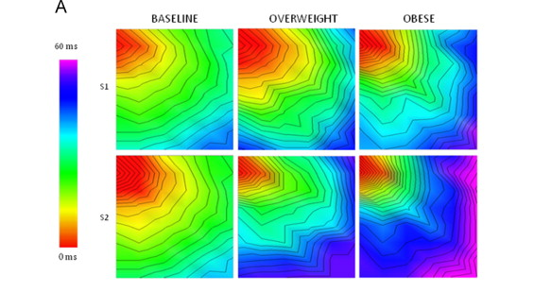
Obesity slows conduction velocity in atria
Abed. Heart Rhythm. 2013;10:90-100.

Slide 28
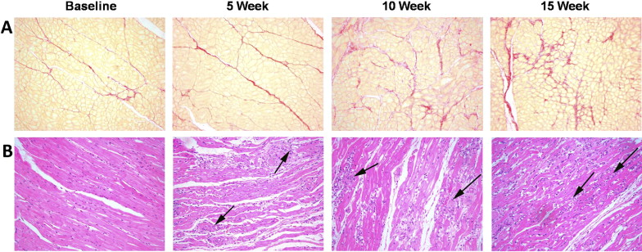
Hypertension leads to progressive atrial remodeling
Fibrosis tissue
Infiltrate
Lau. Heart Rhythm. 2010;7:1282-90.

Slide 29
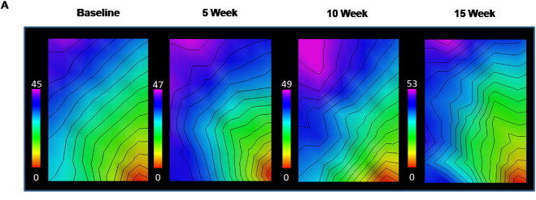
Hypertension leads to a reduction in conduction velocity
Lau. Heart Rhythm. 2010;7:1282-90.

Slide 30
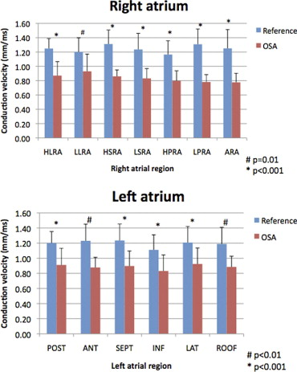
Atrial remodeling in obstructive sleep apnoea
Dimitri. Heart Rhythm. 2012;9:321-7.

Slide 31
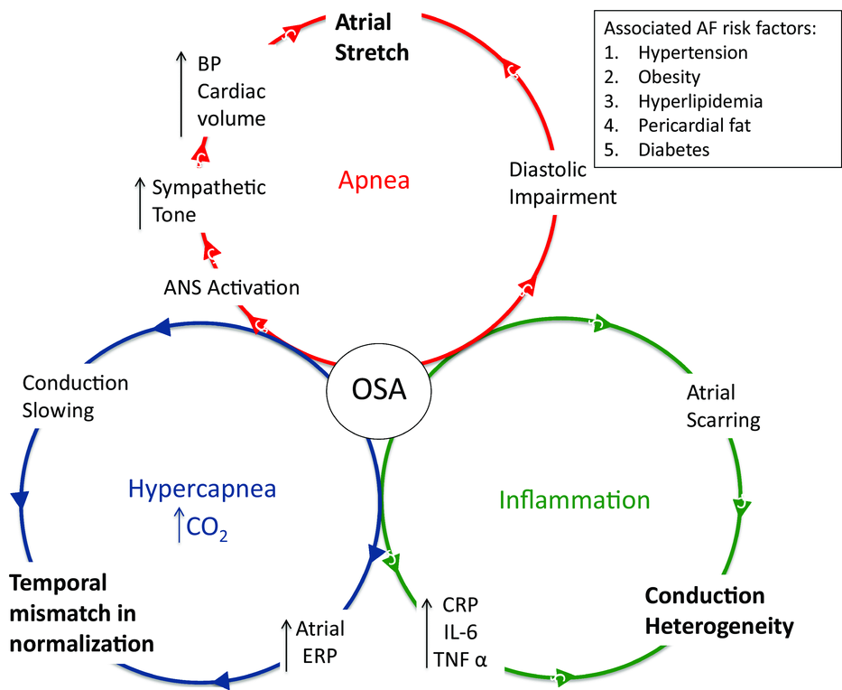
Obstructive sleep apnoea (OSA)
Nalliah J Cardiovasc Electrophysiol. 2016;27:1001-10
Notes:
Main mechanisms contributing to remodeling and AF

Slide 32
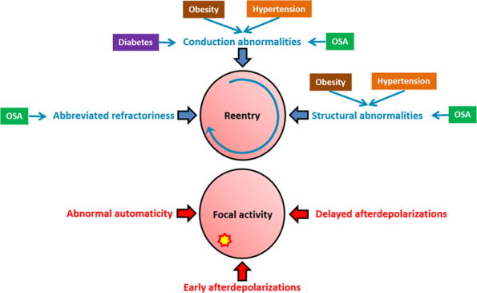
Mechanisms
Lau. Circulation. 2017;136:583-596
.

Slide 33
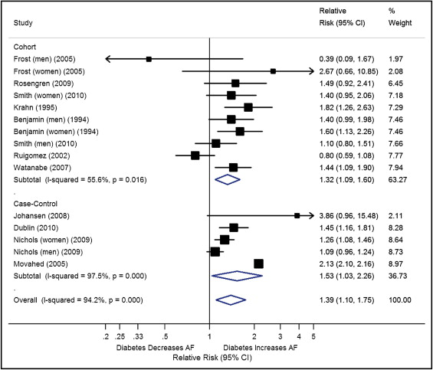
Type 2 Diabetes Mellitus and Risk of AF
Huxley Am J Cardiol. 2011;108:56-62.

Slide 34
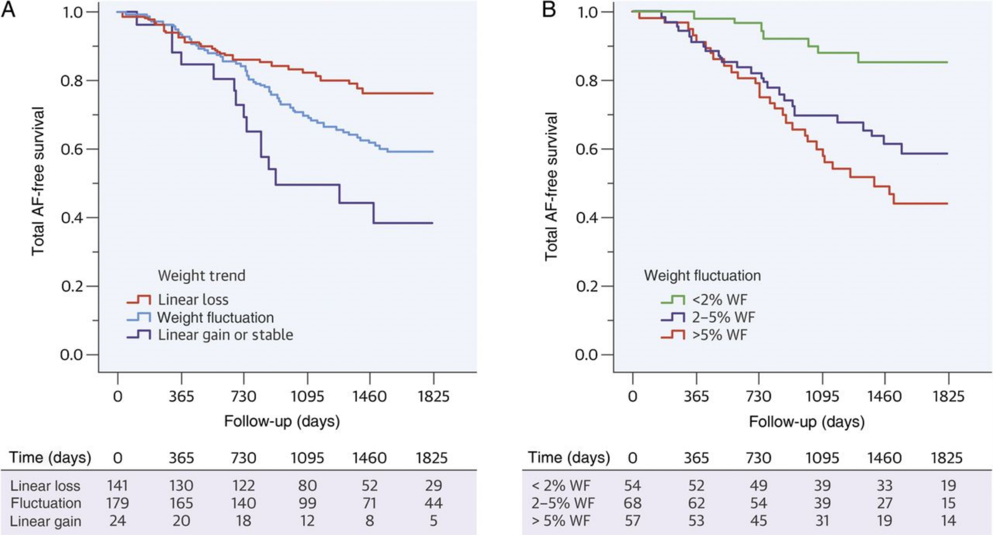
Weight fluctuation
Pathak. J Am Coll Cardiol. 2015;65:2159-69.

