Slide 1
Atrial Fibrillation
“Getting to the heart of the problem”
Luke Shanahan
BExSc. Grad. Dip Cardiac electrophysiology, CCDS, CEPS, FHRS, MBA.
Director Cardiac Investigations GCHHS

Slide 2
Conflicts of Interest
None

Slide 3
Outline
Background, definition and symptoms of Atrial fibrillation (AF)
Detection of AF
Brief overview of clinical management of AF
Practical tips for patients with AF and CIED’s
Proposed AF integrated model of care at GCHHS

Slide 4
Background
Atrial Fibrillation (AF) is a common cardiac rhythm disturbance that increases in prevalence with advancing age.
Prevalence ranges from rates lower than 0.5% among people aged 40-50 years, to 5%-15% among those aged 80 years and this is projected to double in next 50 years.

Slide 5
Definition and pattern of AF
AF is a supraventricular tachyarrhythmia with uncoordinated atrial activation and consequently ineffective atrial contractions.
Characteristics on an electrocardiogram (ECG) include:
Irregular R-R intervals when AV conduction is present
Absence of distinct repeating P waves
Irregular atrial activity

Slide 6
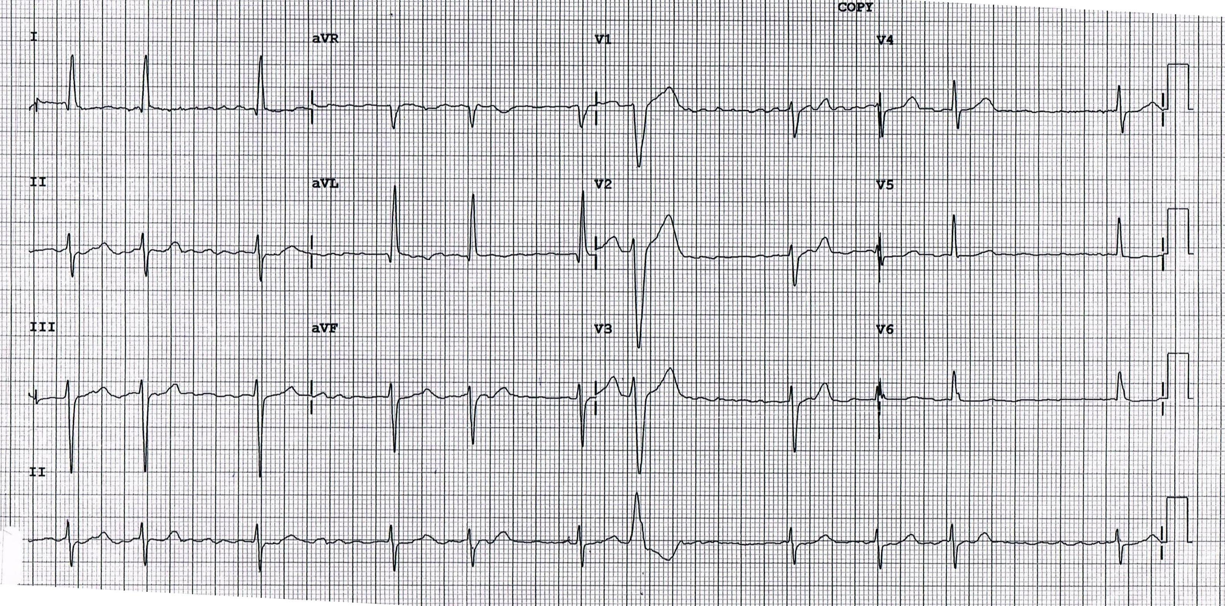
AF Electrocardiogram (ECG)

Slide 7
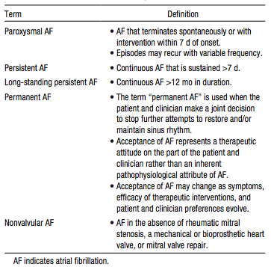
Pattern of AF
*Lone AF- old terminology, age <60, CHADS2Vasc= 0, no structural heart disease

Slide 8
Symptoms
Typical symptoms can include:
Fatigue (most common)
Palpitations
Dyspnea
Hypotension
Syncope
**AF patients can be asymptomatic (sometimes referred to as subclinical AF or occult AF).

Slide 9
AF with Aortic pressure tracing

Slide 10
Detection
Electrocardiograms (ECG)
Telemetry
Holter monitor (long term monitoring >7 days and 12 lead available)
External Event recorders (generally only useful with symptoms)
Smart phones ie. Alivecor/Kardia band (analysis for AF should be validated by clinician)
CIED’s- Implantable loop recorders, pacemakers and Implantable Cardioverter defibrillator (useful symptomatic/asymptomatic patients- ASSERT and CRYSTAL-AF trials)
*Electrocardiographic documentation is recommended to establish diagnosis of AF.

Slide 11
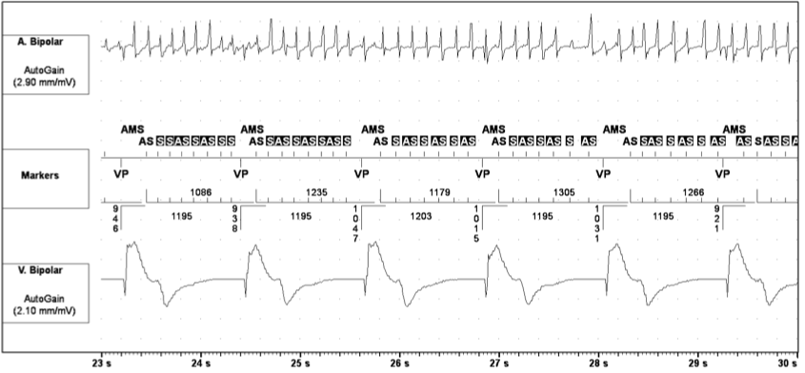
Example of PPM with AF

Slide 12
Overview of clinical management
Anticoagulation
Stroke prevention
Rate control
Symptom improvement
Preservation of LV function
Rhythm control
Symptom improvement
Risk factor modification/treat underlying cause
Cardiovascular risk reduction
Reduction of AF burden/symptoms

Slide 13
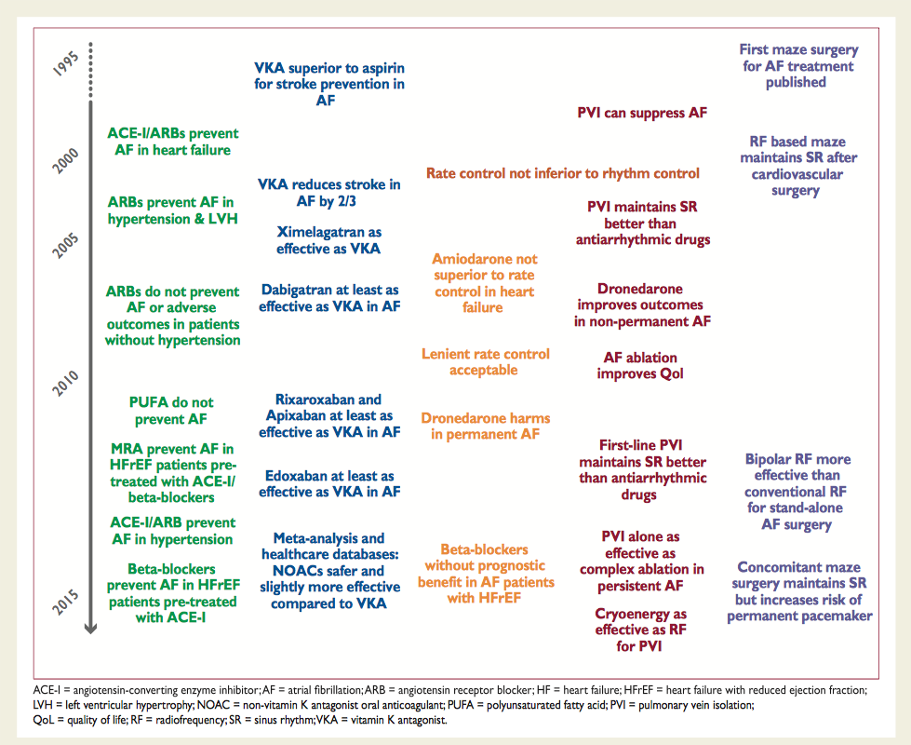
Management of AF landmark trials

Slide 14
Anticoagulation
  Stroke prevention

Slide 15
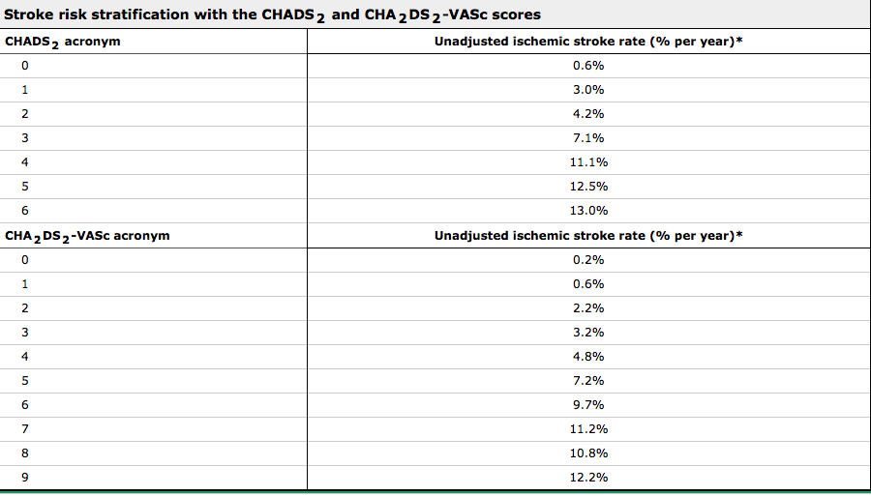

Slide 16
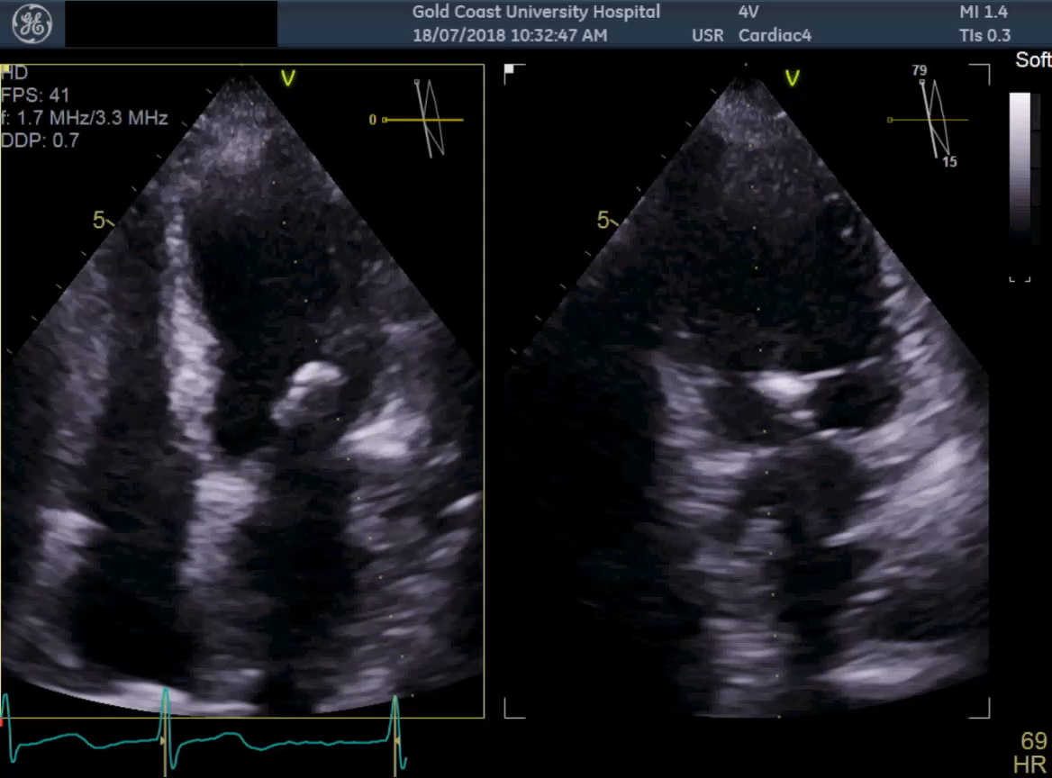
Example of thrombus formation in LAA

Slide 17
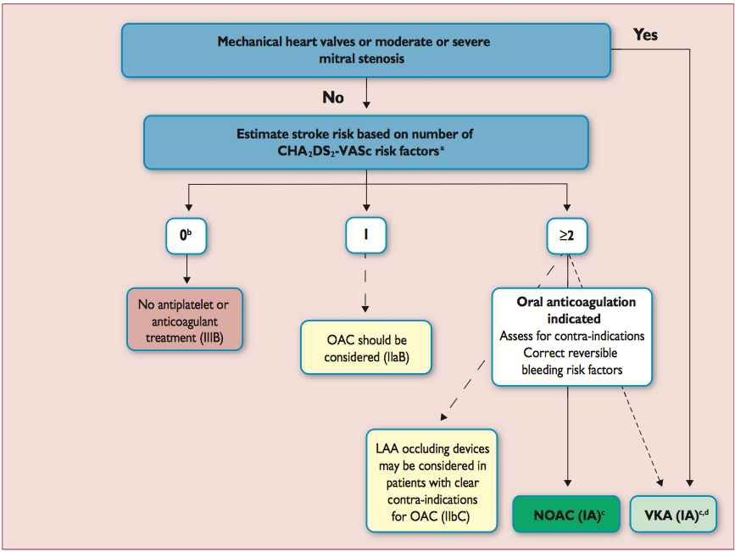
ADD STROKE PREVENTION FROM ESC

Slide 18
Nonpharmacological Stroke Prevention
WATCHMAN device (Boston Scientific)
Amplatzer cardiac plug (St Jude)
LARIAT device (SentreHEART)
Surgical excision in patient undergoing cardiac surgery (LAA ligation).

Slide 19
Rate control
  Symptom improvement
  Preservation of LV function

Slide 20
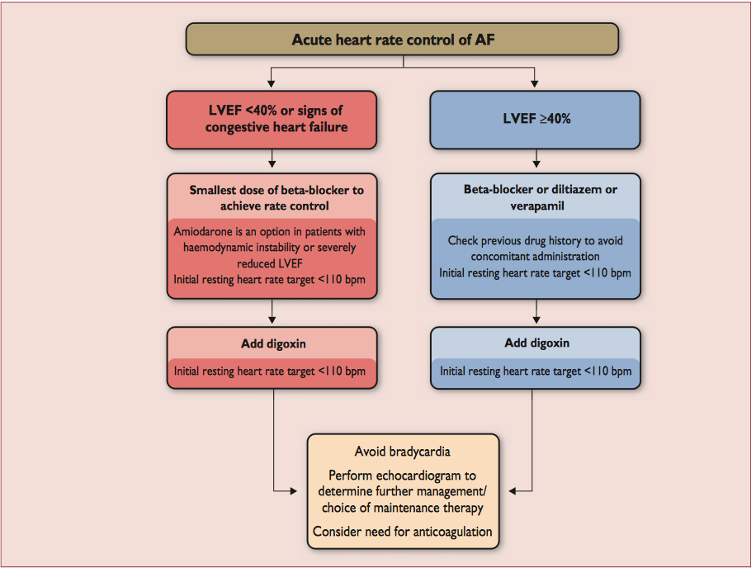

Slide 21
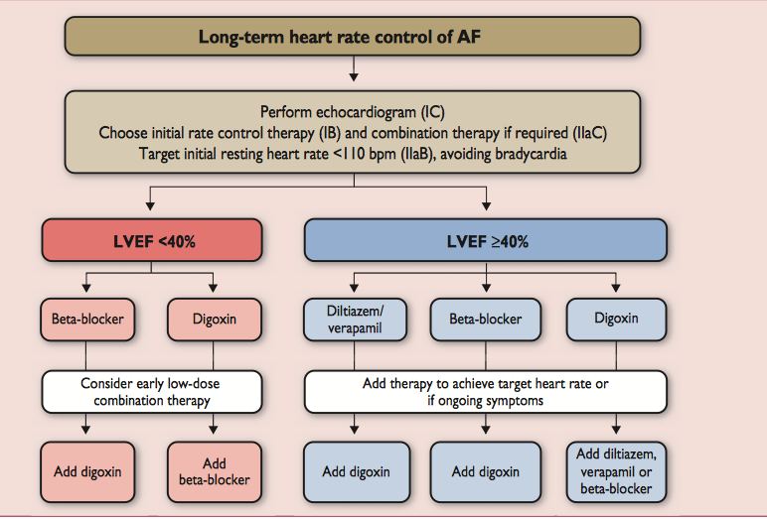

Slide 22
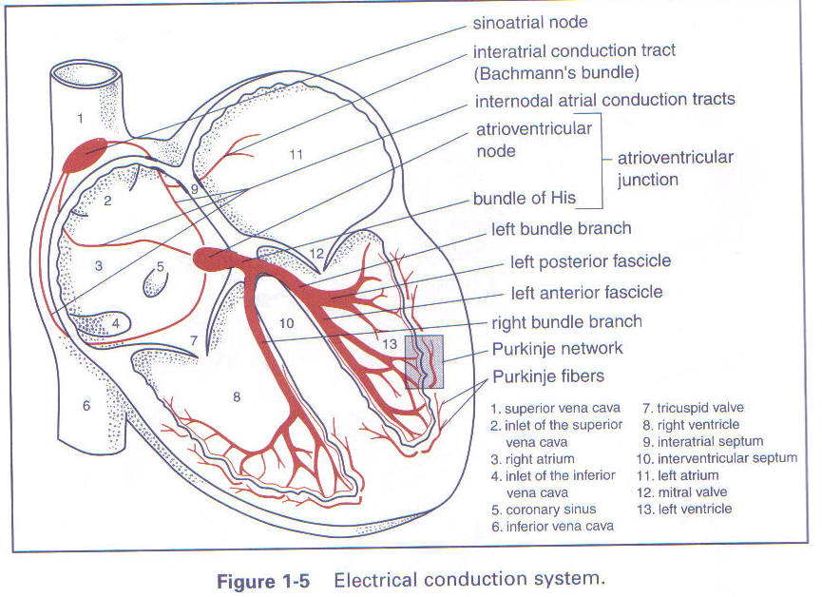
Refractory to medication- AV node ablation (Ablate and Pace,CAAN-AF)

Slide 23
Rhythm control
  Symptom improvement

Slide 24
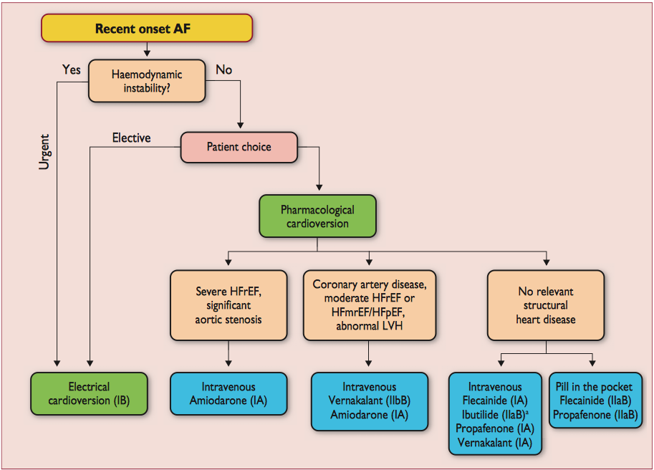
<48 hours8

Slide 25
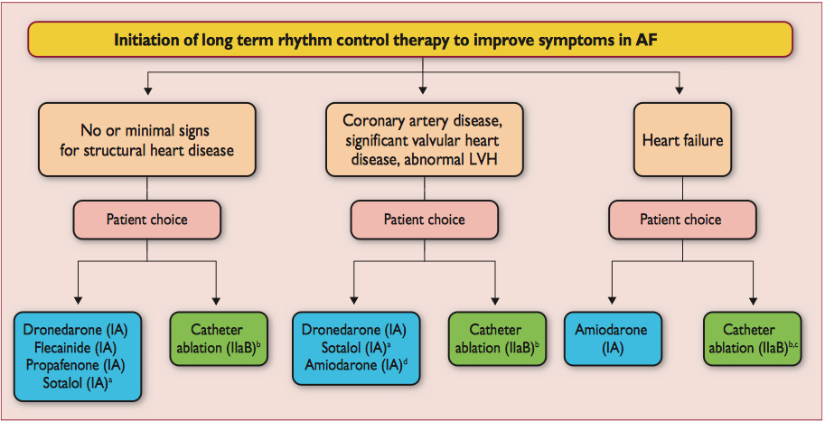

Slide 26
Catheter ablation for Atrial fibrillation
Class 1
AF catheter ablation is useful for symptomatic paroxysmal AF refractory or intolerant to at least 1 class I or III antiarrhythmic medication when a rhythm-control strategy is desired (Level of Evidence: A)
Best results are obtained in younger patients with paroxysmal AF, no structural heart disease and smaller atria.

Slide 27
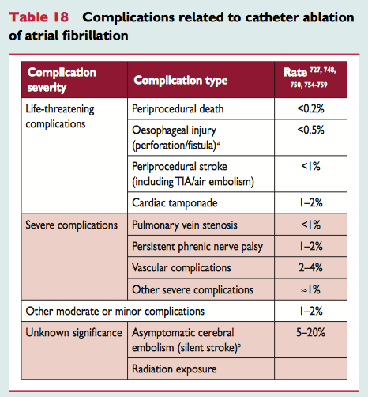

Slide 28
Success rates of AF ablation (curative)
Varies depending on Atrial fibrillation type and anatomy. In general between 50-85% on first attempt, 90% on second attempt and approximately 20% of patients undergo second procedure.
70-80% in patients with drug refractory, paroxysmal AF with no structural heart disease.
Cryotherapy vs Radiofrequency

Slide 29
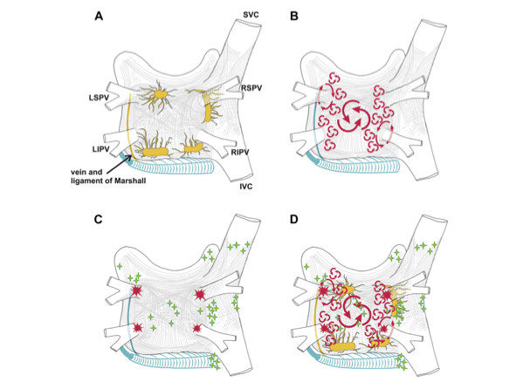
Anatomy and triggers for atrial fibrillation

Slide 30
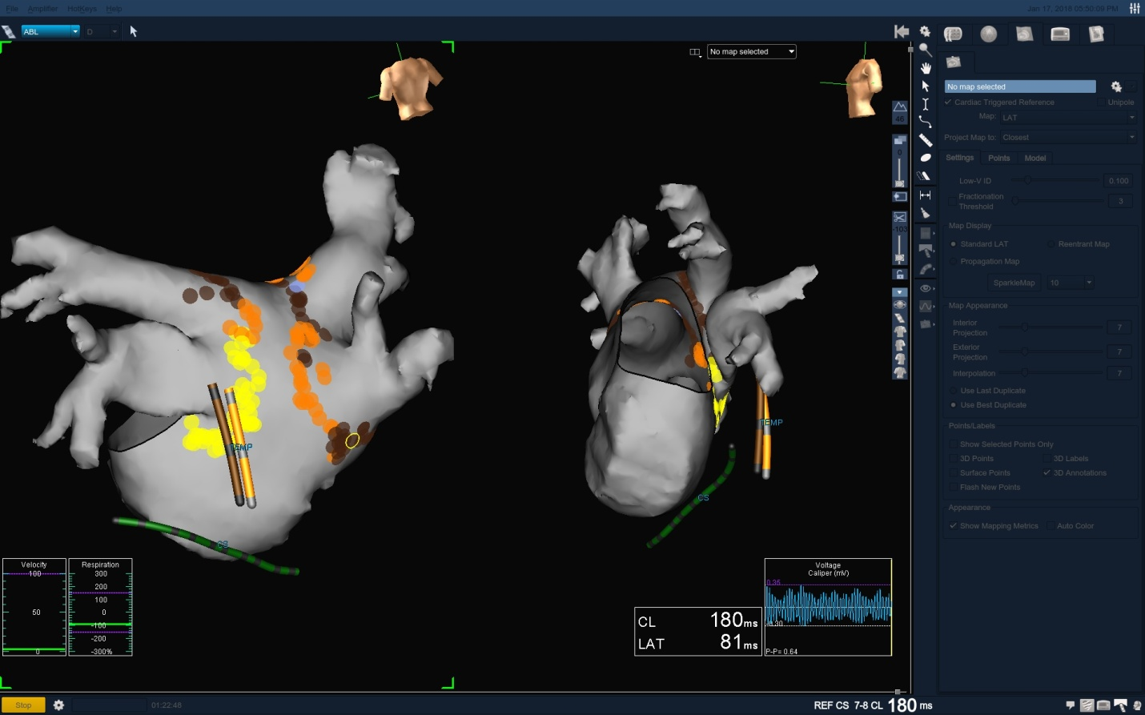
3D image of AF ablation lines

Slide 31
Risk factor modification/treat underlying cause
  Cardiovascular risk reduction
  Reduction of AF burden/symptoms

Slide 32
$$$Opportunity$$$
Alcohol use
Hyperthyroidism
Obesity
Smoking
Obstructive sleep apnea
** Opportunity through collaboration of MDTs and community health to address extra cardiac risk factors especially obesity and poor functional capacity (ARREST-AF, LEGACY and CARDIO-FIT studies all demonstrated reduction in AF burden).

Slide 33
Management and treatment is complex and varies among individuals
Characterize pattern of arrhythmia as outlined in definition.
Try and determine AF cause (see if reversible cause)
Define associated cardiac and extra cardiac disease.
Assess thromboembolic risk.
Determine if rate control is required
Decide on rate vs rhythm control strategy.
Identify and initiate prevention strategies***

Slide 34
Practical considerations in managing AF patients with CIED
Significant diagnostic information provided
Optimizing device function

Slide 35
Significant amount of diagnostic information provided to guide AF management
Heart rates histograms- long and short term
Heart rate variability
Average night and day heart rates
Atrial and ventricular arrhythmias
Patient activity
Burden of AF
Intra-thoracic impedance- HF monitoring
* Most devices can now be linked to remote monitoring to provide immediate updates on changes in patient status.

Slide 36
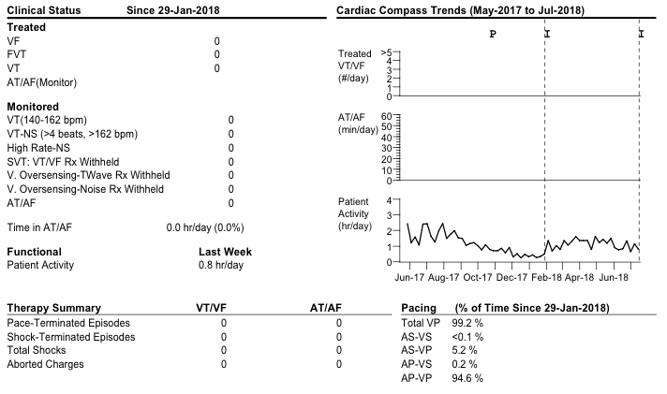
Other features on diagnostics on CIED

Slide 37
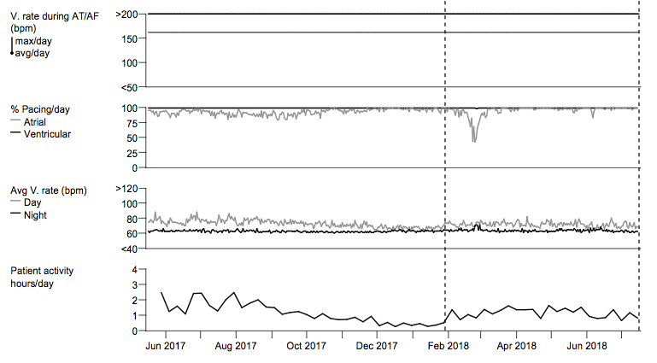
Other features on diagnostics on CIED

Slide 38
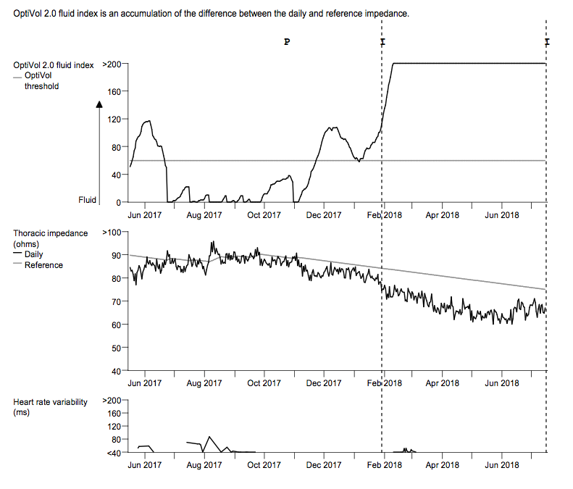
Other features on diagnostics on CIED

Slide 39
Optimizing Device programming for AF
Heart rate
(loss of SA node)
Stroke volume
(reduced by 25% AF)
Cardiac output
Preload
Contractility
Afterload

Slide 40
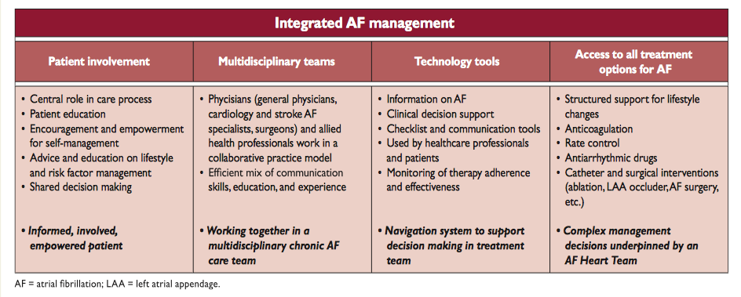
Integrated AF management and proposed model at GCHHS

Slide 41
Prevention
Public awareness
Information sharing (National)
Heart Foundation / Heart Shops
Updated translated resources
Monitoring visitors to our city
Risk factor modification
Health diet & exercise behaviour
Arrhythmia Alliance (AA)
Screening
Identify high risk patients
Risk Factors - CHAD VASC
Filtering mechanism
Depend on if technology is available
Guidelines / Uniformity in decision making process
Diagnosis & Management
Acute
Chronic
Arrhythmia Clinic
Ongoing Care
Pharmacist
Physiotherapist
Exercise physiologist
Dietician
Pyschologist
Nursing
Cardiac rehab
General Practioners
Cardiologist’s
Prevention
ENTRY POINTS - AF
Inpatient
Rural hospital patients
Stroke Unit
Stroke team
ED
MAU / Inpatient unit
AF+ no Complications
AF + symptoms- 24/7 arrhythmia clinic
AF + other symptoms- risk assessment /screen of risk factors early outpatient referral to arrhythmia clinic. GP informed
Cardiologist
Direct referral from GP
Inpatient treatment & monitoring
Arrhythmia clinic
24/7 rapid access
Physical location for Nurse Navigators
Device Based Clinic
Pacemaker
ICD
Loop recorders
GP
Care Plans
MDT care
Evidence based, nurse-led
Allied Health (expansion of current AF MDT)
Case management model + Phone #
CNC for AF/ Stroke / Cardiac /more specific
Accreditation / alignment program
Full assessment + lifestyle data (registry based)
ARM and Weight reduction education / program
Purpose built arrhythmia service
Electrophysiologist doctors
Fast access to TTE,TOE and cardioversion
Bidirectional linkages to other cardiac programs
Comprehensive cardiac investigation services
Dedicated resources providing advice (via phone)
Involved in screening process
- Timely screening (ECG)
- Use of technology
- iPhone ECG – AliveCor, Inc.
Access to phone advice from the community based arrhythmia service
Easy access to common Body guidelines (in line with current best practice)
Pharmacology management
Remote monitoring
Risk stratification to identify target population, and appropriate pathways
Lab based services
3D mapping systems
Specialist staff
Anaesthetist time
Specialised bed management
Outpatient anti-coagulation clinic
Capture patients from other hospitals
Target – pharmacy, anaesthetists
Build close relationship with GP’s
Include other stroke prevention (e.g. device based closures).
Nurse Navigators
A role that supports and follows the whole patient journey in partnership with specialists
Shared Knowledge Platform
EMR, MyHealth, AF registry
Health Literacy & Education
Evidenced based Data ; Specialist Input; Advice System; standardised education → for all clinicians

Slide 42
Paradigm shift required to reduce AF incidence and burden
Challenges:
Finite operational budgets with competing priorities for funding
Requires specialist trained staff (following detection)
Resource intensive (if done properly)
Access for rural and remote hospitals/communities
Private and public system structures (not one model to fit all)
Complex logistics in management requires excellent communication and education.
Increased screening tools will increase pressure on resources.
Challenges achieving risk factor modification

Slide 43
Opportunities:
Intervention on patients before adverse event ie. Stroke
Reduce hospitalizations and mortality (cost effective)
New technologies in detection
Remote monitoring assisting in treating patients at home
Telehealth (and software integration) improving ability to treat isolated communities
Technology advancing in ablation treatment for AF (curative)
Improvements in IT infrastructure to monitor AF patients and outcomes
Partnership building with hospitals and community health to improve outcomes for patients with AF
Preventative measures (ARM) and public awareness of AF show positive outcomes.

