Slide 1
An integrative literature review: Cardiac rehabilitation services for people in rural and remote areas
Pat Field
PhD candidate James Cook University
ACRA 2018
Brisbane

Slide 2
Acknowledgment of Country
I acknowledge the Australian Aboriginal and Torres
Strait Islander peoples, as the first inhabitants of this
country and pay my respects to the traditional
owners and elders, past and present.

Slide 3
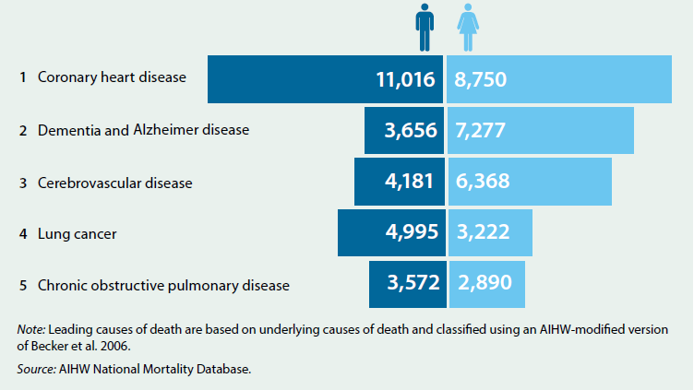
Background: Heart disease in Australia
Largest single cause of mortality and morbidity accounting for 19,800 deaths in 2013 (Australian Institute of Health and Welfare, 2014a )
In 2014–15, an estimated 643,000 Australian adults (3.6%) – 1 in 5 people have heart disease (Heart Foundation of Australia, 2017)
Rates of heart disease in people aged 75 and over, ten times higher than people aged 45–54 with commensurate costs (Australian Bureau of Statistics, 2013).
Figure 1 Leading causes of death, by sex, Australia 2013
Notes:
Large numbers – 1 in 5 adults have heart disease increasing with age

Slide 4
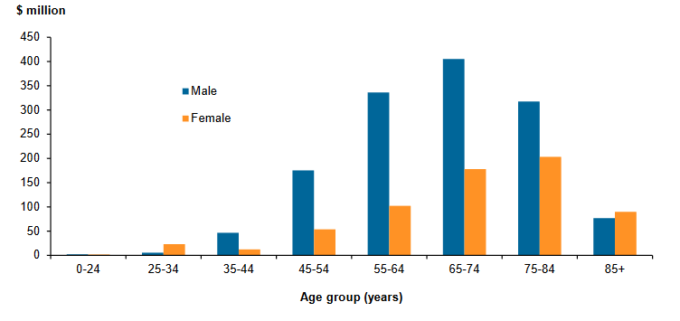
Background: Expenditure – coronary heart disease (CHD)
In 2008–09, total allocated health-care expenditure for CHD was 2,028 million ($1,365 million for males and $663 million for females)
AUSTRALIAN INSTITUTE OF HEALTH AND WELFARE. 2014(b).
Notes:
HD 2 billion – expenditure X 2 + for males, even though there is only an in the number of males with heart disease is only 11% than females

Slide 5
Background: Cardiac rehabilitation (CR)
Evidence based best practice for people with heart disease:
needs lifelong individual commitment with support from health services (National Heart Foundation of Australia, 2010, National Heart Foundation of Australia & Australian Cardiac Rehabilitation Association, 2004, Williams and Kaminsky, 2014)
Most common models include:
6 week facility based program, including exercise and education
home based - usually with telephone support
smart phone and internet based (NHF, 2010, Scalvini et al., 2013, Ski, 2015, Varnfield et al., 2014; Woodruffe et al., 2015)
Victorian participation rates: 30 – 45% (De Gruyter et al., 2014, Heart Foundation of Australia, 2017, Woodruffe et al., 2015)
Queensland – Quality initiative incentive funding showing much improved referral rates (QH, 2018)
International recommended rate 65% (Heart Foundation of Australia. 2017)
Notes:
No accurate referral rates available. Data base being developed by QH and it is anticipated that data will be available in July 2018.
Savings include health services and productivity losses e.g loss of work
Evidence that if people attend CR they Live longer live better. Attendance continues to be low.
We need to be clear about latest evidence and information on barriers, enablers and pathways to CR in rural and remote areas…..therefore an integrative review has been completed to provide this information.

Slide 6
Background: Expenditure – Why Cardiac rehabilitation?
Benefits:
Adults attending cardiac rehabilitation:
17% reduction in repeat heart attacks (myocardial infarction) after 12 months
47% reduction in mortality after 2 years.
12-23% improvement- quality of life expressed as disability adjusted life years.(DALYs)(De gruyter, E., Ford, E. & Stavreski, B. 2014).
Cost savings:
Estimated increase from current 30/45% to 65% = savings of $86.7 million per annum health care costs
Notes:
HD 2 billion – expenditure X 2 + for males, even though there is only an in the number of males with heart disease is only 11% than females

Slide 7
Background: Services and health in rural and remote areas of Australia
services sparse (Australian Institute of Health and Welfare, 2017, Wakerman et al., 2008)
high staff turnover and recruiting difficulties, resulting in inexperienced staff further compounding the problem (Birk et al., 2010)
people have poorer health status than those in urban areas (Australian Institute of Health and Welfare, 2014)
continuing gap in health status between First Peoples and other populations (Australian Institute of Health and Welfare, 2014, Ring et al., 2016).
Notes:
: services: few option and littles choice. Morbidity may be worse as people often move from rural to urban areas for better health care services

Slide 8
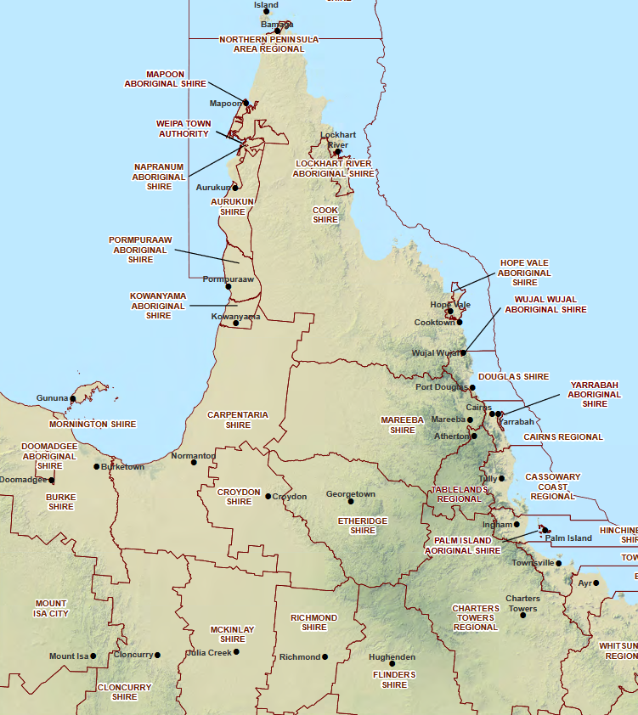
Mossman

Slide 9
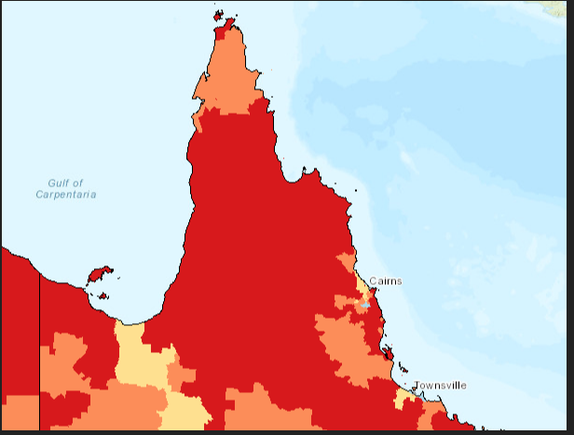
Socioeconomic indicator of advantage (SEIFA) Northern Queensland

Slide 10
Female heart disease hospital admissions 2011 - 16 Indigenous/non-Indigenous

Slide 11
Male heart disease hospital admissions 2011 - 16 Indigenous/non-Indigenous

Slide 12
Integrative Literature Review (IR)
Definition:
Evidenced based process for systematic analysis, critical review and synthesis of selected qualitative, quantitative and mixed method studies to facilitate future directions and perspectives.
Aim:
To identify barriers, enablers and pathways of referral and access to cardiac rehabilitation services for adults living in rural and remote areas of Australia
Notes:
To complete the picture we have done a systematic review of contemporary research studies to ensure we have a sound knowledge of availalbe information: aim

Slide 13
An integrative literature review: Cardiac rehabilitation services for adults living independently in rural and remote areas of Australia
Methods:
- Electronic data base searches
Plus:
reference lists and citations
Inclusion
cardiac rehabilitation in rural and remote areas of Australia and internationally
barriers, enablers and pathways to CR for all people
1st January 2007 - 31st December 2016, in English
peer reviewed
Exclusion
effectiveness of centre-based, home based and technology support programs
one component of CR e.g. exercise
clinical studies
studies not relevant to higher income countries
Notes:
.
Based on International Monetary Fund criteria: Australia in ten largest advanced economies in the world

Slide 14
An integrative literature review: Cardiac rehabilitation services for people living independently in rural and remote areas of Australia
Through a process of critical review and analysis identified:
5 Themes
1. Referral to CR to ensure post hospital information and access
low levels of referral (Kidby, 2016, De Gruyter et al., 2014, Heart Foundation of Australia, 2017, Woodruffe et al., 2015)
lack of eligibility criteria (Phillips, 2017; Watt, 2017)
post discharge follow-up & support (Hamilton , et al 2016).
2. Cultural and geographic factors necessitating alternate and flexible programs
poor geographic access (Australian Institute of Health and Welfare, 2017; Brual, et al 2012;, Fernandez 2010 & 2011)
travel costs (Fernandez et al., 2008, Scane et al., 2012, Shanmugasegaram et al., 2013)
inflexible programs: Content & hours (Jackson et al., 2012, Sangster et al., 2013, De Angelis et al., 2008)
3. Professional roles and influence
inadequate staffing and/or skills (Birk et al; 2010,Dimer, et al 2013; Jackson et al 2012)
doctors perceived as being ‘one-stop shop’ & poor inter-health service communication (Fernandez et al 2011)
Notes:
Enablers: Automatic referrals word of mouth recommendation and involvement of family and community

Slide 15
An integrative literature review: Cardiac rehabilitation services for people living independently in rural and remote areas of northern Queensland.
5 Themes
Findings by theme:
4. Knowing, valuing, psycho-social factors
perception of no benefit (patient and doctors) (Brual et al., 2012, De Angelis C et al., 2008)
services not culturally appropriate as per NHMRC Guidelines for CR for First Peoples (DiGiacomo L, et al 2010)
too old, too sick, too well (De Angelis, et al., 2008)
5. Financial Costs – personal and health services
travel, medication, health professional consultations, lack of funding for services(Fernandez et al., 2008 &2011, Scane et al., 2012, Shanmugasegaram et al., 2013).

Slide 16
An integrative literature review: Cardiac rehabilitation services for people living independently in rural and remote areas of Australia
Conclusions:
CR services are inflexible and lack a systematic policy driven approach
there is a need for:
greater flexibility with health professional/ management support
increased availability of alternative programs
standardised eligibility criteria
it is known that:
CR works to improve health status and reduce costs
too few people are referred and access services

Slide 17
An integrative literature review: Cardiac rehabilitation services for people living independently in rural and remote areas of Australia
Looking forward
We need to:
Close the gap between those eligible for CR, those who are referred and those who attend
How?
Investigate what happens when people are in hospital: CR, discharge & referral
Talk to people after they get home and find out what services were available and their level of support
Look for alternative models e.g:
Staff multi-skilling (with support)
Home based programs phone. video or personal support
Further utlisation of technology to be considered

Slide 18
How can cardiac rehabilitation for adults living in rural and remote areas of NQ be improved?

Slide 19
Advisors – A/Prof. Richard Franklin; A/Prof. Ruth Barker; Prof. Ian Ring Advisor mentor – Prof Peter Leggat College of Public Health, Medical and Veterinary Sciences Mentors, Cultural and Research: Aboriginal and Torres Strait Islander Health Leadership Advisory Council (ATSIHLAC) (Townsville and Cairns) JCU Aboriginal and Torres Strait Islander Ethics Advisers (Townsville)
Acknowledgements

Slide 20
References
Integrative review
AHUJA, S. S., CLARK, S., MORAHAN, E. M., ONO, M., MULLIGAN, H. & HALE, L. 2013. The journey to recovery: experiences and perceptions of individuals following stroke. New Zealand Journal of Physiotherapy [Online], 41. Available: http://physiotherapy.org.nz/assets/Professionaldev/Journal/2013-March/2013MarchMLRoberts.pdf [Accessed 22 August 2017].
BRUAL, J., GRAVELY, S., SUSKIN, N., STEWART, D. E. & GRACE, S. L. 2012. The role of clinical and geographic factors in the use of hospital versus home-based cardiac rehabilitation. International Journal of Rehabilitation Research [Online].3
DE ANGELIS C, BUNKER S & SCHOO, A. 2008. Exploring the barriers and enablers to attendance at rural cardiac rehabilitation programs. Australian Journal of Rural Health [Online], 16. [Accessed 12 December 2016].
DAVEY, M., MOORE, W. & WALTERS, J. 2014. Tasmanian Aborigines step up to health: Evaluation of a cardiopulmonary rehabilitation and secondary prevention program. BMC Health Services Research [Online], 14.
DIGIACOMO, M., DAVIDSON, P. M., TAYLOR, K. P., SMITH, J. S., LYN DIMER, E. N., ALI, M., WOOD, M. M., LEAHY, T. G. & THOMPSON, S. C. 2010. Health information system linkage and coordination are critical for increasing access to secondary prevention in Aboriginal health: A qualitative study. Quality in Primary Care [Online], 18. Available: https://hdl.handle.net/20.500.11937/32805.
KIDBY, K. 2016. RE: Principal Project Officer, Healthcare Improvement Unit, Quality Improvement Program. Type to FIELD, P.
DIMER, L., DOWLING, T., JONES, J., CHEETHAM, C., THOMAS, T., SMITH, J., MCMANUS, A., MAIORANA, J. Build it and they will come: Outcomes from a successful cardiac rehabilitation program at an Aboriginal Medical Service. Aust Health Rev. 2013;37(1):79-82. doi: 10.1071/AH11122.
FERNANDEZ, R., DAVIDSON, P., GRIFFITHS, R. & SALAMONSON, Y. 2008. Cardiac rehabilitation coordinators' perceptions of patient-related barriers to implementing cardiac evidence-based guidelines. Journal of Cardiovascular Nursing [Online], 23. [Accessed 16 December 2017].
FERNANDEZ, R., DAVIDSON, P., GRIFFITHS, R. & SALAMONSON, Y. 2010. Overcoming barriers to guideline implementation: The case of cardiac rehabilitation. Quality and Safety in Health Care [Online], 19.
FERNANDEZ, R., DAVIDSON, P., GRIFFITHS, R. & SALAMONSON, Y. 2011. Improving cardiac rehabilitation services - Challenges for cardiac rehabilitation coordinators. European Journal of Cardiovascular Nursing [Online], 10.
HAMILTON S. MILLS B. MCRAE S..THOMPSON S. 2016. Cardiac Rehabilitation for Aboriginal and Torres Strait Islander people in Western Australia,. BMC Cardiovascular Disorders [Online], 16.
JACKSON, A. M., MCKINSTRY, B., GREGORY, S. & AMOS, A. 2012. A qualitative study exploring why people do not participate in cardiac rehabilitation and coronary heart disease self-help groups, and their rehabilitation experience without these resources. Primary Health Care Research and Development [Online], 13.
MEILLIER, L., NIELSEN, K., LARSEN, F., FINN, B. & MOGENS, L. 2012. Socially differentiated cardiac rehabilitation: Can we improve referral, attendance and adherence among patients with first myocardial infarction? Scandinavian journal of public health [Online].

Slide 21
Integrative review
NATIONAL HEART FOUNDATION OF AUSTRALIA. 2017. Cardiac rehabilitation resources for health professionals [Online]. Available: https://www.heartfoundation.org.au/for-professionals/clinical-information/cardiac-rehabilitation-for-health-professionals [Accessed 1st February 2017].
THOMPSON, S.C, DIGIACOMO, M.L, SMITH, J.S, et al. Are the processes recommended by the NHMRC for improving Cardiac Rehabilitation (CR) for Aboriginal and Torres Strait Islander people being implemented?: An assessment of CR Services across Western Australia. Australia and New Zealand Health Policy. 2009;6(1). doi: 10.1186/1743-8462-6-29. REDFERN J. BRIFFA T. ELLIS E. FREEDMAN S. 2008. Patient-centered modular secondary prevention following acute coronary syndrome: A randomized controlled trial. Journal of Cardiopulmonary Rehabilitation and Prevention [Online], 28. Available: doi=10.1097%2f01.HCR.0000314204.86805.13&partnerID=40&md5=44662e1d8b38c104770eb0d4a4d3ab3e.
SANGSTER, J., FURBER, S., PHONGSAVAN, P., ALLMAN-FARINELLI, M., REDFERN, J. & BAUMAN, A. 2013. Where you live matters: Challenges and opportunities to address the urban-rural divide through innovative secondary cardiac rehabilitation programs. Australian Journal of Rural Health [Online], 21.
SHANMUGASEGARAM, S., OH, P., REID, R. D., MCCUMBER, T. & GRACE, S. L. 2013. A comparison of barriers to use of home- versus site-based cardiac rehabilitation. J Cardiopulm Rehabil Prev [Online], 33. [Accessed Sep-Oct].
WHITE, J. H., MAGIN, P. & POLLACK, M. R. P. 2009. Stroke Patients' Experience with the Australian Health System: A Qualitative Study. Canadian Journal of Occupational Therapy [Online], 76. Available: http://dx.doi.org/10.1177/000841740907600205 [Accessed 22 August 2017].
WOODRUFFE, S., NEUBECK, L., CLARK, R., GRAY, K., FERRY, C., FINAN, J., SANDERSON, S. & BRIFFA, T. 2015. Australian Cardiovascular Health and Rehabilitation Association (ACRA) Core Components of Cardiovascular Disease Secondary Prevention and Cardiac Rehabilitation 2014. Heart, Lung & Circulation.

Slide 22
References: General
AUSTRALIAN BUREAU OF STATISTICS. 2016. Australian Statistical Geography Standards [Online]. Canberra, Australia: ABS. Available: http://www.abs.gov.au/geography [Accessed 15th May 2017].
AUSTRALIAN BUREAU OF STATISTICS. 2013. Australian Health Survey: health service usage and health related actions, 2011–12 [Online]. Canberra: ABS. Available: https://www.aihw.gov.au/getmedia/9844cefb-7745-4dd8-9ee2-f4d1c3d6a727/19787-AH16.pdf.aspx?inline=true [Accessed 22nd Nov 2017].
AUSTRALIAN INSTITUTE OF HEALTH AND WELFARE. 2016. Australia’s health 2016 [Online]. Canberra: ACT: AIHW. Available: https://www.aihw.gov.au/getmedia/2a44d779-bff1-4302-b129-f515e7b07842/ah16-3-5-coronary-heart-disease.pdf.aspx [Accessed 18 January 2018 2018].
AUSTRALIAN INSTITUTE OF HEALTH AND WELFARE. 2014(a). Trends in coronary heart disease mortality: age groups and populations [Online]. Available: www.aihw.gov.au/publication-detail/?id=60129547046 [Accessed 22 August 2016].
AUSTRALIAN INSTITUTE OF HEALTH AND WELFARE. 2014(b). Health-care expenditure on cardiovascular diseases 2008–09 [Online]. Available: http://www.aihw.gov.au/WorkArea/DownloadAsset.aspx?id=60129546379. [Accessed 11 March 2017].
AUSTRALIAN INSTITUTE OF HEALTH AND WELFARE. 2017. Impact of rurality on health status [Online]. Australian Institute of Health and Welfare. Available: http://www.aihw.gov.au/rural-health-impact-of-rurality/ [Accessed 21 May 2017].
BIRK, M., MILLS, J., FRANCIS, K., COYLE, M. & JONES, J. 2010. Models of health service delivery in remote or isolated areas of Queensland: a multiple case study. Australian Journal of Advanced Nursing [Online], 19. Available: http://www.ajan.com.au/Vol28/28-1_Birks.pdf [Accessed August 19th 2016].
BAXTER, P. & JACK, S. 2008 Qualitative Case Study Methodology: Study Design and Implementation for Novice Researchers. The Qualitative Report [Online]. Available :http://nsuworks.nova.edu/tqr/vol13/iss4/2
BENNETT, G. R. July 2016 2016. RE: Manager COACH Program. Type to P, F.
DE GRUYTER, E., FORD, G. & STAVRESKI, B. 2014. Economic and Social Impact of Increasing Uptake of Cardiac Rehabilitation Services 2013; A Cost Benefit Analysis. Heart, Lung and Circulation, 25, 175-183.
GRANT, M. J. & BOOTH, A. 2009. A typology of reviews: an analysis of 14 review types and associated methodologies. Health Information & Libraries Journal [Online], 26.
HEART FOUNDATION OF AUSTRALIA. 2017. Cardiac rehabilitation factsheet: For health service planners, program directors and clinical staff [Online]. Melbourne, Vic. Australia. Available: https://www.heartfoundation.org.au/images/uploads/publications/HF.Cardiac_Rehab_Factsheet_WEBHR.pdf [Accessed 30 August 2017].
IBM. 2017. IBM SPSS Statistics [Online]. Armonk, New York, USA.: IBM. Available: www.ibm.com/us-en/marketplace/spss-statistics [Accessed 31st May 2017].
JOHNSON, R. B., ONWUEGBUZIE, A. J. & TURNER, L. A. 2007. Toward a Definition of Mixed Methods Research. Journal of Mixed Methods Research [Online], 1. Available: http://dx.doi.org/10.1177/1558689806298224
KEMMIS, S. & MCTAGGART, R. 2005. Participatory action research: communicative action and the public sphere. In: DENZIN, N. K. & LINCOLN, Y. S. (eds.) The Sage handbook of qualitative research. 3rd ed. Thousand Oaks, CA: Sage. /original/qualguide.pdf [Accessed 10th January 2017].

Slide 23
References: General
MERLIN, T., WESTON, A. & TOOHER, R. 2005. Re-assessing and revising "levels of evidence" in the critical appraisal process. Corroboree: Melbourne. XIII Cochrane Colloquium, 22–26 October 2005. Melbourne: Australasian Cochrane Centre.
LEE, P. 2006a. Understanding and critiquing qualitative research papers. Nursing times, 102, 30-32.
LEE, P. 2006b. Understanding and critiquing quantitative research papers. Nursing times, 102, 28-30.
LETTS, L., WILKINS, S., LAW, M., STEWART, D., BOSCH, J. & WESTMORLAND, M. 2007. Guidelines for Critical Review Form: Qualitative Studies (Version 2.0) [Online]. Hamilton, Canada. Available: https://www.canchild.ca/system/tenon/assets/attachments/000/000/360/original/qualguide.pdf [Accessed 10th January 2017].
MOHER, D., LIBERATI, A., TETZLAFF, J. & ALTMAN, D. G. 2009. Preferred reporting items for systematic reviews and meta-analyses: the PRISMA statement [Online]. Available: http://annals.org/aim/article/744664/preferred-reporting-items-systematic-reviews-meta-analyses-prisma-statement [Accessed 13 December 2016].
NATIONAL HEART FOUNDATION OF AUSTRALIA. 2010. Secondary prevention of cardiovascular disease [Online]. Available: https://www.heartfoundation.org.au/images/uploads/publications/Secondary-Prevention-of-cardiovascular-disease.pdf [Accessed August 22 2016].
NATIONAL HEART FOUNDATION OF AUSTRALIA & AUSTRALIAN CARDIAC REHABILITATION ASSOCIATION. 2004. Recommended Framework for Cardiac Rehabilitation ’04 [Online]. National Heart Foundation of Australia. Available: http://heartfoundation.org.au/images/uploads/publications/Recommended-framework.pdf. [Accessed 22 August 2016].
ONWUEGBUZIE A & LEECH N. 2005. On Becoming a Pragmatic Researcher: The Importance of Combining Quantitative and Qualitative Research Methodologies. International Journal of Social Research Methodology [Online], 8.
NATIONAL HEART FOUNDATION OF AUSTRALIA. 2010. Secondary prevention of cardiovascular disease [Online]. Available: https://www.heartfoundation.org.au/images/uploads/publications/Secondary-Prevention-of-cardiovascular-disease.pdf [Accessed August 22 2016].
NATIONAL HEART FOUNDATION OF AUSTRALIA & AUSTRALIAN CARDIAC REHABILITATION ASSOCIATION. 2004. Recommended Framework for Cardiac Rehabilitation ’04 [Online]. National Heart Foundation of Australia. Available: http://heartfoundation.org.au/images/uploads/publications/Recommended-framework.pdf. [Accessed 22 August 2016].
PATTON, M. Q. 1990. Qualitative Evaluation and Research Methods, London, United Kingdom, Sage Publications.
PHILLIPS, S. 2017. RE: CR eligibility criteria. Type to FIELD, P.
QUEENSLAND HEALTH. 2017. Queensland Hospital Admitted Patient Data Collection: 2016 - 2017 [Online]. Queensland: State of Queensland (Queensland Health). Available: https://www.health.qld.gov.au/hsu/collections/qhapdc [Accessed 14 April 2017].
QSR INTERNATIONAL. 2017. What is NVivo? [Online]. Available: http://www.qsrinternational.com/what-is-nvivo [Accessed 29 March 2017].
RING, I., DIXON, T., LOVETT, R. & AL-YAMAN, F. 2016. Are Indigenous mortality gaps closing: how to tell, and when? Med J Aust [Online], 205. [Accessed Jul 04].
SCOTT, I. A., LINDSAY, K. A. & HARDEN., H. E. 2003. Utilisation of outpatient cardiac rehabilitation in Queensland. 179 (7) Available: https://www.mja.com.au/journal/2003/179/7/utilisation-outpatient-cardiac-rehabilitation-queensland [Accessed 27th August 2017].
SECHREST, L. & SIDANI, S. 1995. Quantitative and qualitative methods. Evaluation and Program Planning [Online], 18. Available: http://www.sciencedirect.com/science/article/pii/014971899400051X [Accessed 2 Jan 2017].
STATISTICS SOLUTIONS. 2013. ANOVA [WWW Document]. [Online]. Available: http://www.statisticssolutions.com/academic-solutions/resources/directory-of-statistical-analyses/anova/ [Accessed 26th May 2017].
TORRACO, R. J. 2005. Writing integrative literature reviews: Guidelines and examples. Human resource development review [Online], 4.

Slide 24
References: General
WAKERMAN, J., HUMPHREYS, J. S., WELLS, R., KUIPERS, P., ENTWISTLE, P. & JONES, J. 2008. Primary health care delivery models in rural and remote Australia–a systematic review. BMC Health Services Research [Online], 8.
WAPAU, H. J., D. HAPEA, E. MEIN, J. CURNOW, V. MCDONALD, M. 2016. Coming to Town: Reaching agreement on a thorny issue Cairns: Apunipima.
WHITTEMORE R & KNAFL K. 2005. The integrative review: updated methodology. Journal of Advanced Nursing [Online], 52. [Accessed 3 March 2017].
WILLIAMS, M. & KAMINSKY, L. 2014. Healthy Lifestyle Medicine in the Traditional Healthcare Environment: Primary Care and Cardiac Rehabilitation,. Progress in Cardiovascular Diseases, 59, 448-454.
WORLD HEALTH ORGANISATION. 1986. Ottawa Charter for Health Promotion [Online]. Ottawa. Available: http://www.who.int/healthpromotion/conferences/previous/ottawa/en/index4.html [Accessed 27th August 2017 2017].
WORLD HEALTH ORGANISATION. 2016. International Statistical Classification of Diseases and Related Health Problems 10th Revision (ICD-10) [Online]. Available: http://apps.who.int/classifications/icd10/browse/2016/en#/IX [Accessed 10th May 2017].

