Slide 1
Heart Foundation My heart, my life Support Program

Slide 2
Our research has identified:
1 in 2 patients either don’t return to work or return in a reduced capacity
1 in 3 stop taking their medications as directed
1in 5 failed to regularly check their BP or Cholesterol
< 50% have succeeded in creasing their level of physical activity post heart attack
<1 in 4 eligible patients attend cardiac rehabilitation
Notes:
Many face difficulties with every day activities/functions
1 in 5 have failed to regularly check their blood pressure or cholesterol levels
< 50% have succeeded in increasing their level of physical activity post heart attack
1 in 2 of respondents who smoked prior to their heart attack continued to smoke

Slide 3
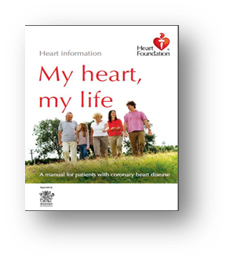
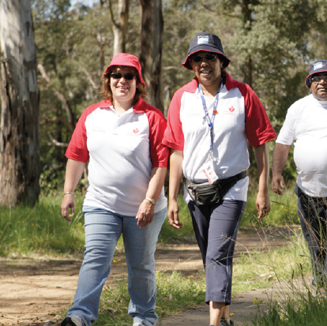
Method
1. A copy of My heart, my life
2. Heart health emails – 7 over 6 months
3. A phone call from Heart Foundation Helpline health professional staff.
Notes:
These stats were the impetus to re design our offerings and help to fill the supply gaps of MHML in Qld Hospitals
MHML 3 year trial from 2014-2017 with 43 public and private hospitals participating.
The program operated as patient support trial where they could sign up to receive a copy of MHML regular email communication and an outbound call from HF Helpline
helped create an engagement pathway and create a database of highly relevant people to the Heart Foundation
establish a consumer centric program and a sustainable distribution of MHML and consumer engagement model.

Slide 4
Evaluation Three final evaluations have been completed: • Patient survey • Health Professional survey • Original pre and post survey

Slide 5
Patient outcomes
43 hospitals
7734 patients (5308 male, 2200 female, 226 DNA)
490 carers
Patient/carer survey (N = 916) showed:
69% of patients found MHML most useful
20% found Helpline’s call most useful
69% were very confident or confident in reducing their risk factors
58% were confident recognising a future heart attack
79% were referred to CR, with 68% reporting attendance.
Notes:
43 hospitals, 7734 patients (5308 male, 2200 female, 226 DNA) and 490 carers participated.
A patient/carer survey (N = 916) showed:
69% of patients found MHML most useful
20% found Helpline’s call most useful
69% were very confident or confident in reducing their risk factors
58% were confident recognising a future heart attack
79% were referred to CR, with 68% reporting attendance.

Slide 6
Feedback from patients:
"A very useful book to take home from hospital”
"A vital service providing professional information to clients“
"A worthwhile service and education program“
"A very interesting book full of information on how to keep heart healthy and eat a balanced diet".
Notes:
"A vital service providing professional information to clients“
"A worthwhile service and education program“
"A very interesting book full of information on how to keep heart healthy and eat a balanced diet".

Slide 7
Health professional feedback
HPs were asked about the main reason they signed up to the MHML SP included:
“Excellent resource book for patient education”
“Support for patient education, Excellent resource to compliment out-patient education”
To ensure patient information given to patients is consistent and evidenced based
The information is patient friendly

Slide 8
Equity impact
This trial targeted regional and remote areas where CR services and resource capacity was limited
116 Aboriginal and Torres Strait Islander peoples participated
194 people who spoke a language other than English participated in the program.
Notes:
This trial targeted regional and remote areas where CR services and resource capacity was limited (i.e. hospitals with annual ACS admissions <100).
Even though the program didn’t specifically target Aboriginal and Torres Strait Islander People and CALD people,116 Aboriginal and Torres Strait Islander peoples and 194 people who spoke a language other than English participated in the program.
The program trial has laid the foundations to add additional elements, such as SMS, and apply more integrated information and support patient engagement models across other CVD.

Slide 9
Implications for practice
Providing an integrated model of Heart Foundation information and support services is better for:
-hospitals,
-patients/carers
-and HF
This method allowed us to know exactly who is receiving our services and to develop a relationship with them.
Notes:
Providing an integrated model of Heart Foundation information and support services is better for hospitals, patients/carers and Heart Foundation.
This method allowed us to know exactly who is receiving our services and to develop a relationship with them.

Slide 10
Conclusion
The MHMLSP improves engagement with patients following their hospital admission and is a sustainable distribution model.

