Slide 1
Living Well with SCAD
A Novel Cardiac Rehabilitation Programme
Christchurch Cardiac Rehabilitation Team
Notes:
In Christchurch we are seeing an increasing number of people with SCAD related MIs. 68 over a 6 year period 85% of whom were women. SCAD patients are a very different demographic from those with an atherosclerotic MI. They are generally young, fit, healthy females with little or no risk factors for CAD.

Slide 2
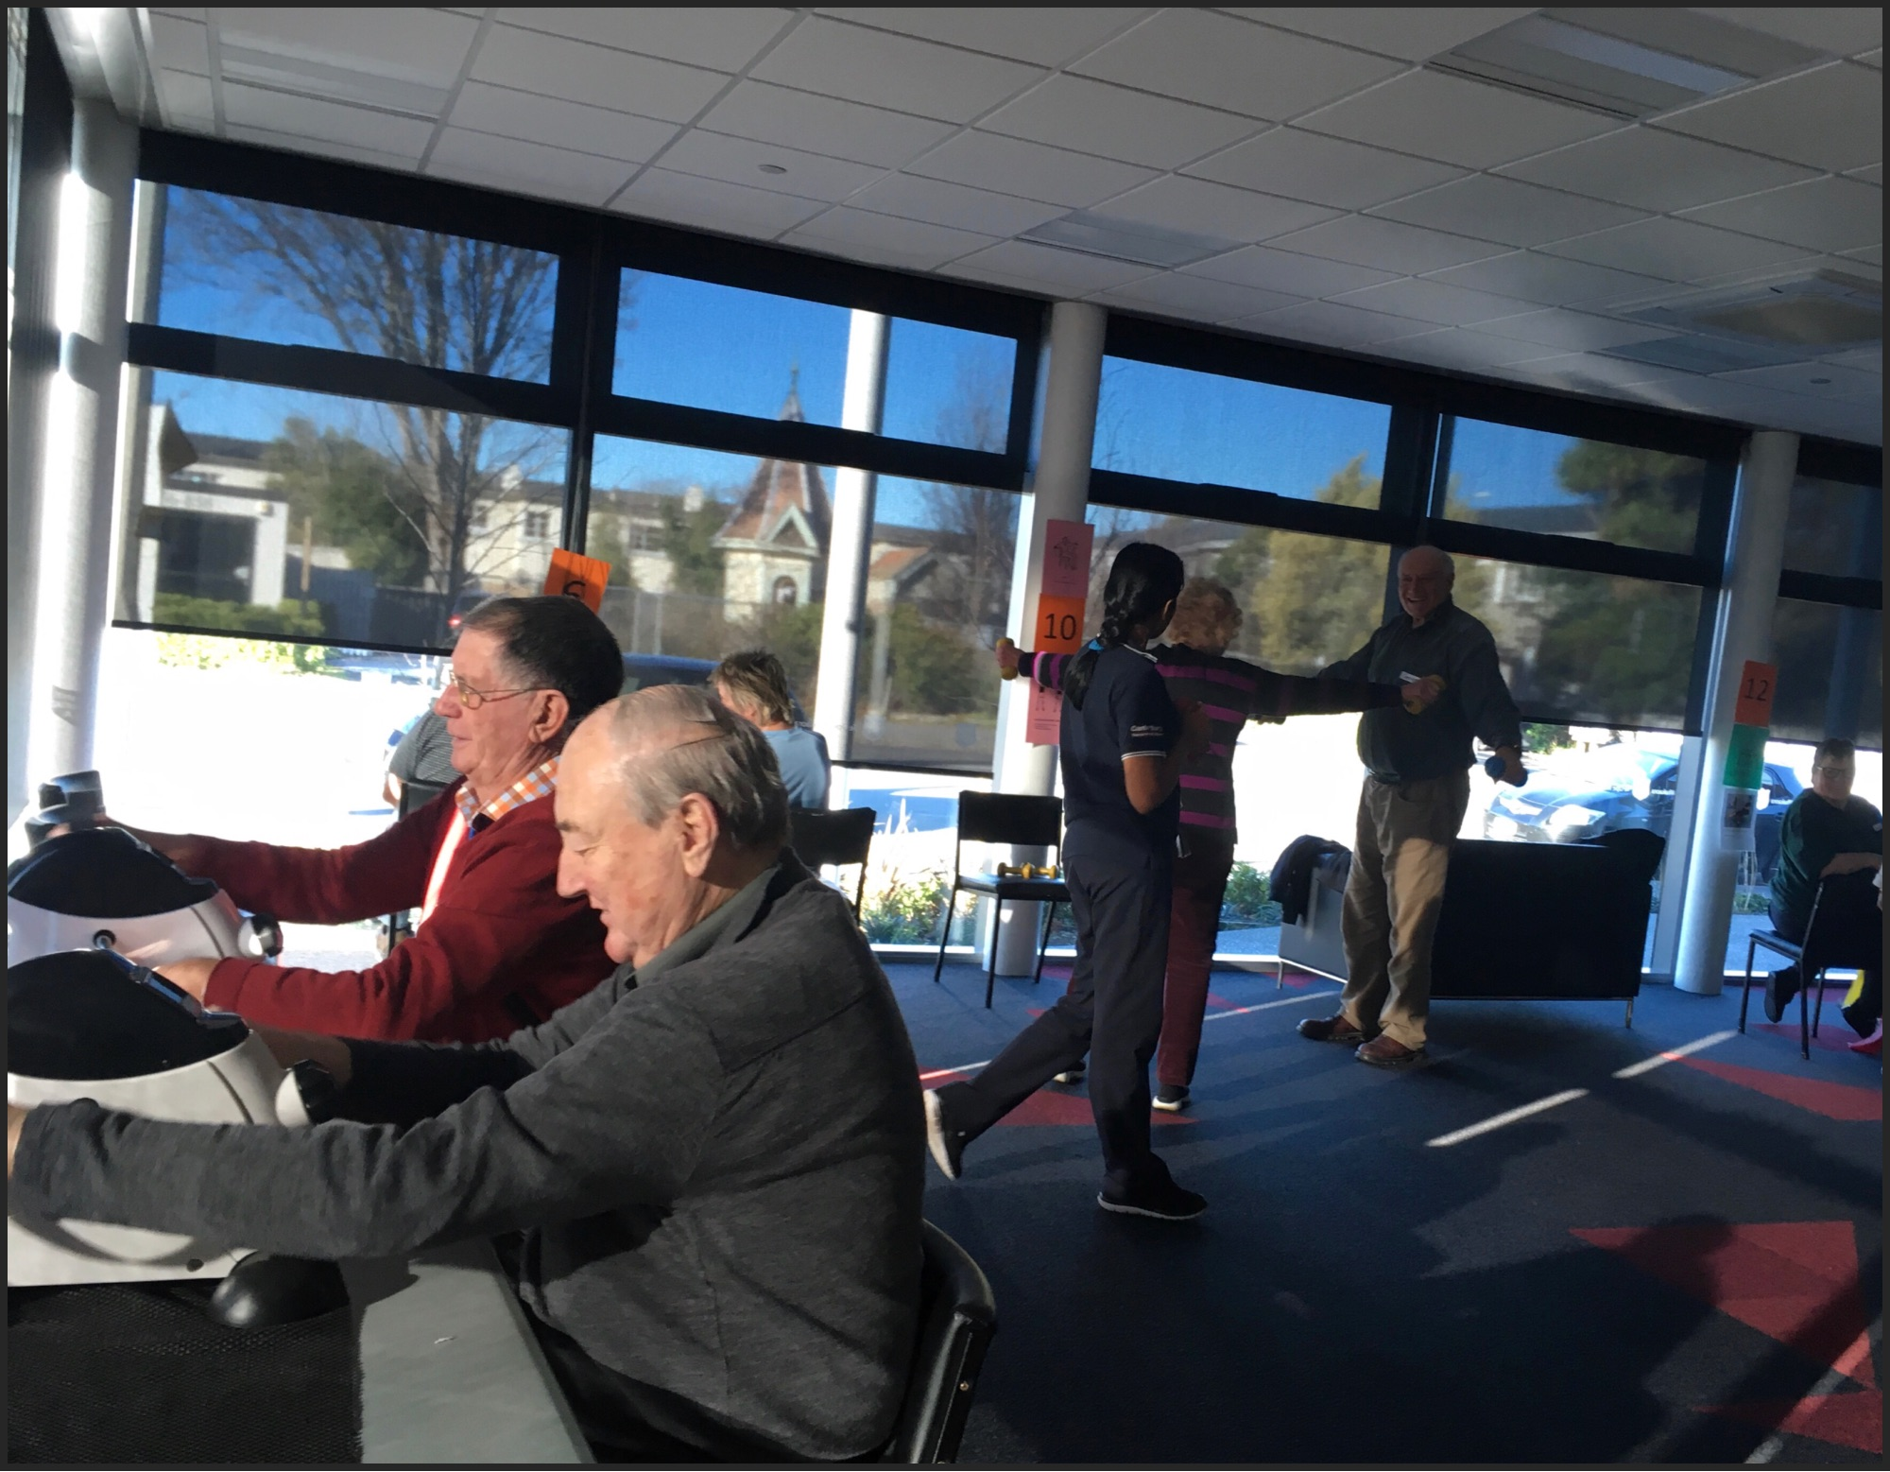
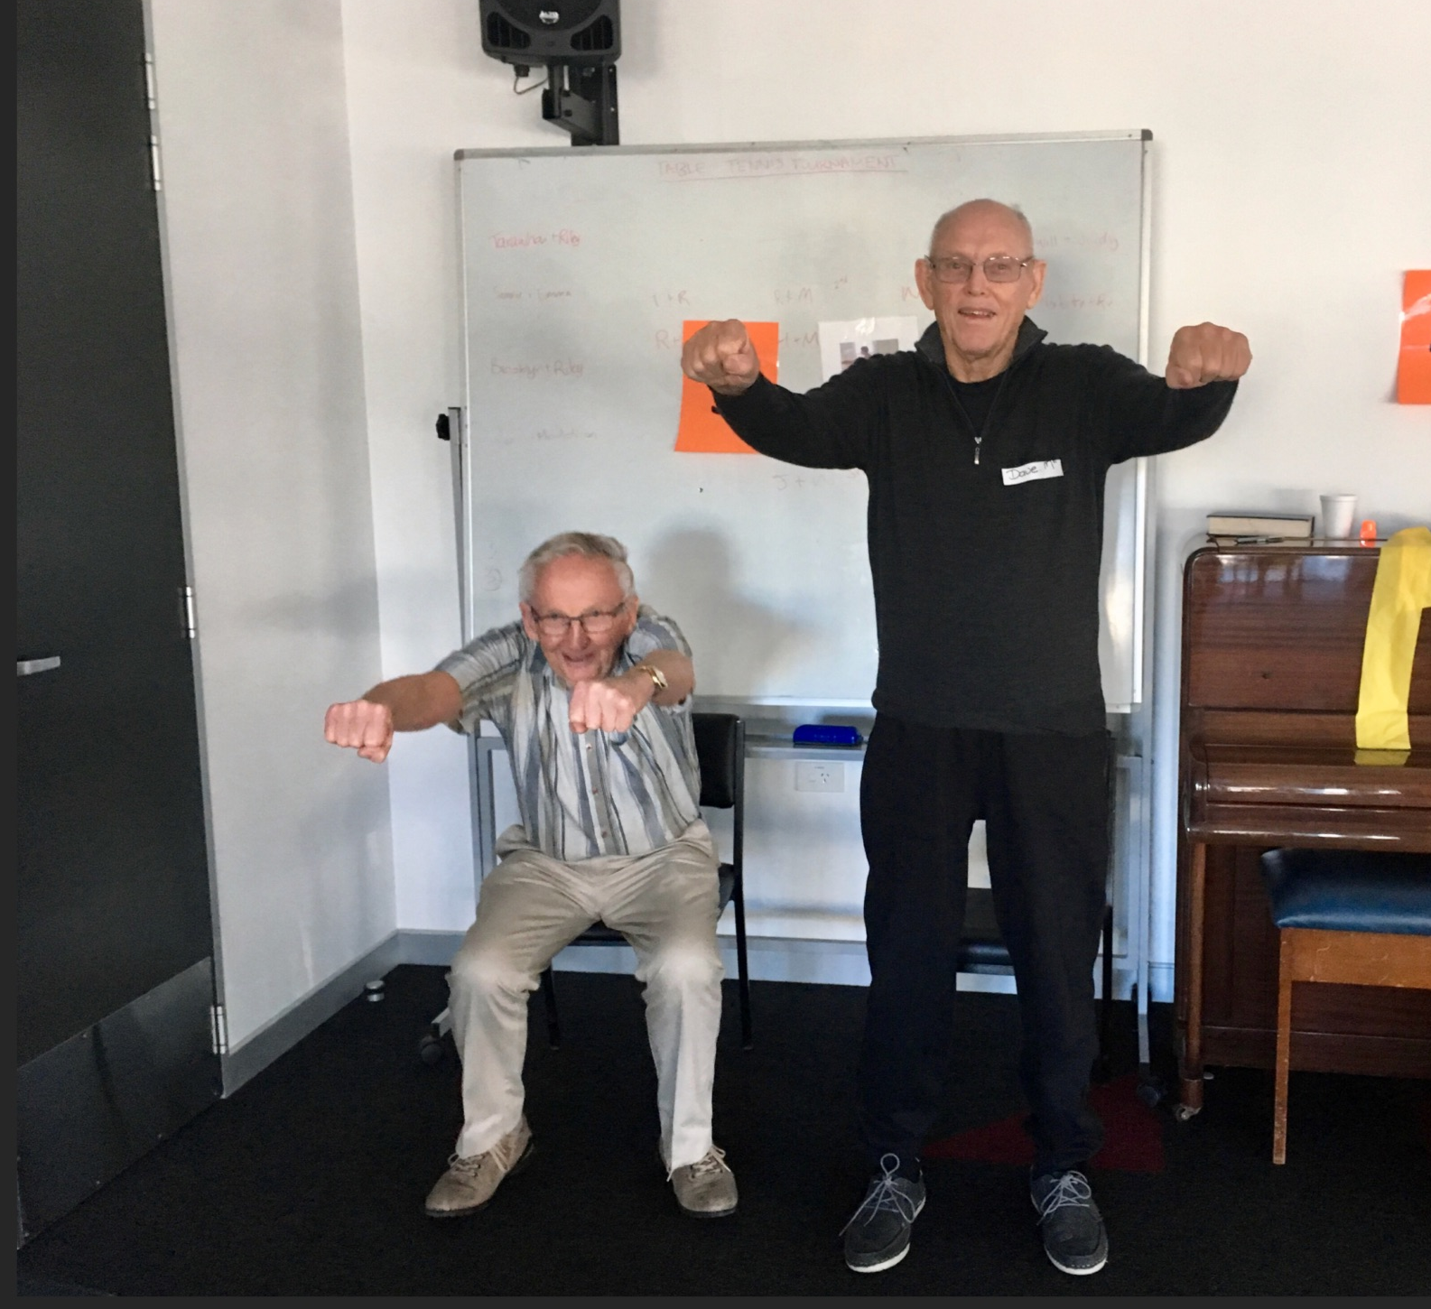
Our Existing Phase II Programme
Six weekly, daytime sessions
Focus on identifying and modifying risk factors for CAD
Included 30 min exercise sessions
SCAD patients NOT attending
Notes:
Our existing phase II programme was not meeting there needs. To start with, they couldn’t attend during the day, because a lot of them were busy working mothers. A lot of them were multisport athletes. And they generally didn’t have risk factors for CAD

Slide 3
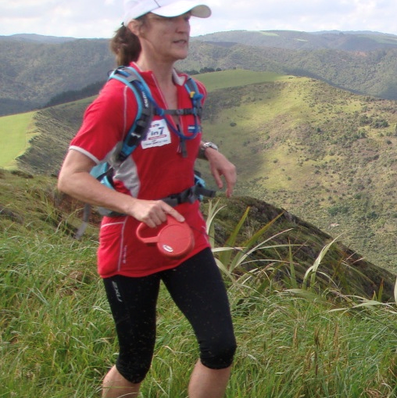
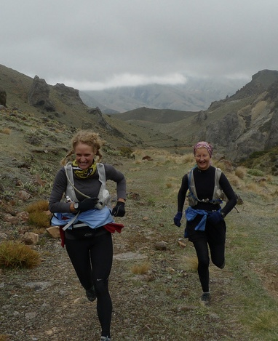
Living Well with SCAD Seminars
ZERO budget
Initial small group appointments with Nurse and Physio
Evening Session 1:
Cardiologist – Treatments, management, latest research and Q&A.
Nurse Specialist – General discussion about patients’ experience
Evening Session 2:
Nutritionist – Eating well for good health.
Clinical Psychologist - Wellness and wellbeing.
Invited recent SCAD patients and their supporters
(from the previous 18 months)
Notes:
So we developed a dedicated CR programme. Problem – we had to do this within our existing budget. We had initial one on one sessions with physio and Nurse soon after there event. We had to hold the sessions in the evenings to enable them to attend. We invited all the patients we knew of over the last 18 month period. Of the 30 pts we invited, we had 23 attend the first session. They were very keen to attend

Slide 4
What we learnt
Where to from here
Overwhelmingly positive feedback.
Real thirst for information and exercise guidelines
More time needed for discussion amongst SCAD survivors
More time needed for psychologist – sleep and stress management
A definite need for a SCAD specific rehab programme
Online support groups very important
We have achieved a slight increase in budget, allowing us to hire a more suitable venue
Spread out over 3 evening sessions, allowing more time for each speaker and for discussion
Aim to run the programme 3 times a year to meet demand
Encourage participation in research and online support groups so we can learn more about this condition

Slide 5
Excerpt from letter from Clinical Psychologist
“she found the SCAD series of talks invaluable, especially in terms of overcoming the fear of death, acceptance, and shifting her focus to wellness moving forward. She said she felt better equipped to learn to feel more in control, more confident and to desensitise herself to re-integrate back into normal living.”
Notes:
Finally, This is a statement about a lady in her late forties we referred to a psychologist because prior to her SCAD event, she had been very outgoing, working fulltime, keen horse rider and generally always on the go and all this stopped after her MI

