Slide 1
After Hours Cardiac Rehabilitation
Princess Alexandra Hospital
Meeting the needs of our younger patients
Emma Mcglynn
Mary Boyde, Robyn Peters, Ben Shea, Sharyn Furze, Rita Hwang

Slide 2
Background
Cardiovascular Disease (CVD) is the leading cause of death in Australia¹
1/4 people in Australia and New Zealand experience a repeat cardiac event post discharge^{2,3}
Repeat cardiac events are more likely to be fatal as compared to initial event⁴
1. Australian Bureau of Statistics 2017, Causes of Death Australia 2016, 2. Aliprandi-Costa et al., 2011 Med J Aust 3. Chew et al, 2008, MJA 4. Briffa et al, 2011, Population Trends of Recurrent Coronary Heart Disease Event Rates Remain High. Circulation
Notes:
Cardiovascular disease in the leading cause of death for Australians. Despite the known benefits of cardiac rehabilitation on outcomes for the post ACS patient and its ongoing inclusion in clinical guidelines as gold standard care post an ACS event uptake of cardiac rehabilitation programs remain low, estimated to be between 10-30%. It is conservatively estimated that one in four patients who have had and myocardial infarction will have a repeat ACS event.

Slide 3
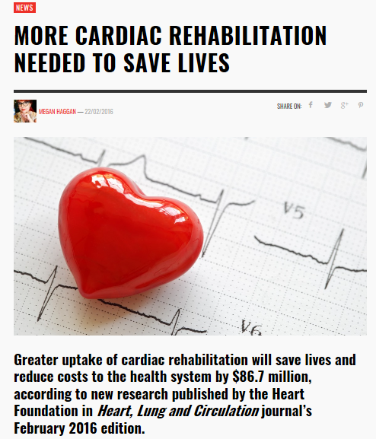
Background
Cardiac rehabilitation(CR) improves clinical outcomes⁵ however uptake continues to be poor in Australia,10-30%⁶
Flexible programs are proposed as a strategy to increase uptake^{6,7}
5. National Heart Foundation of Australia & Cardiac Society of Australia and New Zealand: Australian Clinical Guidelines ACS 2016, Heart Lung and Circulation 6. Clark et al., 2013, European Journal of Preventive Cardiology 7. National Heart Foundation, 2014, Cardiac Rehabilitation Advocacy Strategy, 2013-2017
Notes:
These repeat ACS events are more likely to be fatal as compared to an initial ACS event. As cardiac rehabilitation programs reduce the risk of repeat myocardial infarction, improve quality
of life, cardiovascular risk factors and survival. A 2013 systematic review by Clark of Alternate models of cardiac rehabilitation suggested creativity and flexibility in the model of cardiac rehabilitation offered to patients to improve uptake.

Slide 4
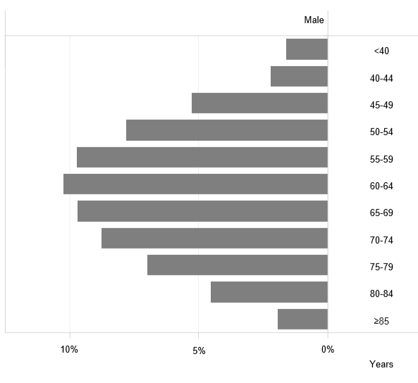
Retirement Age
2016 Male NSTEMI Cases
The Household, Income and Labour Dynamics in Australia (HILDA) Survey, 2017, Melbourne Institute Applied Economic & Social Research pages 65-66
Queensland Cardiac Outcomes Registry Annual Report 2016, State-wide Cardiac Clinical Network pages 96-98

Slide 5
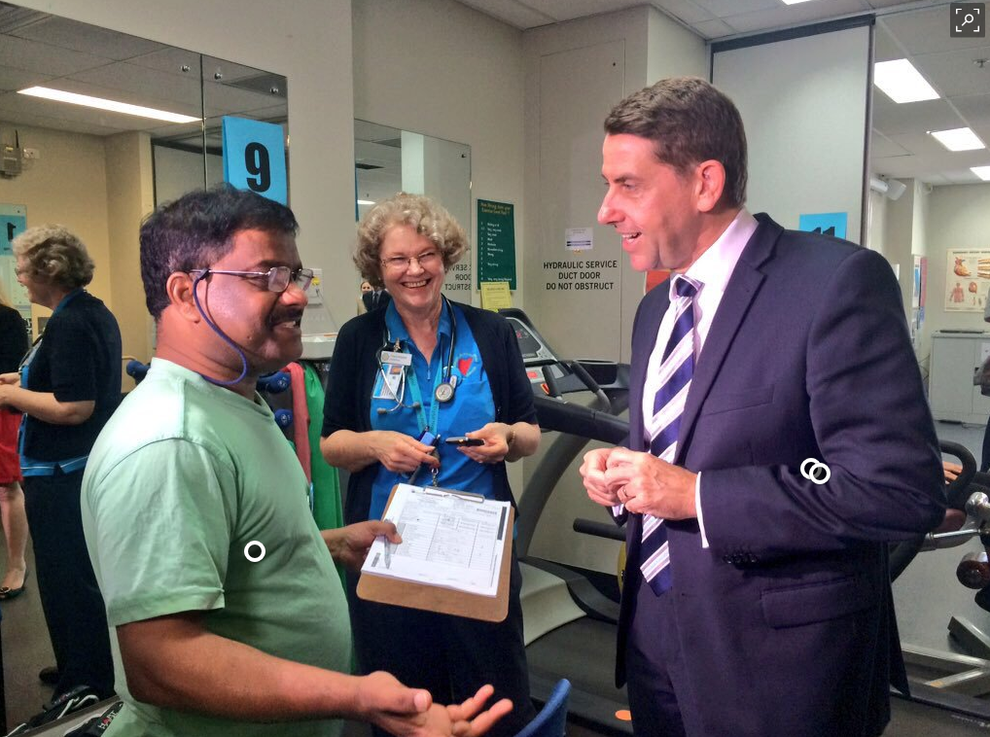
Government Funding
QLD Government announces funding to boost CR participation 2015
Notes:
Within our service we were receiving growing amounts of requests from our younger patients about an after hours or weekend program. PAH program (at the time) operated twice a week for 4 weeks within business hours. In 2015 the Queensland government committed $5 million dollars Statewide to increase cardiac rehabilitation participation known to most Queensland CR services as QIP. Metro south cardiac rehabilitation services then establish a steering committee to assist in the direction of funds. Funding was used within metrosouth for various alternate models of cardiac rehabilitation including a mobile phone app, a telehealth program and the after hours program.

Slide 6
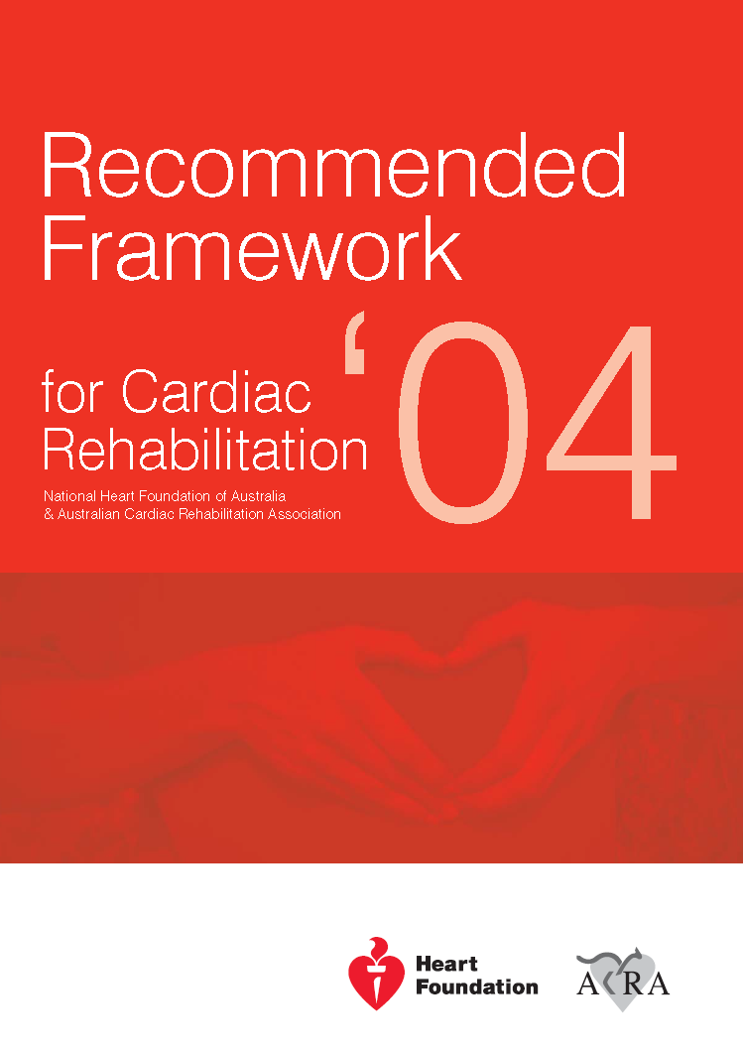
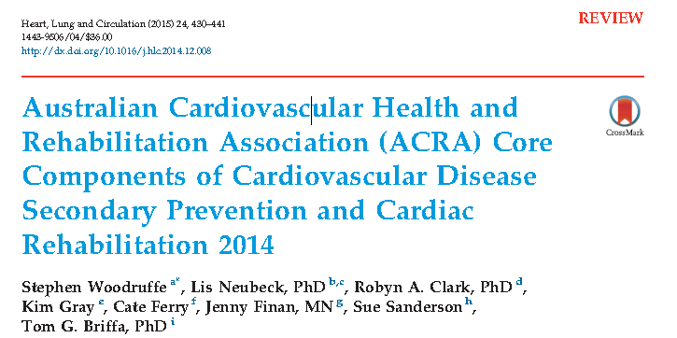
Aim
To introduce an evidence-based cardiac rehabilitation program operating outside of business hours
Notes:
With the funding we began the investigatory and implemntary processes associated with a new model of care.
Our aim was to introduce an evidence-based cardiac rehabilitation program operating outside of business hours.

Slide 7
Methods
Pilot study
Exercise and education
Once a week program for 8 weeks, 4-6pm
Data collected April 2017- Jan 2018
Participants attended program April-Nov 2017
Class size limited to 10 patient per session
Baseline
Week 0
Complete CR
Week 8
Follow-up Ax
Week 12
Notes:
The program was started as a trial with a pilot study.
The program included exercise and education was run weekly for 8 weeks. As opposed to our usual care program which was run twice weekly for 4 weeks.
Functional and clinical data was collected at initial assessment 2-4 weeks post discharge from acute admission.
Final data was collected 12 weeks post the initial assessment.
Although data collection continued until early January, patients attended and completed the exercise and education program between April and November of 2017.
Class sizes were capped to 10 patients per class, the total number of patients able to participate in this pilot would have been 40

Slide 8
Exercise
Senior Physiotherapist and Clinical Nurse Consultant
Individualised program
25-30 minutes exercise on gym equipment
10 minute warm-up and cool down
Clinical observations are collected pre and post and as required throughout
Family, friend or carer are encouraged to attend
Notes:
The exercise program is led by a senior physiotherapist and clinical nurse consultant. We thought the use of senior experienced staff to be particularly important given this program was initiated with a younger male population in mind. In our experience these patients tend enjoy pushing themselves in the gym environment and after 4pm within our clinical environment support is available however not as easily available as during normal business hours. The patients received an individualised exercise program that includes a 10 minute warm up and cool down and 25-30 minutes of cardio and strength training exercises aiming for a modified borg scale of 3 indicating moderate exertion.
Clinical observations were routinely collected pre and post exercise and mid way through during a patients first session or ad hoc if any concerns arose. Family, friend or carers were encouraged to attend to participate in the educational activities and watch exercise.

Slide 9
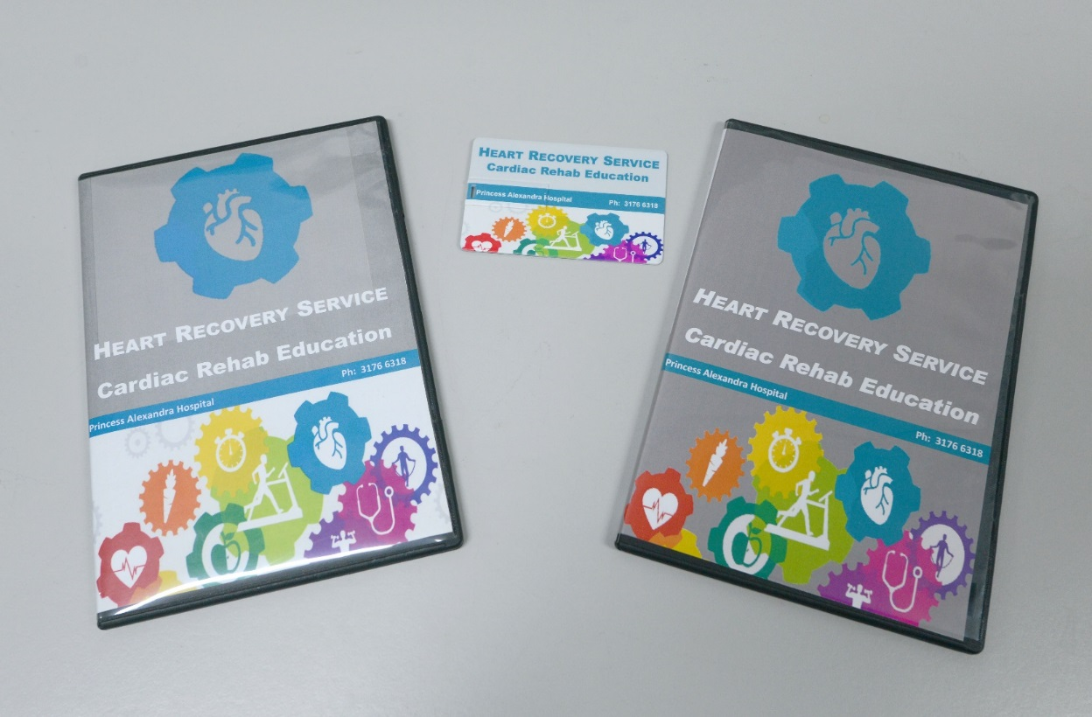
Education
Take home multimedia resources
Interactive activities
Individual referrals to allied health staff
Notes:
As the aim of the program was to continue to provide an evidence based program an alternate to our usual class based education in the form of structured lectures was developed.
This comprised of 3 different modes of delivery. Take home multimedia resources, Interactive activities and individual referrals to allied health staff.
Our usual education lecture sessions were scripted by our allied health and recorded by our media and communications team at the PA hospital. These were then offered to the patients either as a DVD or as a USB. As our media team recorded the education free of charge the resources remained fairly cost effective.
The patients were given a weekly roster of education topics and asked to watch the topic for that week at their convenience prior to attending on the Wednesday evening.
On arriving to the class the patients participate in a small 10-15 minute interactive learning activity which was run by the nurse and the physiotherapist in charge of the program. These activites were de signed to recap the major points of the education provided on the DVD/USB and provide the patients with an opportunity to ask questions to both the clinicians and each other.
The patients were also offered one on one sessions with allied health if they wanted to learn more about a specific subject or specific concerns arose throughout the program.

Slide 10
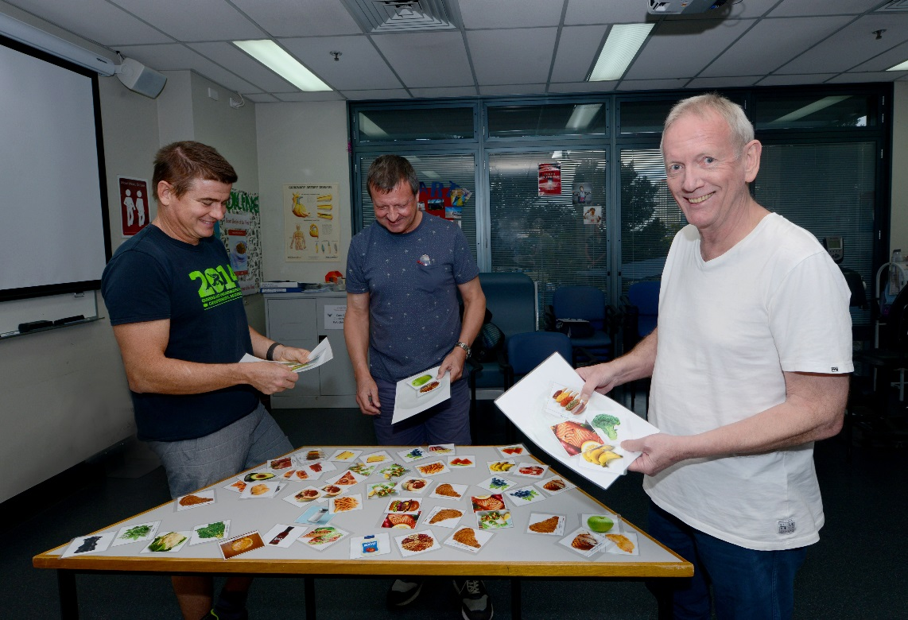
And educational activities
Notes:
This is an example of one of the activities we currently do.
In these photos we see our patients putting together a heart healthy plate. Once patients have done this we discuss as a group the national heart foundation recommendations

Slide 11
Results
26 patients agreed to attend
20 (77%) attended at least one class
18 (90%) completed
Demographics:-
 | After Hours group | Business hours group | P-value
Age, mean (SD) years | 53 (9.5) | 62 (11.1) | 0.0008*
Male, % | 91 | 72
70% Vs 30%
⁸
Hawkes, A.L et al, 20019, BMC Cardiovasc Disord
Notes:
Over the 7 months between April and November 26 patients agreed to attend. 77% attended at least one class of these 90% completed the program with a 12 week assessment. The majority of patients were male at 91% , with a mean age of 53yrs with a standard deviation of 9.5 years. As you can see in the graph over the same time period the mean age of the patients within our usual cardiac rehabilitation program was statistically significantly older at 62yrs with a standard deviation of 11.1 years.
As you can see here the gender of patients within the usual care business hours program reflects what is expected within the literature an article by Hawkes 2016 based on hospital separations for coronary syndromes participant gender should likely reflect 70% male and 30% female.
https://link.springer.com/article/10.1186/1471-2261-9-16

Slide 12
Results
Within group difference | Baseline mean | 12 week mean | Mean improvement | P-value
6MWT (meters) | 522 | 586 | + 64 | 0.0005*
Total Cholesterol (mmol/L) | 5.22 | 3.46 | -1.74 | 0.0019*
LDL (mmol/L) | 3.45 | 1.82 | -1.63 | 0.0002*
Weight (BMI) | 30.65 | 30.31 | -0.34 | 0.1402
* statistically significant
Notes:
The mean 6 minute walk test difference was an improvement of 64 meters. This is both clinically and statistically significant. An improvement of 25 meters or more in patients with coronary artery disease post an acute coronary syndrome event based on a 2011 prospective study by Gremeaux.. A key finding from the 2012 systematic review by Bellet assessing 6MWT distance in outpatient cardiac rehabilitation programs suggested a 6MWT improvement of 60.4 for program comparison of effectiveness. https://www-sciencedirect-com.ezproxy.library.uq.edu.au/science/article/pii/S0031940612000223
https://www.ncbi.nlm.nih.gov/pubmed/23122432 6MWT

Slide 13
Results
Within group difference | Baseline mean | 12 week mean | Mean improvement | P-value
6MWT (meters) | 522 | 586 | + 64 | 0.0005*
Total Cholesterol (mmol/L) | 5.22 | 3.46 | -1.74 | 0.0019*
LDL (mmol/L) | 3.45 | 1.82 | -1.63 | 0.0002*
Weight (BMI) | 30.65 | 30.31 | -0.34 | 0.1402
9. Gremeaux et al, 2011, Archives of Physical Medicine and Rehabilitation 10. Bellet et al, 2012, Journal of Physiotherapy
* statistically significant
Notes:
The mean 6 minute walk test difference was an improvement of 64 meters. This is both clinically and statistically significant. An improvement of 25 meters or more in patients with coronary artery disease post an acute coronary syndrome event based on a 2011 prospective study by Gremeaux.. A key finding from the 2012 systematic review by Bellet assessing 6MWT distance in outpatient cardiac rehabilitation programs suggested a 6MWT improvement of 60.4 for program comparison of effectiveness. https://www-sciencedirect-com.ezproxy.library.uq.edu.au/science/article/pii/S0031940612000223
https://www.ncbi.nlm.nih.gov/pubmed/23122432 6MWT

Slide 14
Results
Within group difference | Baseline mean | 12 week mean | Mean improvement | P-value
6MWT (meters) | 522 | 586 | + 64 | 0.0005*
Total Cholesterol (mmol/L) | 5.22 | 3.46 | -1.74 | 0.0019*
LDL (mmol/L) | 3.45 | 1.82 | -1.63 | 0.0002*
Weight (BMI) | 30.65 | 30.31 | -0.34 | 0.1402
11. Chen, Y., et al, 2017, European Journal of Cardiovascular Nursing 12. Chatziefstratiou, et al, 2013, British Journal of Nursing 13. Vergès, B. L. et al, 1998, Journal of Cardiopulmonary Rehabilitation
* statistically significant
Notes:
The mean 6 minute walk test difference was an improvement of 64 meters. This is both clinically and statistically significant. An improvement of 25 meters or more in patients with coronary artery disease post an acute coronary syndrome event based on a 2011 prospective study by Gremeaux.. A key finding from the 2012 systematic review by Bellet assessing 6MWT distance in outpatient cardiac rehabilitation programs suggested a 6MWT improvement of 60.4 for program comparison of effectiveness. https://www-sciencedirect-com.ezproxy.library.uq.edu.au/science/article/pii/S0031940612000223
https://www.ncbi.nlm.nih.gov/pubmed/23122432 6MWT

Slide 15
Satisfaction
Patient perceptions measured with survey
9 questions
Response rate n= 13 (72%)
Completed at 12 week assessment visit
Reason for choosing after hours program
Work commitments n=11
Travel commitments n=1
Other : convenience n=1

Slide 16
Satisfaction survey n=13
Question | Yes
Meet your needs | 100%
Educational activities assisted learning | 100%
Preference for joining in | 77%
Questions answered | 100%
Use the DVD | 69%
USB helpful | 69%
Program beneficial | 100%
Other comments:
Great program
Enjoyed interactive education
Allowed me to ask questions
Would have preferred more variation in warm-up exercises

Slide 17
Discussion
Met the needs of
Younger
Male
Working
Improved clinical outcomes
Effective exercise program
Effective education program
Satisfaction
High overall satisfaction
High satisfaction in educational resources and activities

Slide 18
Considerations for an after hours program
Safety
Senior staff
Development of procedures
Ensure rapid support available
Education
Cost effective, time consuming
Trial and error
Staffing
Working hours change
Financial investment
Difficulty covering emergent leave

Slide 19
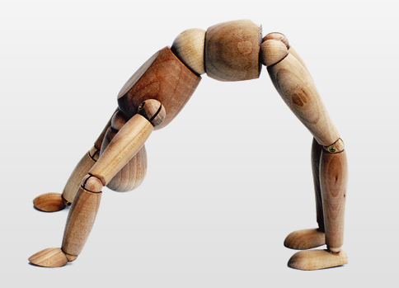
Conclusion
As the demographics of our
patients change, younger
patients need CR programs
that are flexible and promote a
work/rehabilitation balance
Aim introduce an evidence-based cardiac rehabilitation program operating outside of business hours
The Princess Alexandra after hours cardiac rehabilitation program has been an effective alternate model of care for patients

Slide 20
References
Australian Bureau of Statistics 2017, Causes of Death Australia 2016, ABS cat. No. 3303.0
Aliprandi-Costa B, Ranasinghe I, Chow V, Kapila S, Juergens C, Devlin G, et al. Management and outcomes of patients with acute coronary syndromes in Australia and New Zealand, 2000-2007. Med J Aust. 2011;195(3):116-21
Chew, D. P, Amerena, J. V., Coverdale, S. G., Rankin, J. M., Astley, C. M., Soman, A., & Brieger, D. B. (2008). Invasive management and late clinical outcomes in contemporary Australian management of acute coronary syndromes: observations from the ACACIA registry. The Medical journal of Australia, 188(12), 691.
Briffa, G. T., Hobbs, S. M., Tonkin, M. A., Sanfilippo, C. F., Hickling, C. S., Ridout, C. S., & Knuiman, C. M. (2011). Population Trends of Recurrent Coronary Heart Disease Event Rates Remain High. Circulation: Cardiovascular Quality and Outcomes, 4(1), 107-113. doi:10.1161/CIRCOUTCOMES.110.957944
Australia, N. H. F. o. (2016). National Heart Foundation of Australia & Cardiac Society of Australia and New Zealand: Australian Clinical Guidelines for the Management of Acute Coronary Syndromes 2016. Heart, Lung and Circulation, 25(9), 895-951.
Clark, R. A., Conway, A., Poulsen, V., Keech, W., Tirimacco, R., & Tideman, P. (2013). Alternative models of cardiac rehabilitation: A systematic review. European Journal of Preventive Cardiology, 22(1), 35-74. doi:10.1177/2047487313501093
National Heart Foundation, 2014, Improving the delivery of cardiac rehabilitation in Australia The Heart Foundations Cardiac Rehabilitation Advocacy Strategy, Viewed 29/07/2018 https://www.heartfoundation.org.au/images/uploads/publications/Improving-the-delivery-of-cardiac-rehabilitation.pdf

Slide 21
References
Hawkes, A.L, Atherton, J., Taylor, C.B et al. BMC Cardiovasc Disord (2009) 9:16 https://doi.org/10.1186/1471-2261-9-16
Gremeaux, Vincent, Troisgros, Odile, Benaïm, Sylvie, Hannequin, Armelle, Laurent, Yves, Casillas, Jean-Marie, & Benaïm, Charles. (2011). Determining the Minimal Clinically Important Difference for the Six-Minute Walk Test and the 200-Meter Fast-Walk Test During Cardiac Rehabilitation Program in Coronary Artery Disease Patients After Acute Coronary Syndrome. Archives of Physical Medicine and Rehabilitation, 92(4), 611-619.
Bellet, Adams, & Morris. (2012). The 6-minute walk test in outpatient cardiac rehabilitation: Validity, reliability and responsiveness—a systematic review. Physiotherapy, 98(4), 277-287.
Chen, Y., Tsai, J., Liou, Y., & Chan, P. (2017). Effectiveness of endurance exercise training in patients with coronary artery disease: A meta-analysis of randomised controlled trials. European Journal of Cardiovascular Nursing, 16(5), 397-408.
Chatziefstratiou, Anastasia A, Giakoumidakis, Konstantinos, & Brokalaki, Hero. (2013). Cardiac rehabilitation outcomes: Modifiable risk factors. British Journal of Nursing, 22(4), 200-207.
Vergès, B. L., Patois-Vergés, B. M., Cohen, M., & Casillas, J. (1998). Comprehensive cardiac rehabilitation improves the control of dyslipidemia in secondary prevention. Journal of Cardiopulmonary Rehabilitation, 18(6), 408-415.
University of Melbourne Melbourne Institute of Applied Economic and Social Research 2015, 2th Annual Statistical Report of the HILDA Survey 2017, MIAESR, Melbourne, viewed 29 Jul 2018, https://melbourneinstitute.unimelb.edu.au/__data/assets/pdf_file/0010/2437426/HILDA-SR-med-res.pdf

